Slide 1


NUMERICAL MODELING OF FRICTION STIR WELDING PROCESSES
María de los Angeles González
Barcelona, November 11th 2015

Slide 2
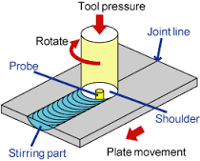
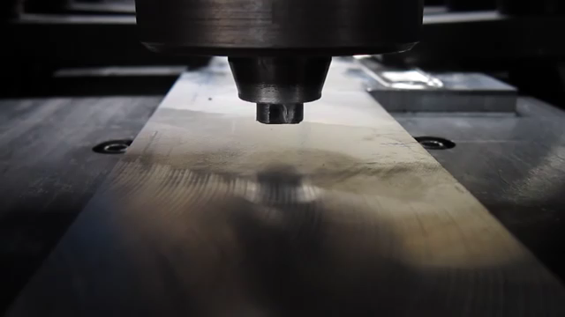
INTRODUCTION
FSW Process Sketch
Real FSW Process
[1]
[2]

Slide 3
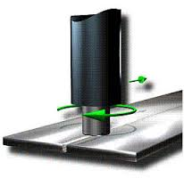
INTRODUCTION
Benefits and Advantages of FSW
Ability to join materials that are difficult to weld.
Low distortion and shrinkage.
No porosity.
No spatter.
[3]

Slide 4
PROBLEM STATEMENT
2D Model
The model is built
The problem is solved
Data is given by SAPA company
Program COMET- FWS provided by Prof. Michele Chiumenti
The results are visualize
Geometry, Materials, and velocities
Pre and postprocessor GID program

Slide 5
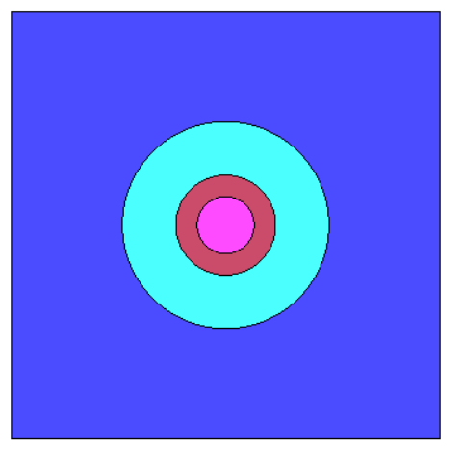
PROBLEM STATEMENT
Zones
Geometry
30
Plate
Pin
30
HAZ
4
14.5
Units in mm

Slide 6
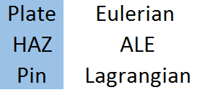
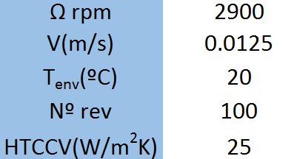
PROBLEM STATEMENT
Kinematic Framework
Initial Data
Eulerian
Lan
ALE

Slide 7
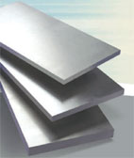
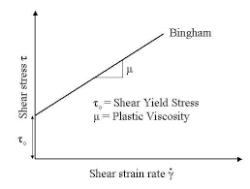
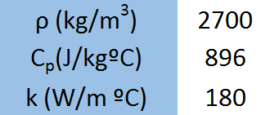
PROBLEM STATEMENT
Plate and HAZ Properties- Aluminum 6063
Thermal Properties
Mechanical Properties
[4]
Bingham model

Slide 8
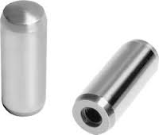
PROBLEM STATEMENT
PIN Properties-Steel
The specific heat, density and conductivity depend of temperature
[5]
Mechanical Properties
The pin is considered rigid

Slide 9

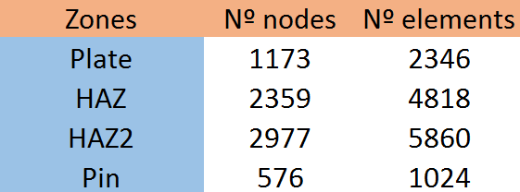
PROBLEM STATEMENT
Mesh Discretization
A transition between the surfaces was defined. From 0.01 mm to 1 mm.

Slide 10
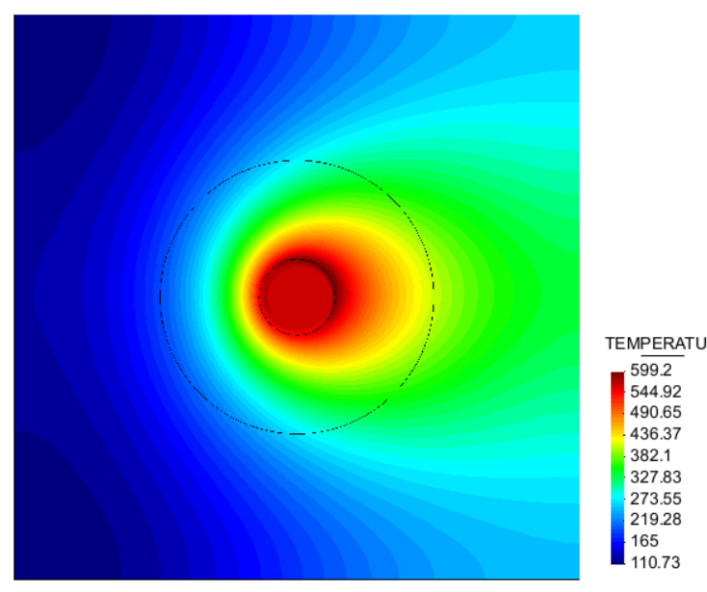
RESULTS AND DISCUSSIONS
Temperature- Contour fill

Slide 11
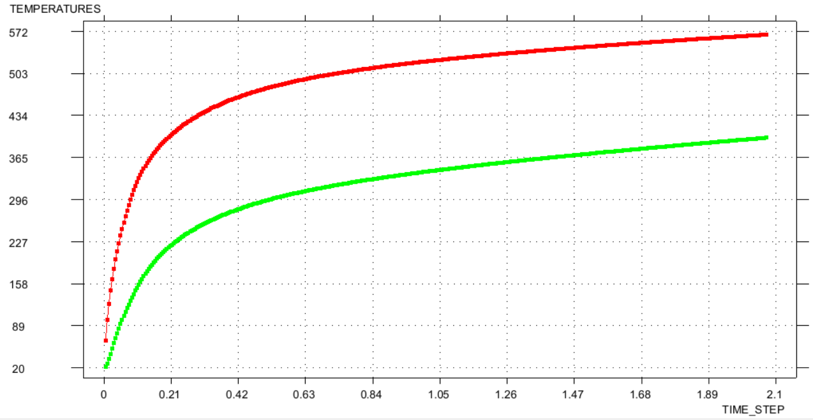
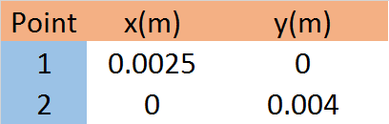
RESULTS AND DISCUSSIONS
Evolution of Temperature
Point 1
Point 2
2
1

Slide 12
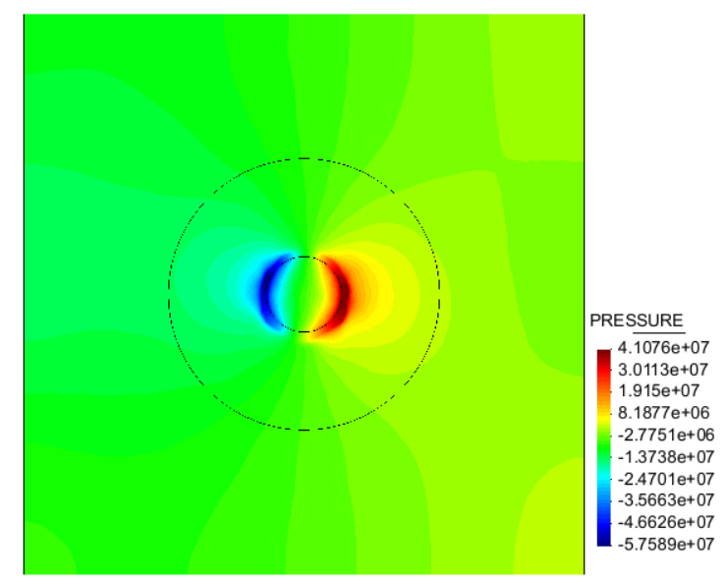
RESULTS AND DISCUSSIONS
Pressure- Contour fill

Slide 13
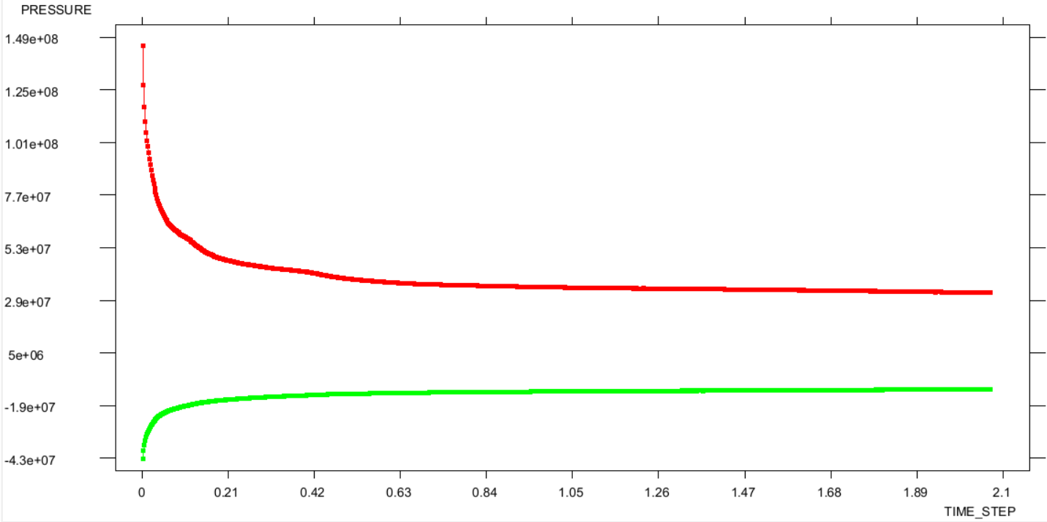
RESULTS AND DISCUSSIONS
Evolution of Pressure
Point 1
2
1
Point 2

Slide 14
CONCLUSIONS AND FUTURE WORK
The program generates stable and expected solutions for temperature and pressure.
A convergence analysis should be perform in order to choose the most suitable mesh.
The numerical results must be compare again the experimental data with the purpose to validate the model.
A sensibility analysis of FSW process parameters using simplified pin mesh discretization should be perform.

Slide 15
REFERENCES [online]
[1]
“What is Friction Stir Welding (FSW)?” [online]. [Date of consultation: 10-11-2015]. Available in: http://www.mosaka.com/fsw/en/fsw/about_fsw.html
[2]
“ Friction Stir Welding of Aluminum” [online]. [Date of consultation: 10-11-2015]. Available in:
http://www.youtube.com/watch?v=BQYLdw8W5wE
[3]
“Friction Stir Welding (FSW): Introduction” [online]. [Date of consultation: 10-11-2015]. Available in: http://aluminium.matter.org.uk/content/html/default.asp?catid=205&pageid=2144416862
[4]
“CM: Case Modding” [online]. [Date of consultation: 10-11-2015]. Available in: http://www.techzine.nl/uploaded/4718_cab3ee96.jpg
[5]
“Welcome to Techno Engineering Co.” [online]. [Date of consultation: 10-11-2015]. Available in:http://www.indiamart.com/technoengineeringco/

Slide 16
THANK YOU FOR YOUR ATTENTION

