Slide 1
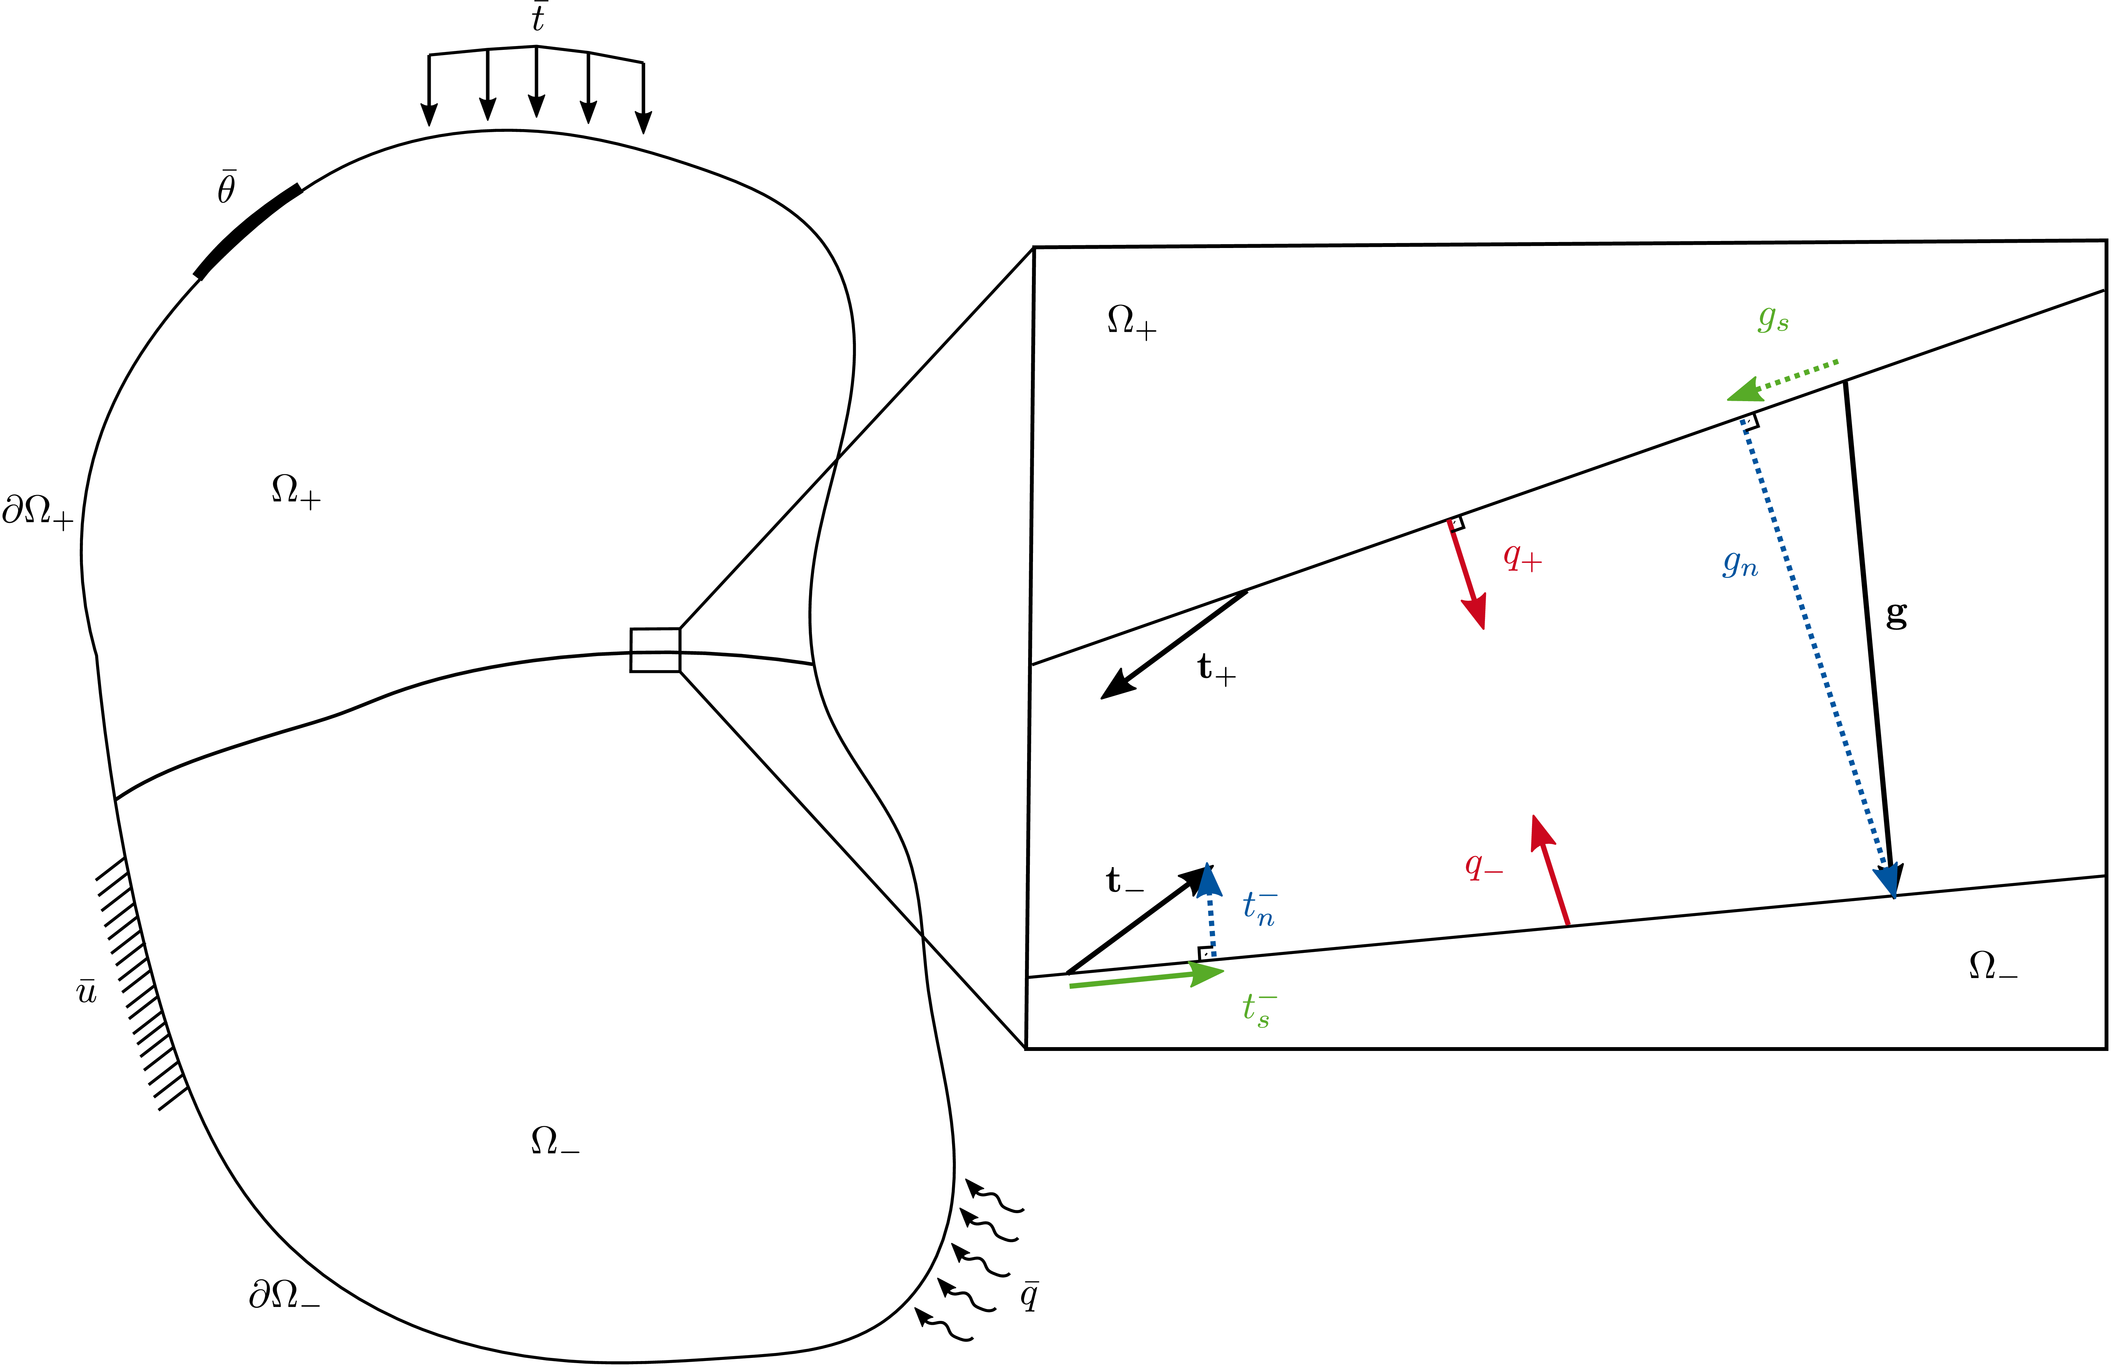
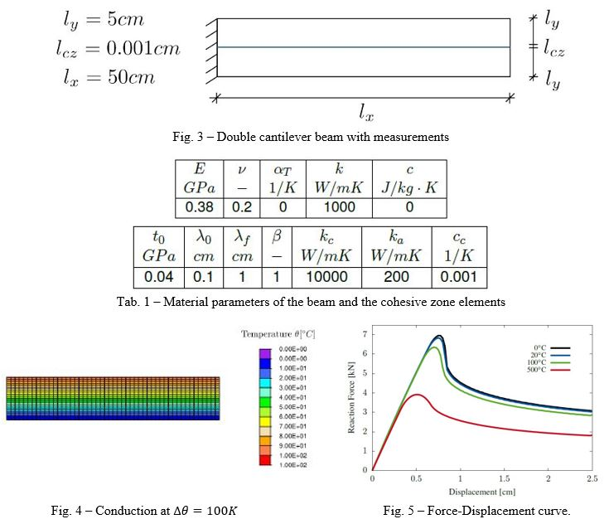



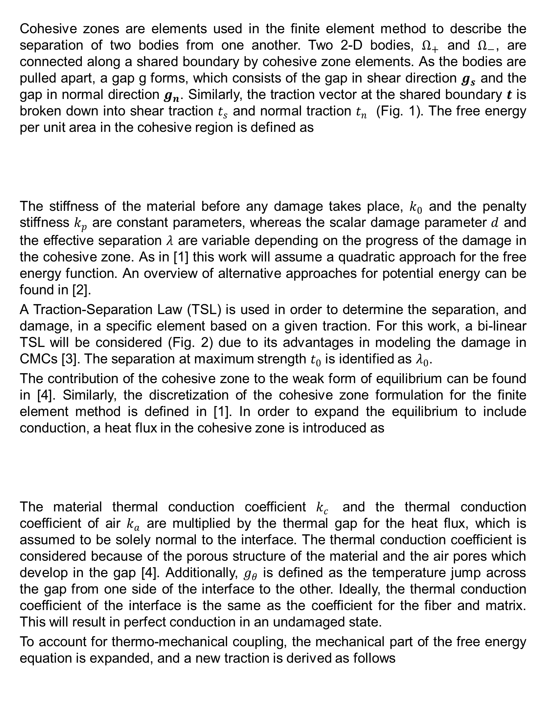
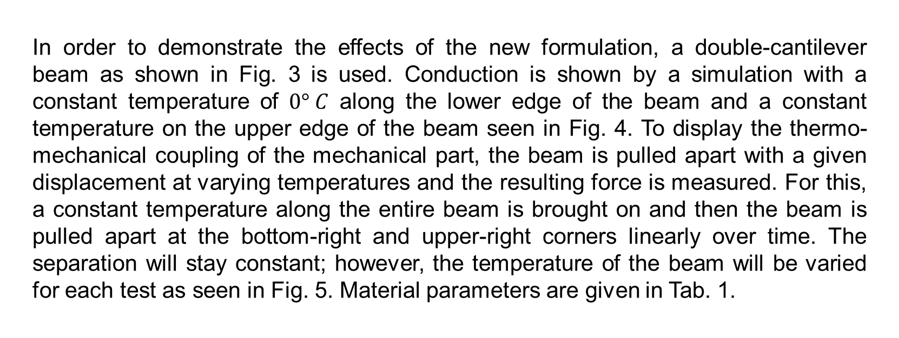
A thermomechanical cohesive zone formulation describing interface separation in ceramic matrix composites
Wiebke Coenen, Espen Torsvik, Lukas Vögeli, Jonathon Hartman
Institute for Applied Mechanics (ifam) at RWTH Aachen University
Introduction
Fig. 1 - Separation of two bodies at a cohesive region with traction, heat flux, and gap vectors.
Research and development in aerospace engineering has had a significant focus on developing new materials to increase the lifetime, load-bearing capacity, and economic viability of aerospace vehicles. Materials in the engines of aerospace machines must be able to withstand corrosive environments at high temperatures while being subjected to large mechanical loads. However, the materials must also be light in order to decrease the dead weight of the machine. For this purpose, ceramic matrix composites (CMCs) were developed.
The development of CMCs as a new material has led to the question of how the material should be characterized. Before any material can be trusted to fly safely, many tests must be carried out. To this end, the numerical modeling of CMCs can be used to evaluate and assess their performance without having to conduct expensive tests. The numerical modeling takes place using finite elements, and the failure of CMCs can be modeled using many different methods. For this work, a cohesive zone formulation is used. The current cohesive zone formulation is written to solve delamination problems without mechanical interactions with other environmental influences. However, because the material properties and failure mechanism of CMCs change at high temperatures, it is necessary that this interaction be taken into account for the cohesive zone formulation.
The expansion of the current cohesive zone formulation to include temperature influences in the mechanics can not only be used for CMCs for use in jet engines but can also be useful in other engineering fields that model the thermo-mechanical interaction of materials.
Results
In order to demonstrate the effects of the new formulation, a double-cantilever beam as shown in Fig. 3 is used. Conduction is shown by a simulation with a constant temperature of $0° C$ along the lower edge of the beam and a constant temperature on the upper edge of the beam seen in Fig. 4. To display the thermo-mechanical coupling of the mechanical part, the beam is pulled apart with a given displacement at varying temperatures and the resulting force is measured. For this, a constant temperature along the entire beam is brought on and then the beam is pulled apart at the bottom-right and upper-right corners linearly over time. The separation will stay constant; however, the temperature of the beam will be varied for each test as seen in Fig. 5. Material parameters are given in Tab. 1.
Objective
A cohesive zone formulation for numerical modeling is expanded upon to include thermal phenomena of ceramic matrix composites (CMCs). To begin, an expanded cohesive zone formulation is described, and that formulation is then thermo-mechanically coupled to account for thermal behavior of CMCs. The formulation is then tested to evaluate its mechanical viability and an outlook to possible future research is given.
Methodology
Cohesive zones are elements used in the finite element method to describe the separation of two bodies from one another. Two 2-D bodies, $Ω_{+}$ and $Ω_{−}$, are connected along a shared boundary by cohesive zone elements. As the bodies are pulled apart, a gap g forms, which consists of the gap in shear direction $g_{s}$ and the gap in normal direction $g_{n}$. Similarly, the traction vector at the shared boundary $t$ is broken down into shear traction $t_{s}$ and normal traction $t_{n}$ (Fig. 1). The free energy per unit area in the cohesive region is defined as
The stiffness of the material before any damage takes place, $k_{0}$ and the penalty stiffness $k_{p}$ are constant parameters, whereas the scalar damage parameter $d$ and the effective separation $λ$ are variable depending on the progress of the damage in the cohesive zone. As in [1] this work will assume a quadratic approach for the free energy function. An overview of alternative approaches for potential energy can be found in [2].
A Traction-Separation Law (TSL) is used in order to determine the separation, and damage, in a specific element based on a given traction. For this work, a bi-linear TSL will be considered (Fig. 2) due to its advantages in modeling the damage in CMCs [3]. The separation at maximum strength $t_{0}$ is identified as $λ_{0}$.
The contribution of the cohesive zone to the weak form of equilibrium can be found in [4]. Similarly, the discretization of the cohesive zone formulation for the finite element method is defined in [1]. In order to expand the equilibrium to include conduction, a heat flux in the cohesive zone is introduced as
The material thermal conduction coefficient $k_{c}$ and the thermal conduction coefficient of air $k_{a}$ are multiplied by the thermal gap for the heat flux, which is assumed to be solely normal to the interface. The thermal conduction coefficient is considered because of the porous structure of the material and the air pores which develop in the gap [4]. Additionally, $g_{θ}$ is defined as the temperature jump across the gap from one side of the interface to the other. Ideally, the thermal conduction coefficient of the interface is the same as the coefficient for the fiber and matrix. This will result in perfect conduction in an undamaged state.
To account for thermo-mechanical coupling, the mechanical part of the free energy equation is expanded, and a new traction is derived as follows
Conclusion
The aim of this work is to expand an existing cohesive zone formulation as proposed by [1], taking the material behavior of CMCs at varying temperatures into account, to include conduction and thermo-mechanical coupling. Conduction is included in the formulation by expanding the traction vector with a heat flux for the cohesive zone and expanding the gap vector to include a thermal gap, or the temperature gradient from one side of the cohesive zone to the other. The heat flux is defined with respect to the new thermal gap and the interfacial thermal conduction coefficient. The thermo-mechanical coupling is needed to couple not only the mechanical part with the temperature, but also the thermal part with the mechanics. To achieve this, a material stiffness softening term is added to the mechanical part. This softening term reduces the material stiffness based on the temperature at the mid-plane of the cohesive zone and the experimentally defined variable cc of the interface. The heat flux is then expanded with a damage parameter, reducing the thermal conduction coefficient of the interface with increasing damage.
Possible further research could include the accurate characterization of material parameters for the interface through physical tests, temperature dependence of other material parameters, and the addition of fiber bridging, another important thermal phenomenon of CMCs.
References
[1] S. Rezaei, S. Wulfinghoff, and S. Reese. Prediction of fracture and damage in micro/nano coating systems using cohesive zone elements. International Journal of Solids and Structures, 121:62–74, 2017.
[2] K. Park and G. H. Paulino. Cohesive zone models: A critical review of traction-separation relationships across fracture surfaces. Applied Mechanics Reviews, 64(6), 2011.
[3] R. S. Kumar, M. Mordasky, and G. Ojard. Delamination fracture in ceramic matrix composites: From coupons to components. Turbomachinery Technical Conference and Exposition GT2018, 2018.
[4] T. Wu and P. Wriggers. Multiscale diffusion-thermal-mechanical cohesive zone model for concrete. Computational Mechanics, 55(5):999–1016, 2015.

