Slide 1
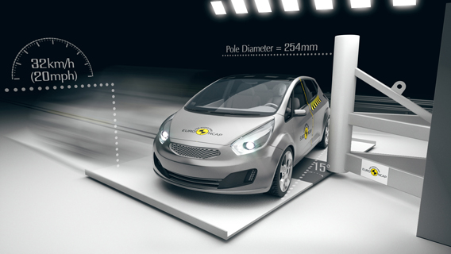
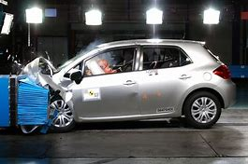
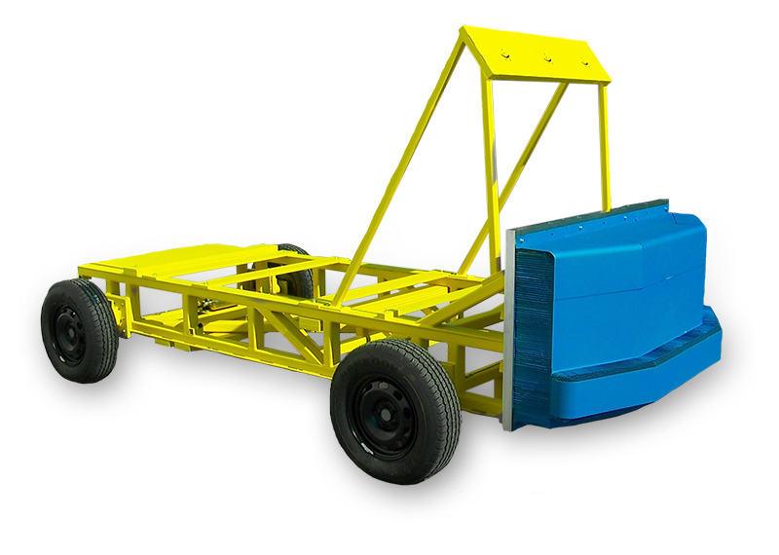
Crashworthiness assessment with FEM
Jordi Parra Porcar
Master in Numerical Methods in Engineering

Slide 2
1. Definition
2. Motivation
3. Evolution
4. Legal regulations & NCAP
5· EuroNCAP load cases
6. Popular FEM Comercial software
7. Computacional resources
8. Modelling techniques
GUIDE

Slide 3
1. Definition
2. Motivation
3. Evolution
4. Legal regulations & NCAP
5· EuroNCAP load cases
6. Popular FEM Comercial software
7. Computacional resources
8. Modelling techniques
GUIDE

Slide 4
1. Definition
¨Crashworthiness is the ability of an automobile to protect its occupants from major injury or death in the occurrence of collisions of a specific part and gives a measure of the ability of a structure to safeguard their occupants in survivable crashes¨
(ScienceDirect)

Slide 5
1. Definition
2. Motivation
3. Evolution
4. Legal regulations & NCAP
5· EuroNCAP load cases
6. Popular FEM Comercial software
7. Computacional resources
8. Modelling techniques
GUIDE

Slide 6
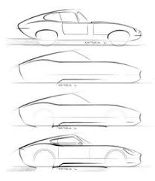
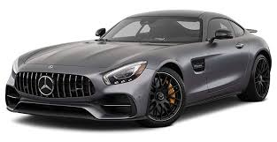

2. Motivation
Physical testing /correlation
FEM simulation

Slide 7
1. Definition
2. Motivation
3. Evolution
4. Legal regulations & NCAP
5· EuroNCAP load cases
6. Popular FEM Comercial software
7. Computacional resources
8. Modelling techniques
GUIDE

Slide 8
3. Evolution
5 starts EURONCAP rated car: Jaguar I pace electric (2018)
US library car crash (1930)

Slide 9
1. Definition
2. Motivation
3. Evolution
4. Legal regulations & NCAP
5· EuroNCAP load cases
6. Popular FEM Comercial software
7. Computacional resources
8. Modelling techniques
GUIDE

Slide 10
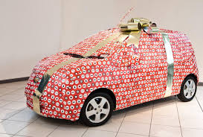
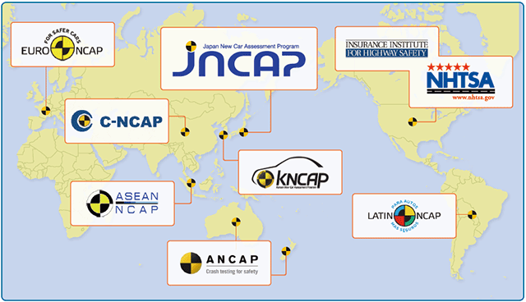
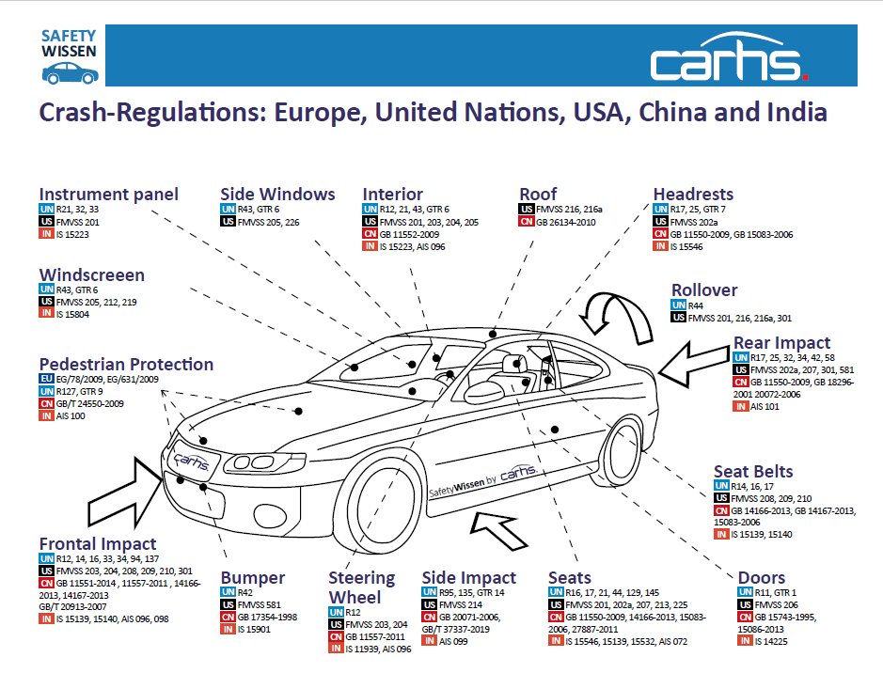
4. Legal regulations & NCAP
But before go into the market…
A safe car is worthy to buy!

Slide 11
1. Definition
2. Motivation
3. Evolution
4. Legal regulations & NCAP
5· EuroNCAP load cases
6. Popular FEM Comercial software
7. Computacional resources
8. Modelling techniques
GUIDE

Slide 12
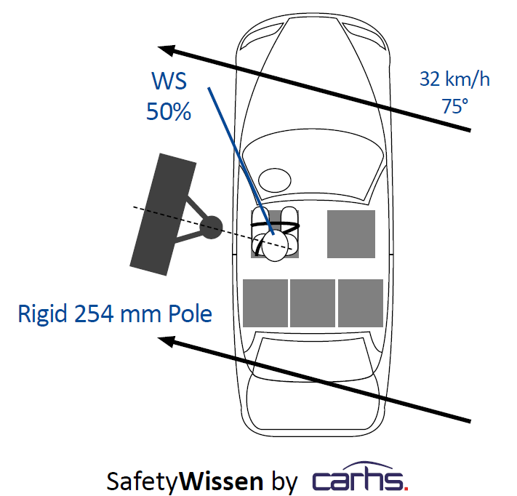
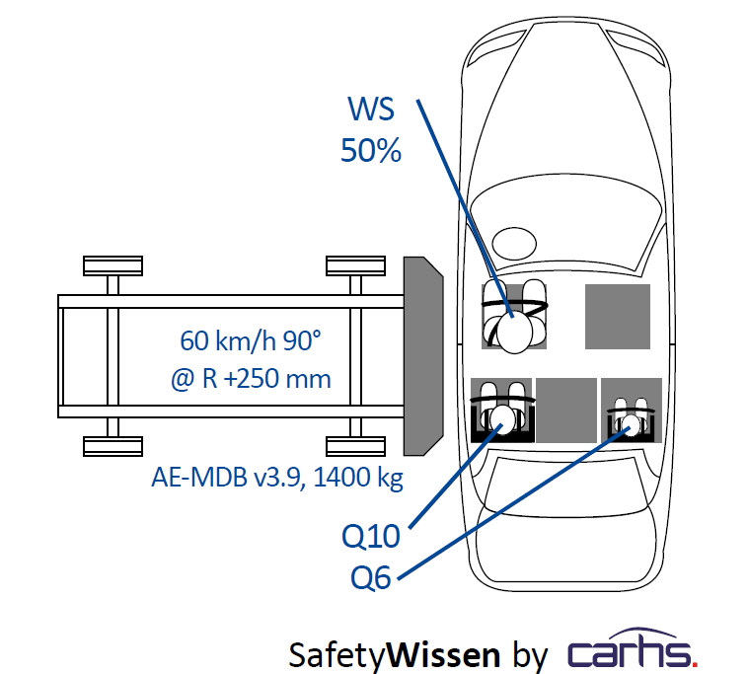
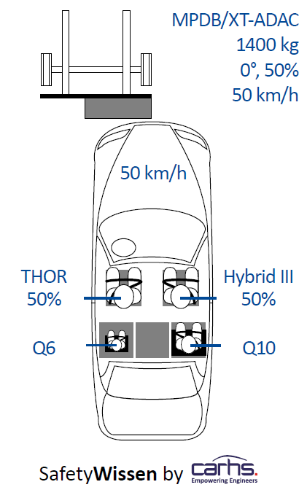
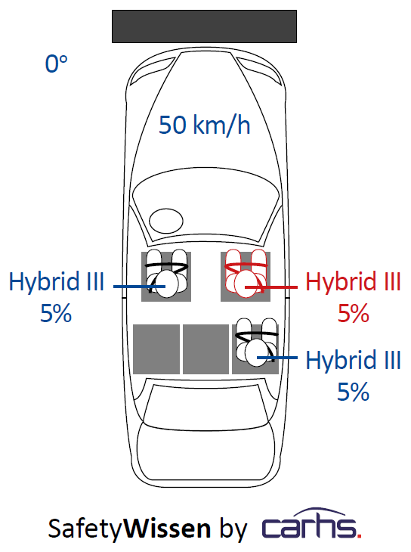
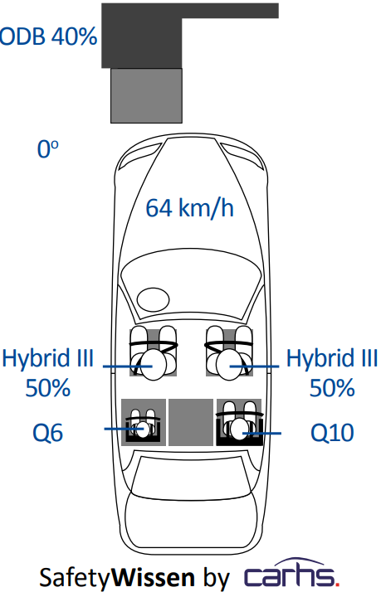
5· EuroNCAP load cases load cases
Pole
MDB
Compatibility test - Upcoming in 2020…
Full Width
ODB

Slide 13
1. Definition
2. Motivation
3. Evolution
4. Legal regulations & NCAP
5· EuroNCAP load cases
6. Popular FEM Comercial software
7. Computacional resources
8. Modelling techniques
GUIDE

Slide 14



6. Popular FEM Comercial software
Preprocessor
· Selection features
· Meshing
· Desks …
Postprocessor
· Selection features
· High image quality
· …
Solver
· high degree of interaction with the numerical model
· Highly developed
· …

Slide 15
1. Definition
2. Motivation
3. Evolution
4. Legal regulations & NCAP
5· EuroNCAP load cases
6. Popular FEM Comercial software
7. Computacional resources
8. Modelling techniques
GUIDE

Slide 16

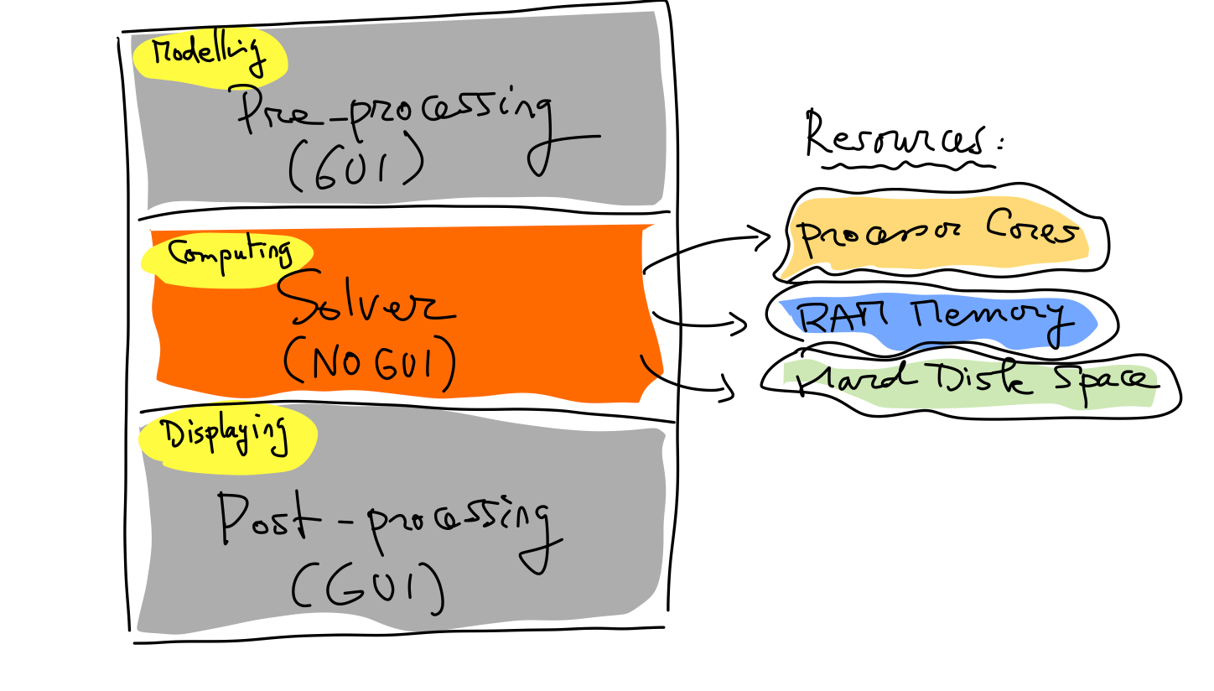

7. Computacional resources
· Explicit / implicit
· Nº dofs
· Material models
· Contact conditions
…

Slide 17
1. Definition
2. Motivation
3. Evolution
4. Legal regulations & NCAP
5· EuroNCAP load cases
6. Popular FEM Comercial software
7. Computacional resources
8. Modelling techniques
GUIDE

Slide 18
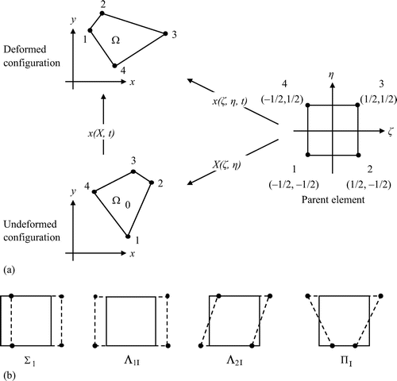
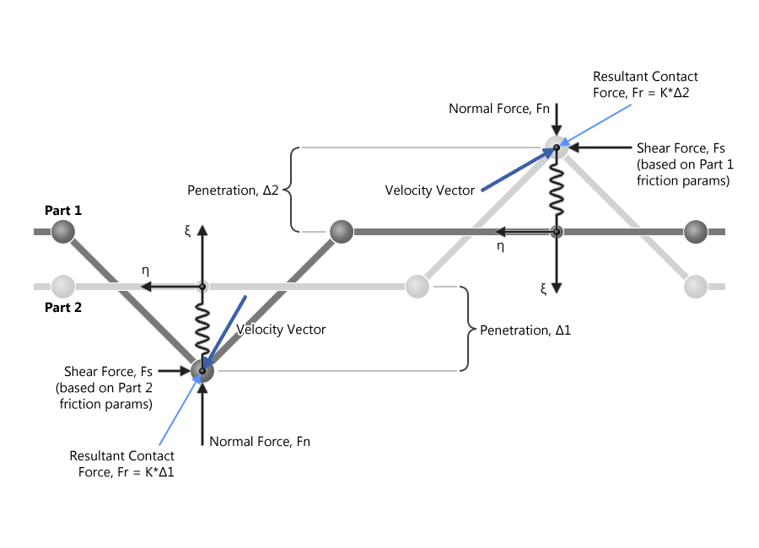
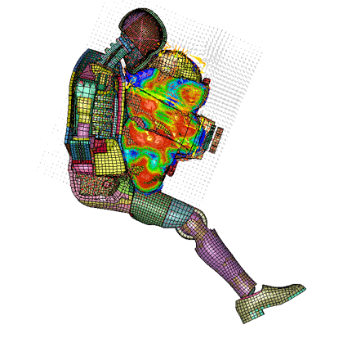
· Elements type
· Hourglass control
· Contact algorithms
· Seatbelts
· Airbags
· Accelerometers
· Sections
8. Modelling techniques

