Slide 1

Wood Concrete multifunctional LCA
Master project FS19 by Lukas Vögeli
Assisted by Francesco Pittau under the chair of Guillaume Habert
In collaboration with HEIA Fribourg
Notes:
What is Wood concrete multifunctional LCA?
LCA = Life cycle assessment = tool to measure the environmental impact of something
Multifunctional: More than one function: Mechanical properties + insulation

Slide 2
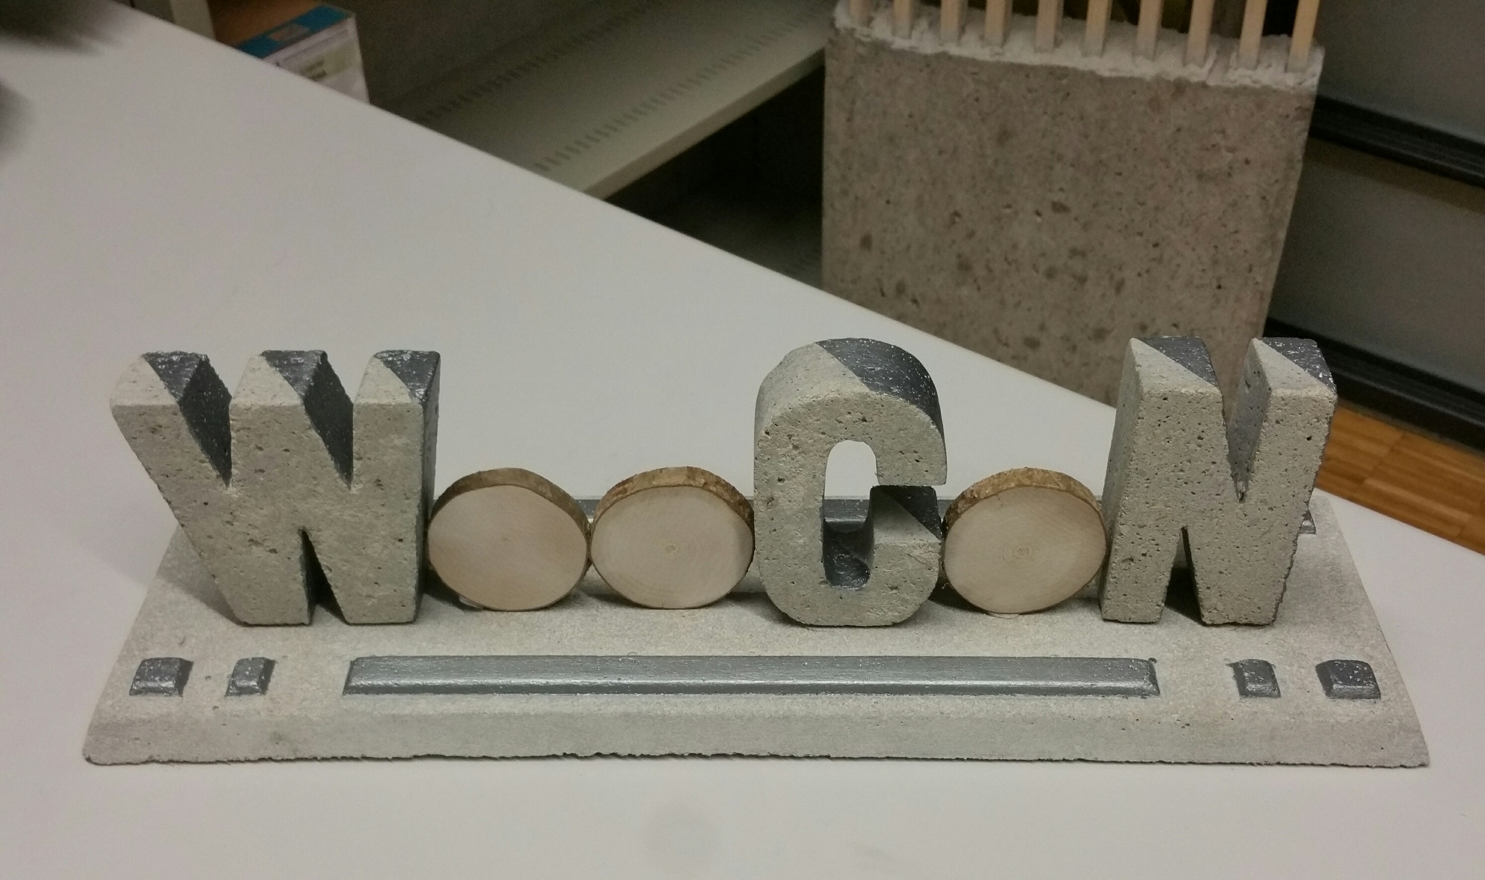
What is WooCon?
© D. Zwicky
Notes:
WooCon = special concrete containing wood (sawdust) and bio-based materials (grape seeds, cherry pits, nutshell) = additives
In collaboration with HEIA Fribourg (Haute école of engineering and architecture Fribourg)
It was my job to do a LCA on WooCon in order to get a reference whether the product might be competitive from an environmental perspective and therefore suitable for the future construction market…

Slide 3
Why multifunctional?
Mechanical properties
Thermal properties

Slide 4
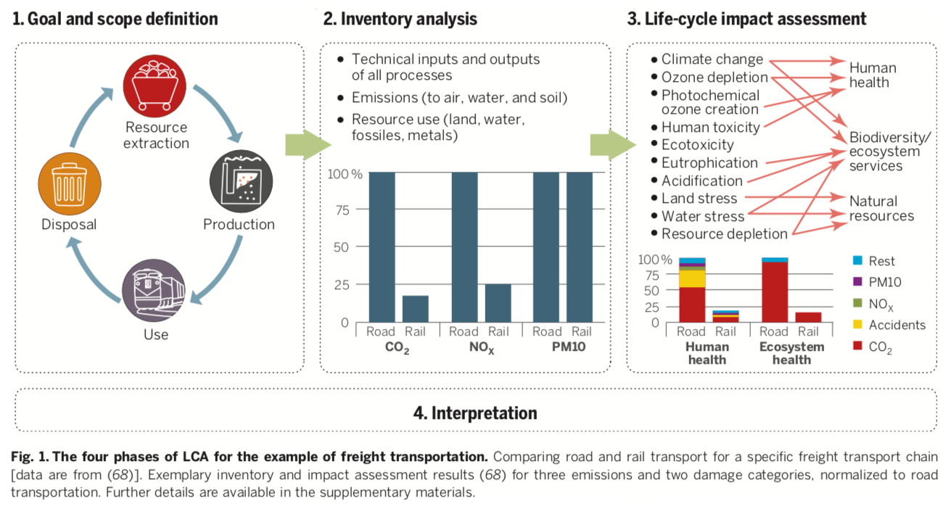
What is LCA?
Notes:
LCA = Tool to assess the total environmental impact of something
1. Goals & scope definition → boundaries of the system (FU)
2. Life-cycle inventory → data collection (Input)
3. Impact assessment → environmental impact (Output)
4. Interpretation

Slide 5
Objectives
Analysing and comparing WooCon on material level Functional unit (FU): 1 m³ of concrete
Analysing and comparing WooCon on structural level Functional unit (FU): 1 m² of slab
Adding multifunctionality (thermal insulation)
Optimisation of material
Notes:
So what exactly am I analysing?
It's all about the FU

Slide 6
Objectives
Analysing and comparing WooCon on material level Functional unit (FU): 1 m³ of concrete
Analysing and comparing WooCon on structural level Functional unit (FU): 1 m² of slab
Adding multifunctionality (thermal insulation)
Optimisation of material
Notes:
So what exactly am I analysing with my LCA
It's all about the FU

Slide 7
WooCon mix design
 |  | WooCon 06 | WooCon 10 | WooCon 12 | WooCon 13 | WooCon 14
Cement | [kg/m³] | ca. 475 | ca. 475 | ca. 475 | ca. 475 | ca. 475
Lime filler | [kg/m³] | ca. 400 | ca. 400 | ca. 400 | ca. 400 | ca. 400
Sawdust | [kg/m³] | ca. 100 | ca. 100 | ca. 100 | ca. 100 | ca. 100
Expanded glass | [-] | x | x | x | x | x
Water | [-] | x | x | x | x | x
Superplasticizer | [-] | x | x | x | x | x
Sand | [-] | x | - | - | - | -
Expanded clay | [-] | x | x | - | - | x
Grape seeds | [-] | - | x | x | x | x
Cherry pits | [-] | x | - | x | x | x
Nuthsell | [-] | - | - | x | - | -
Saturated density | [kg/m³] | 1660 | 1580 | 1600 | 1600 | 1550
Bulk density | [kg/m³] | 1411 | 1343 | 1360 | 1360 | 1318
Compressive strength | [MPa] | 18.0 | 18.9 | 13.6 | 12.9 | 14.0
E-Modulus | [GPa] | 9.1 | 8.5 | 6.1 | 6.5 | 6.2
Bio-based material | [M-%] | 4.0 | 2.3 | 10.4 | 10.2 | 6.6
Notes:
MATERIAL LEVEL
Concrete: Aggregates (stone, gravel, sand) & paste (cement, water, additives, admixtures)
There are no real aggregates!
Just paste with lots of additives

Slide 8


LCA modelling
Notes:
It’s not rocket science and I can’t focus on modelling too much, I just want to let you know the key things:
Normal materials → SimaPro database
Biobased materials → More complicated
Key assumption: it’s a waste product (zero impact)
Only processes (Washing, Crushing, Drying, Sorting, Transport)

Slide 9
WooCon GWP analysis
Notes:
Focus of this presentation: GWP (global warming potention) = [kg-CO2-eq.]
17 other impact categories measured with SimaPro:
Air and water pollutants, ozone depletion radiation, resource scarcity (land use, copper, oil), toxicity (Water, Land, Human health), acidification, biodiversity
GWP: 79% - 83% cement!

Slide 10
Material level – Functional unit
 |  | WooCon 06 | WooCon 10 | WooCon 12 | WooCon 13 | WooCon 14 | C 30/37 | LC 16/18 | LC 12/13 | LC 8/9
Bulk density | [kg/m³] | 1411 | 1343 | 1360 | 1360 | 1318 | 2400 | 1200 | 1100 | 1000
Avg. compressive strength (cylinder) | [MPa] | 18.0 | 18.9 | 13.6 | 12.9 | 14.0 | 38 | 24 | 20 | 16
E-Modulus | [GPa] | 9.1 | 8.5 | 6.1 | 6.5 | 6.2 | 33.6 | 15 | 12.5 | 10
Functional unit: 1 m³ of concrete
Notes:
Explain SIA C30/37
Functional unit – what do I compare
From now on I will proceed with WooCon 6…

Slide 11
Material comparison

Slide 12
Material comparison
Notes:
The lighter the concrete the higher its GWP per volume (higher cement content)
C → higher density and much higher strength
LC 16/18 & 12/13 → slightly lower density and higher strength
LC 8/9 → lower density and lower strength
So overall WooCon is worse but in the range of being competitive
Sand → Scarcity of resources (Espen will confirm)

Slide 13
Outlook
Structural level
Thermal insulation
Notes:
Structural level: 1 m^2 of slab instead of 1 m^3 of material
Adding multifunctionality → only small effect

Slide 14
Optimisation
Notes:
80% of GWP comes from cement (CEM I) !!!
Other optimisations of the mix design possible: Less expanded glass, more sawdust (and sand)

Slide 15
Conclusion
WooCon potentially competitive
High uncertainties for bio-based materials
FU is crucial
Optimisation takes time (iterative process)
Notes:
Everything depends on functional unit
Material level
Structural level
Global level → (1) Total structure
→ (2) what if everybody uses WooCon?

Slide 16

Thank you for your attention!

Slide 17
Acknowledgement
ETH Zürich
Prof. Dr. Guillaume Habert
Dr. Francesco Pittau
Alina Galimshina
HEIA Fribourg
Prof. Dr. Daia Zwicky
Adam Attila Meszes

