Slide 1

Effect of partial replacement of sand by plastic waste on impact resistance of concrete: experiment and simulation
By
Maher Al-Tayeb, Mustafa Ismail, Hanafi Rade Mahmoud and B.A.Tayeh

Slide 2
Overview
Background
Objective
Method
Results
  Workability
  Compressive strength
  Impact and bending strength
Conclusion

Slide 3
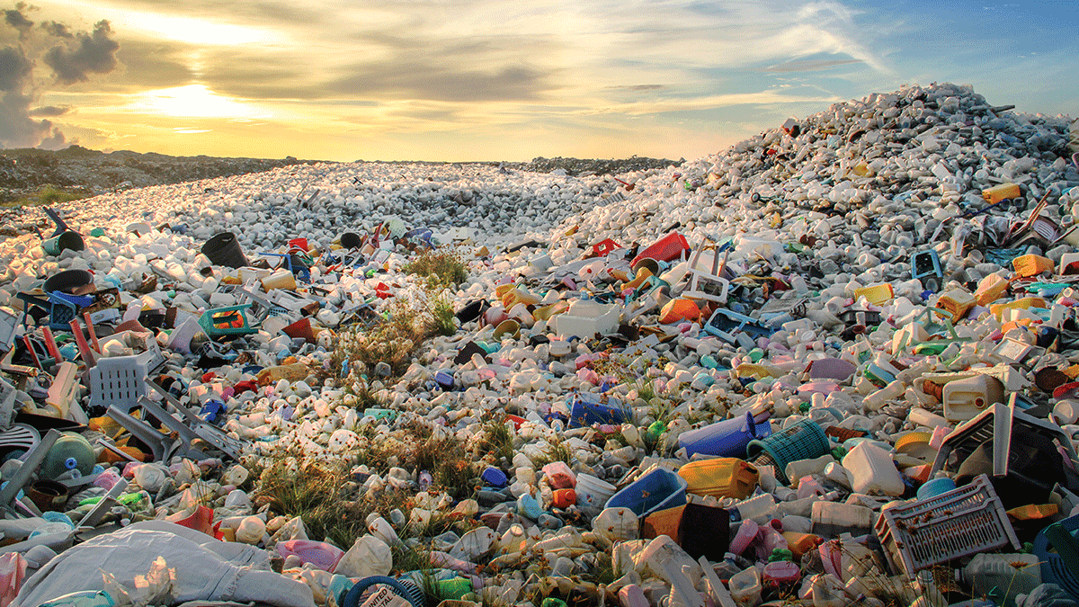
Background
Disposal of waste plastic
Lack of good sand
Improve concrete properties
  Tensile strength
  Ductility
  Impact energy absorption
Earlier investigation on workability

Slide 4
Objective
Study of impact load and the resulting displacement, and fracture energy, of concrete with plastic waste particles.
Numerical simulation to study the load-displacement behaviour of concrete with plastic waste particles, using FEM.

Slide 5
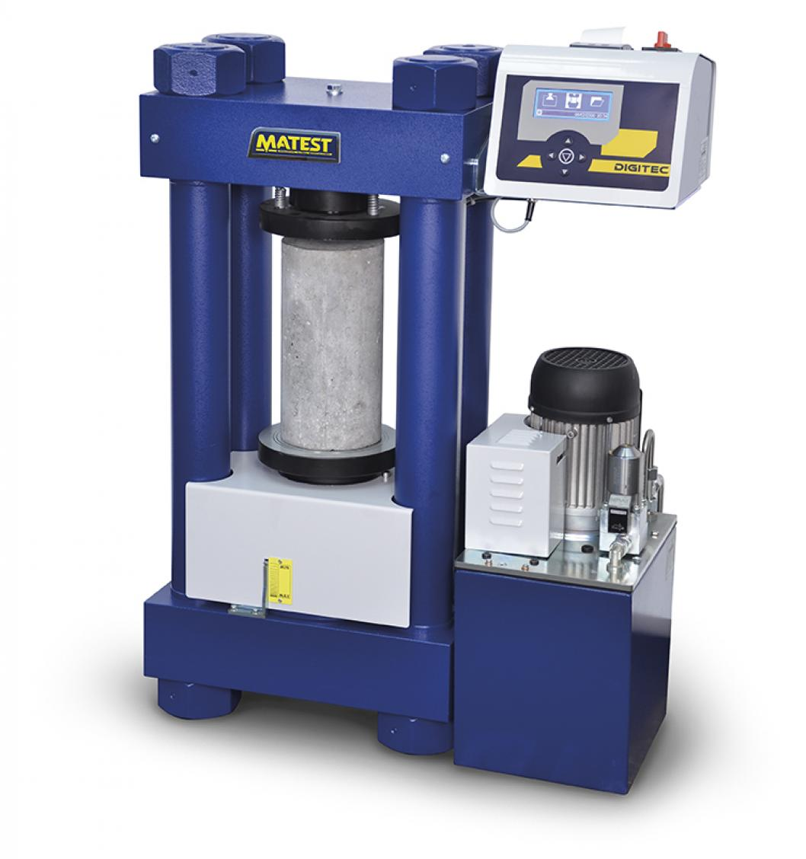
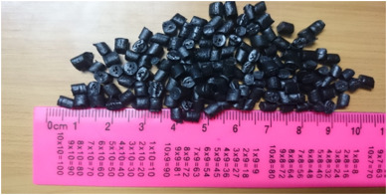
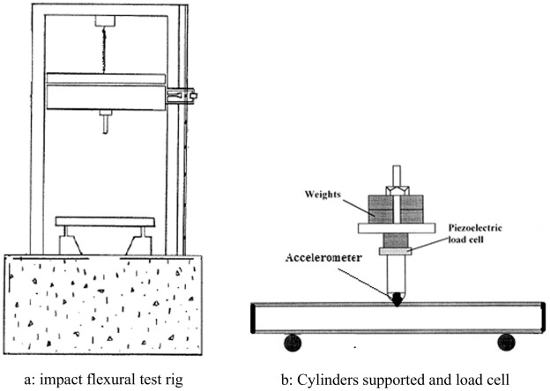
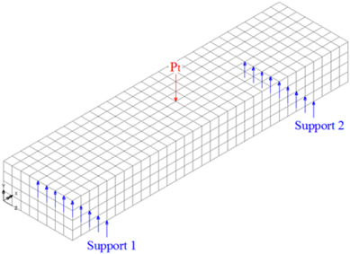
Method
Materials
  45 MPa concrete with ordinary Portland cement
  Industrial waste polycarbonate (PW)
Experimental set-up
Finite element method

Slide 6
Results
Slump values
Compressive strength
Elastic modulus

Slide 7
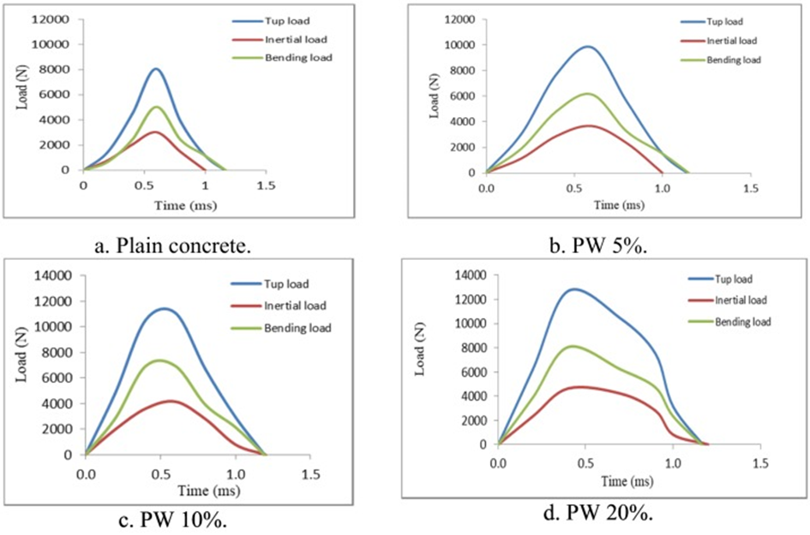
Tup, inertial and bending load

Slide 8
Comparison between static and impact load

Slide 9
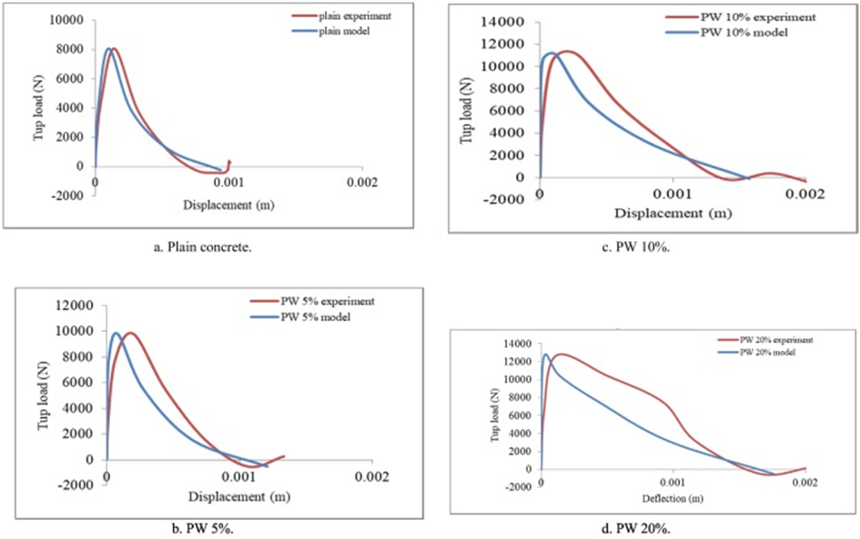
Comparison between experiment and FEM

Slide 10
Conclusion
Increasing plastic content led to
  Decreased slump
  Decreased compressive strength
  Decreased static strength
  Increased impact strength
FEM modeling and simulations could predict the behavior of the concrete

Slide 11
Reference
https://www.sciencedirect.com/science/article/pii/S2352012419301018

