Slide 1

“[…] the annual dietary exposure for European shellfish consumers can amount to 11,000 microplastics per year.” (Van Cauwenberghe,2014)

Slide 2
“[…] the annual dietary exposure for European shellfish consumers can amount to 11,000 microplastics per year.” (Van Cauwenberghe,2014)

Slide 3

Assessment of the toxicity of microplastic polyester fibres on Lymnaea stagnalis
Communications skills 2 Wiebke Coenen 15/11/19

Slide 4
Introduction
Microplastics < 5 mm
Primary and secondary microplastics
Pass wastewater treatment plants
High abundance of fibrouse shapes
60% synthetic fibres 90% polyester
Shed during washing
Notes:
Reach aquatic ecosystem
Taken in by organisms of lower trophic level
Transported further up the food chain
Reach humans

Slide 5
Figure 1: Total fibre demand and prediction for textile use in million tons (Textile World, 2015).

Slide 6
Test set-up
Test duration: 28 days
Test medium: Polyester fibres
Test organism: Lymnaea stagnalis
Endpoints: mortality inhibition of growth
Test concentrations: c1 = 50 mg/L c2 = 25 mg/L c3 = 10 mg/L c4 = 1 mg/L
Test sizes: 5 µm - 50 µm 150 µm - 500 µm
Notes:
Snails are expected to take in the fibres
False statiation
5 replica per concentration
5 snails per beaker
5 controls

Slide 7
Figure 2: Test vessel in plant growth chamber covered with net and connected to oxygen pump.
Notes:
Plant growth chamber
Light dark circle 16/8
Concentration renewed each week

Slide 8
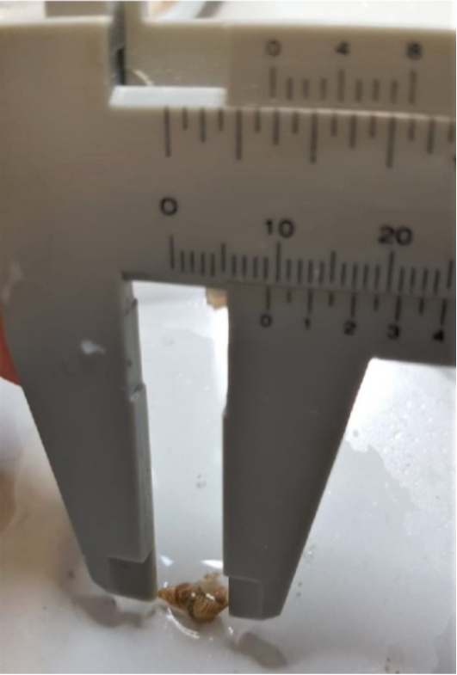
Lymnaea stagnalis
Great common pond snail
herbivores
lifespan: two years
shallow littoral zones
Test: 0.3 cm to 1.3 cm
Figure 3: Measurement of snail with Vernier calliper.
Figure 4: Three Lymnaea stagnalis.
Notes:
Indicator for the health of the aquatic ecosystem
High distribution around the world
Foodsource for many other organisms

Slide 9
Results

Slide 10
Mortality
Figure 5: Percentage of the alive, dead and missing snails after the exposure period exposed to the size fraction 5 – 50 μm (T=28 days).
Notes:
Each week mortalitiy tested
No significant results
No trend visible

Slide 11
Inhibition of Growth
Figure 7: Inhibition of the growth of the snails exposed to the size fraction of PET fibres 150 – 500 µm. Each dot represents the average shell inhibition of the snails tested in each concentration (n=5).
Notes:
Indicates relation between conzentration anf inhibition of growth
Not significant
Different shape
Should start in zero
Concentrations tested not found in environment

Slide 12
Conclusion
Experiment implies impact
Experiment not significant
Size range of snails too big
Furhter experiments necessary - Shapes - Materials - Concentrations
Notes:
This experiment alone not significant
Is it the plastic and the shape?
What would happen with different shape and different material
Smaller/more logical conz.
Different duration

Slide 13
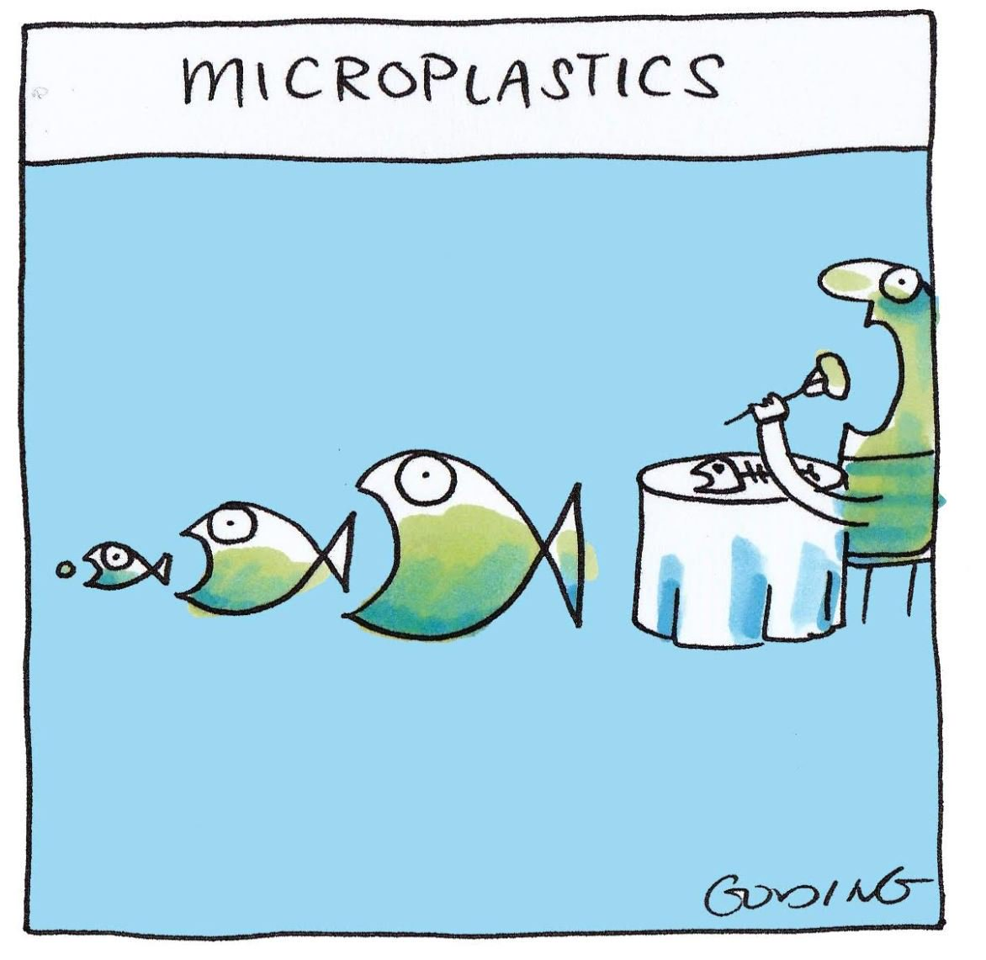
Thank you for your attention!
https://twitter.com/goldingcartoons/status/1054659603303030785

