Slide 1
A cohesive zone formulation describing interface separation in ceramic matrix composites
Jonathon Tyler Hartman
Presentation for Communication Skills II

Slide 2
Overview
Motivation
Cohesive Zones
Numerical Examples
Summary and Outlook

Slide 3
Overview
Motivation
Cohesive Zones
Numerical Examples
Summary and Outlook

Slide 4

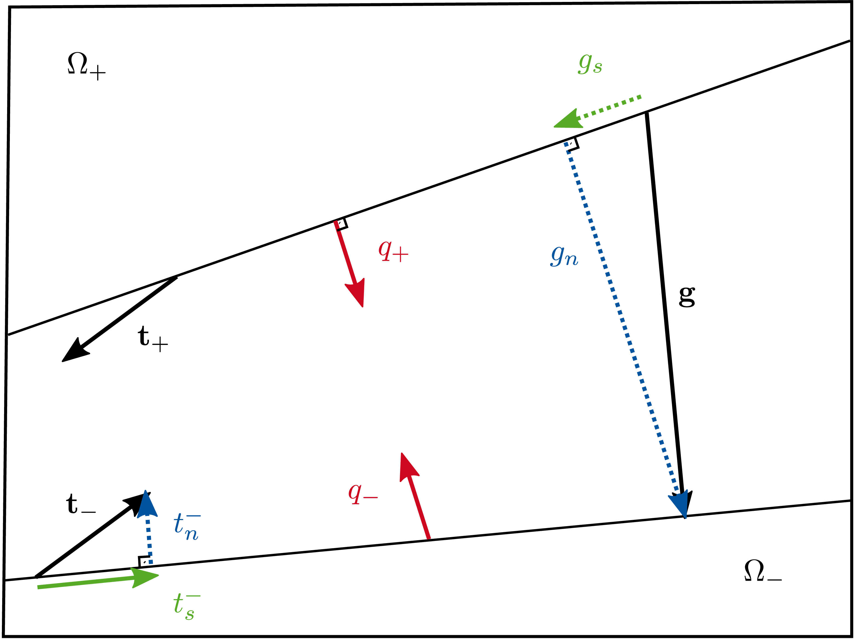
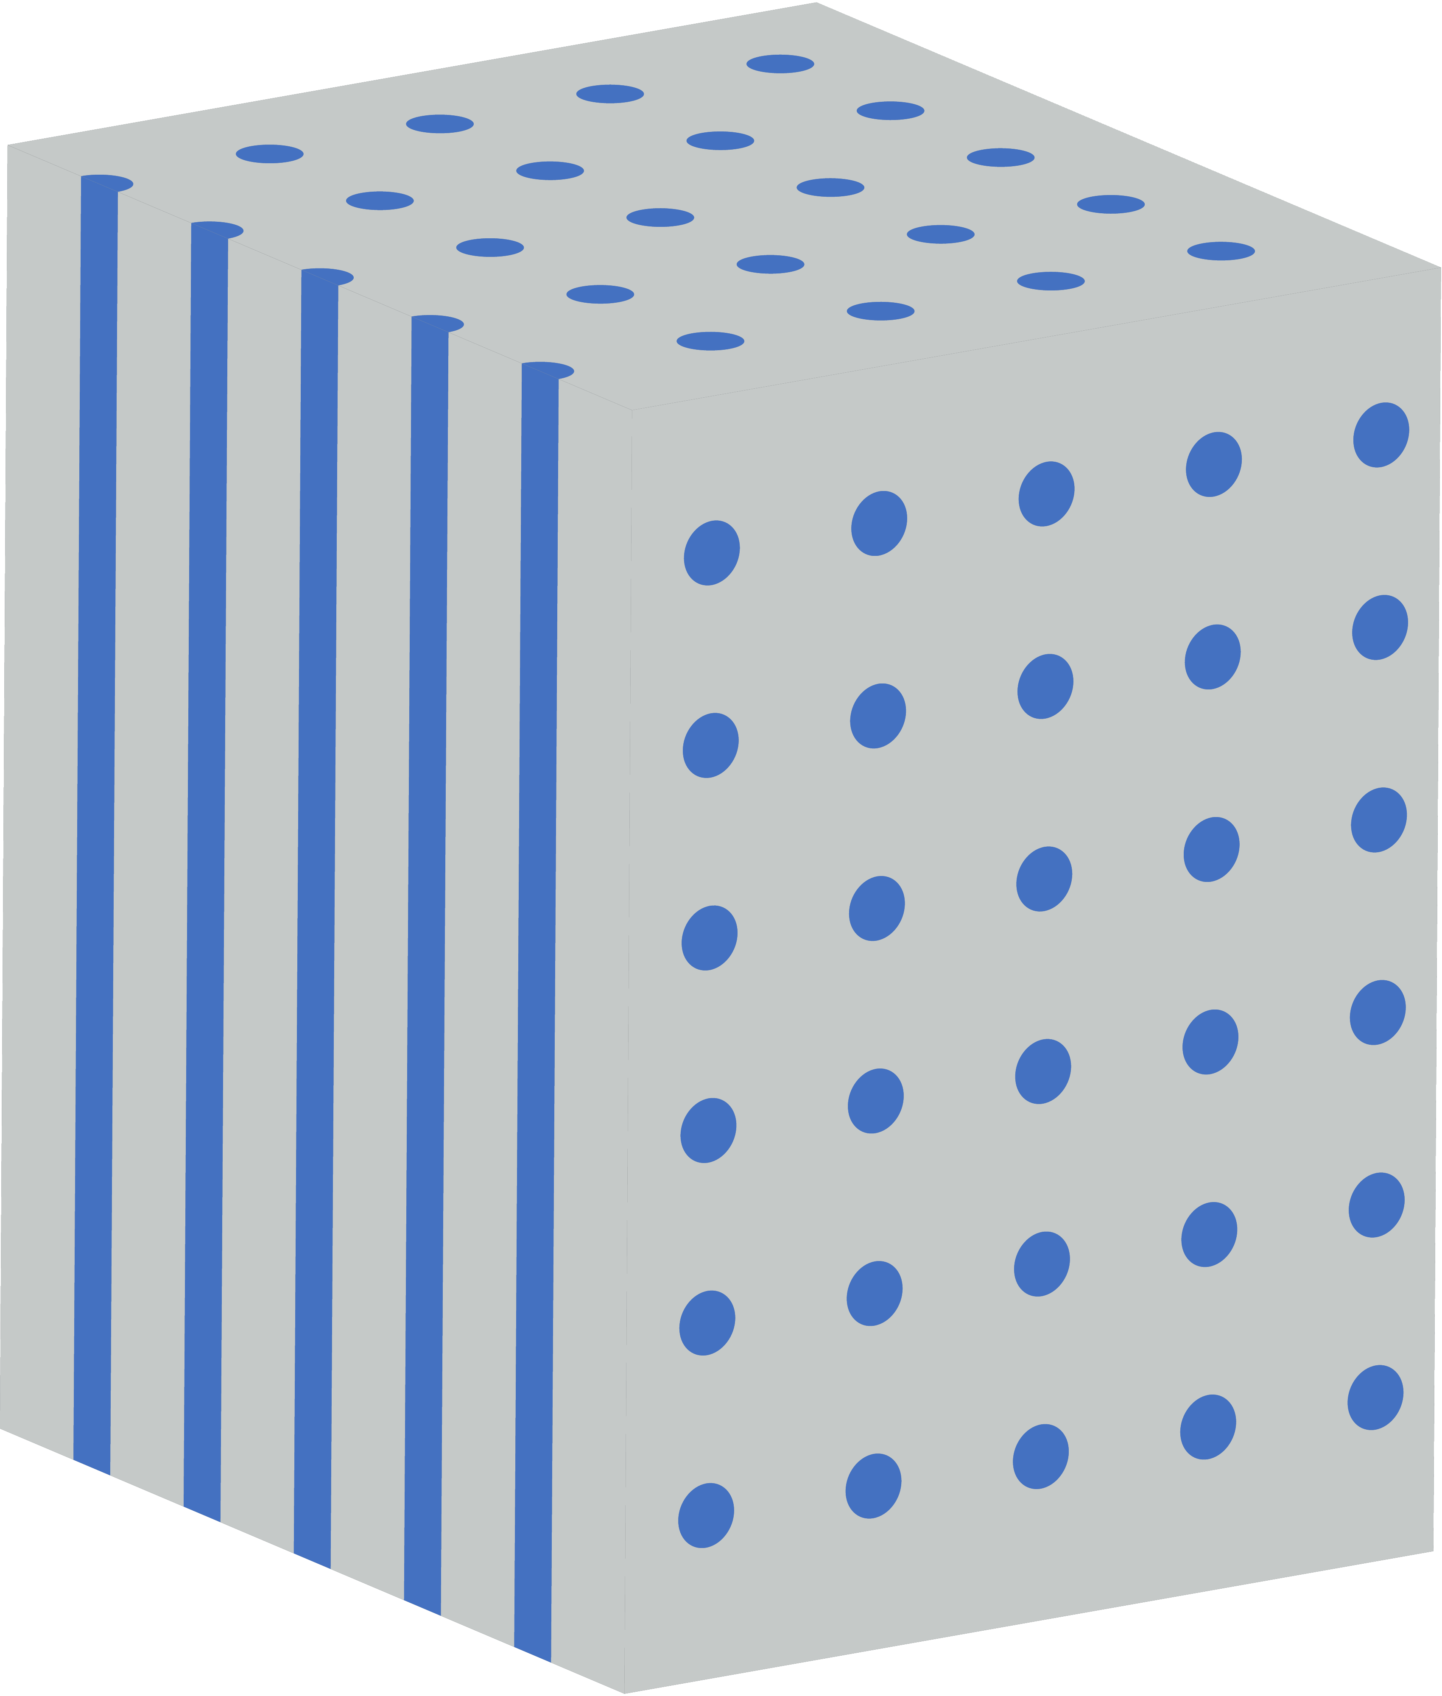
Motivation
High Temperature
Large Loads
Weight = Money
Corrosion
[mtu.de]
Failure Modeling
Cohesive Zones
Notes:
What I want to cover in this presentation as a recap:
-What a CMC is and why the damage is modeled with CZs
-What a CZ is and how it models damage
-How I expanded a current CZ formulation

Slide 5
Overview
Motivation
Cohesive Zones
Free Energy
Traction-Separation Law
Numerical Examples
Summary and Outlook

Slide 6
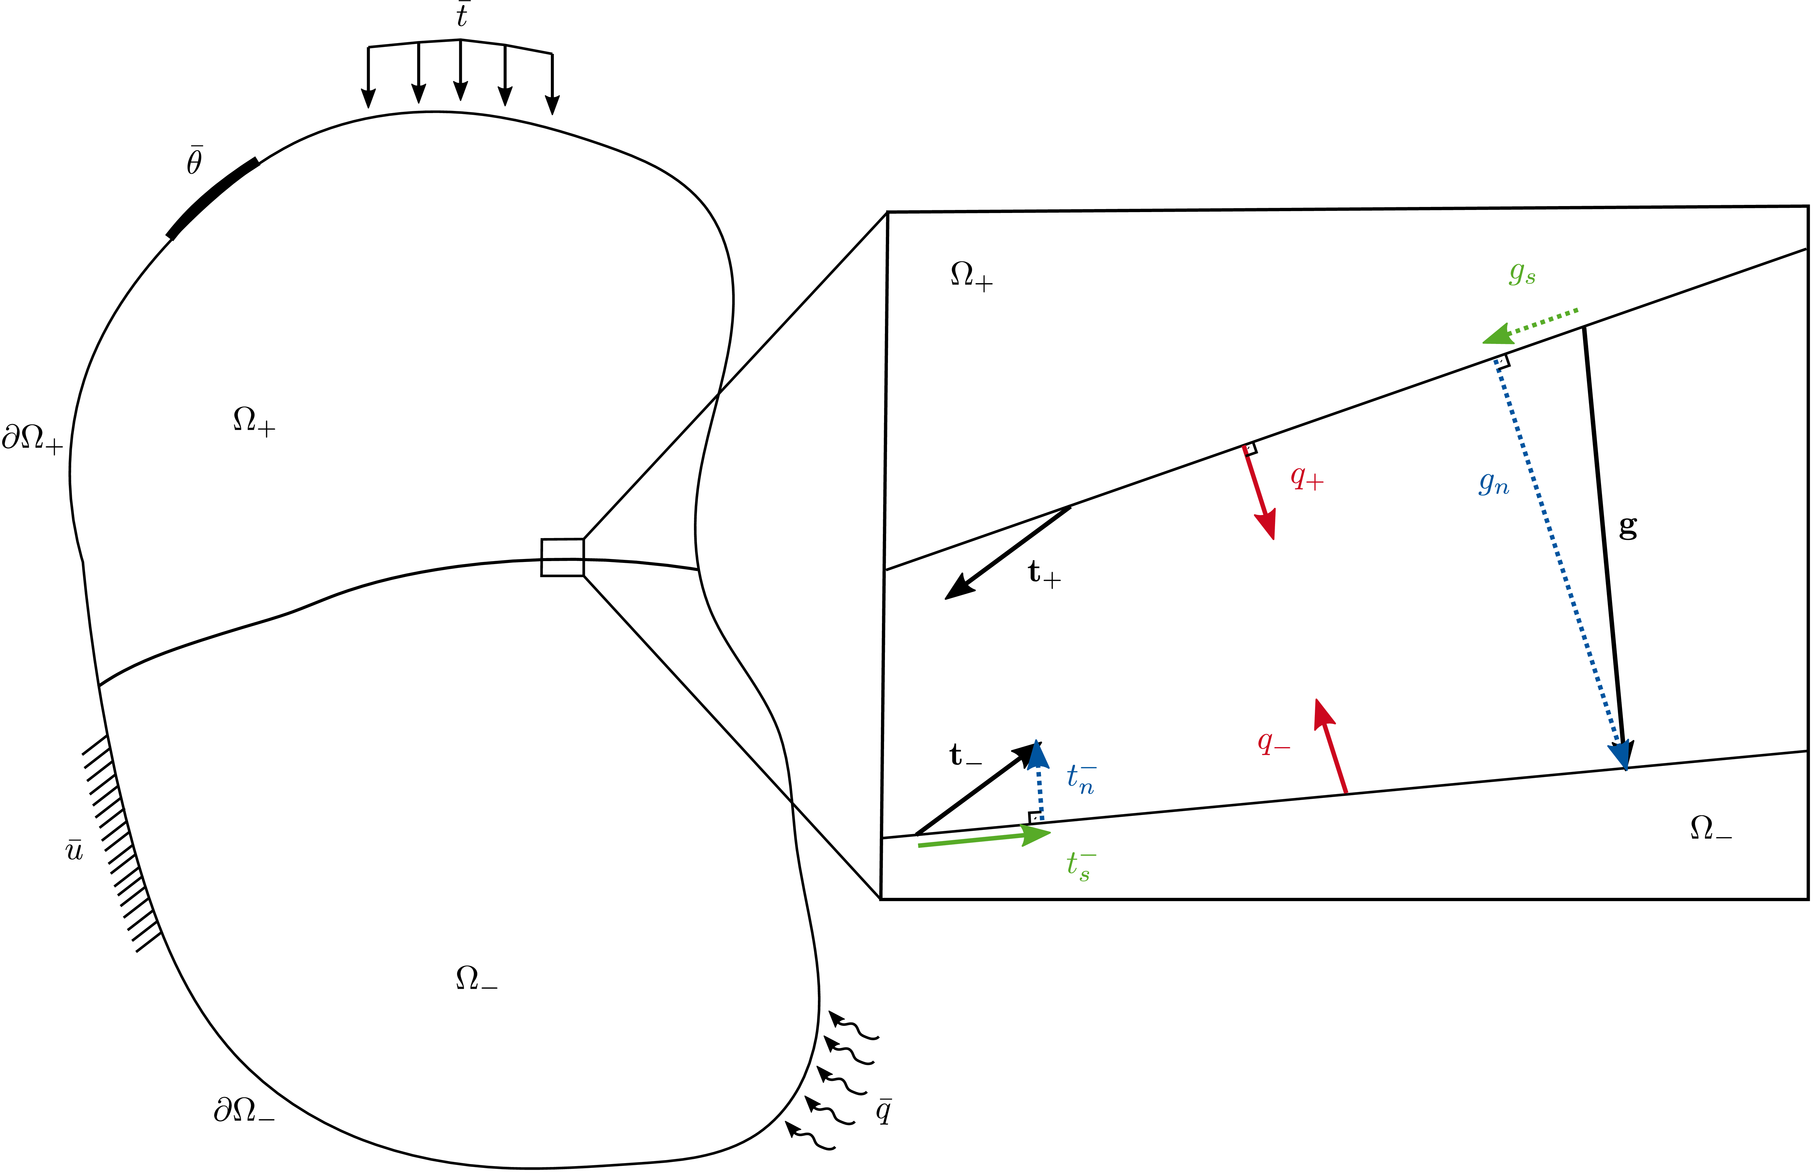



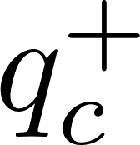









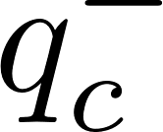


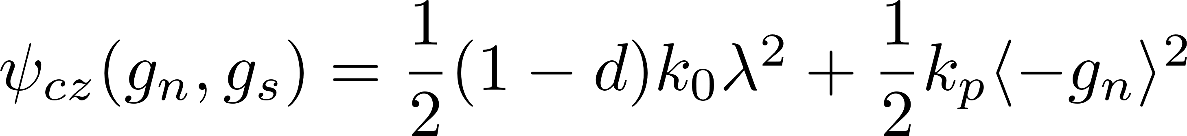
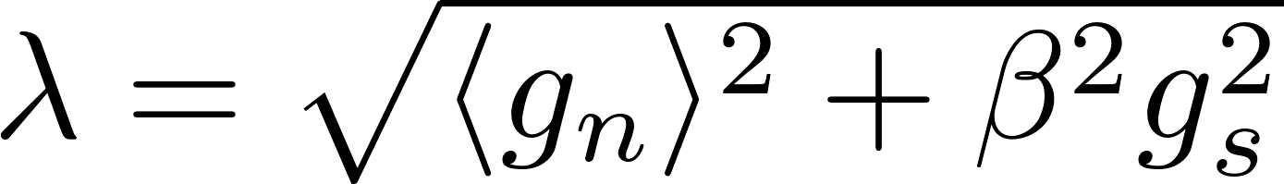
Free Energy
Cohesive Zones model the separation of two bodies from one another
: damage parameter
: initial stiffness
: effective separation
: penalty stiffness
: Macaulay brackets
[Rezaei et al. 2017]
Notes:
-What are CZs and what are they used for?
-Explanation that this model exists and will be expanded on later
-What does the free energy for a CZ look like? With Fig. 4.1 and definition of the effective separation

Slide 7
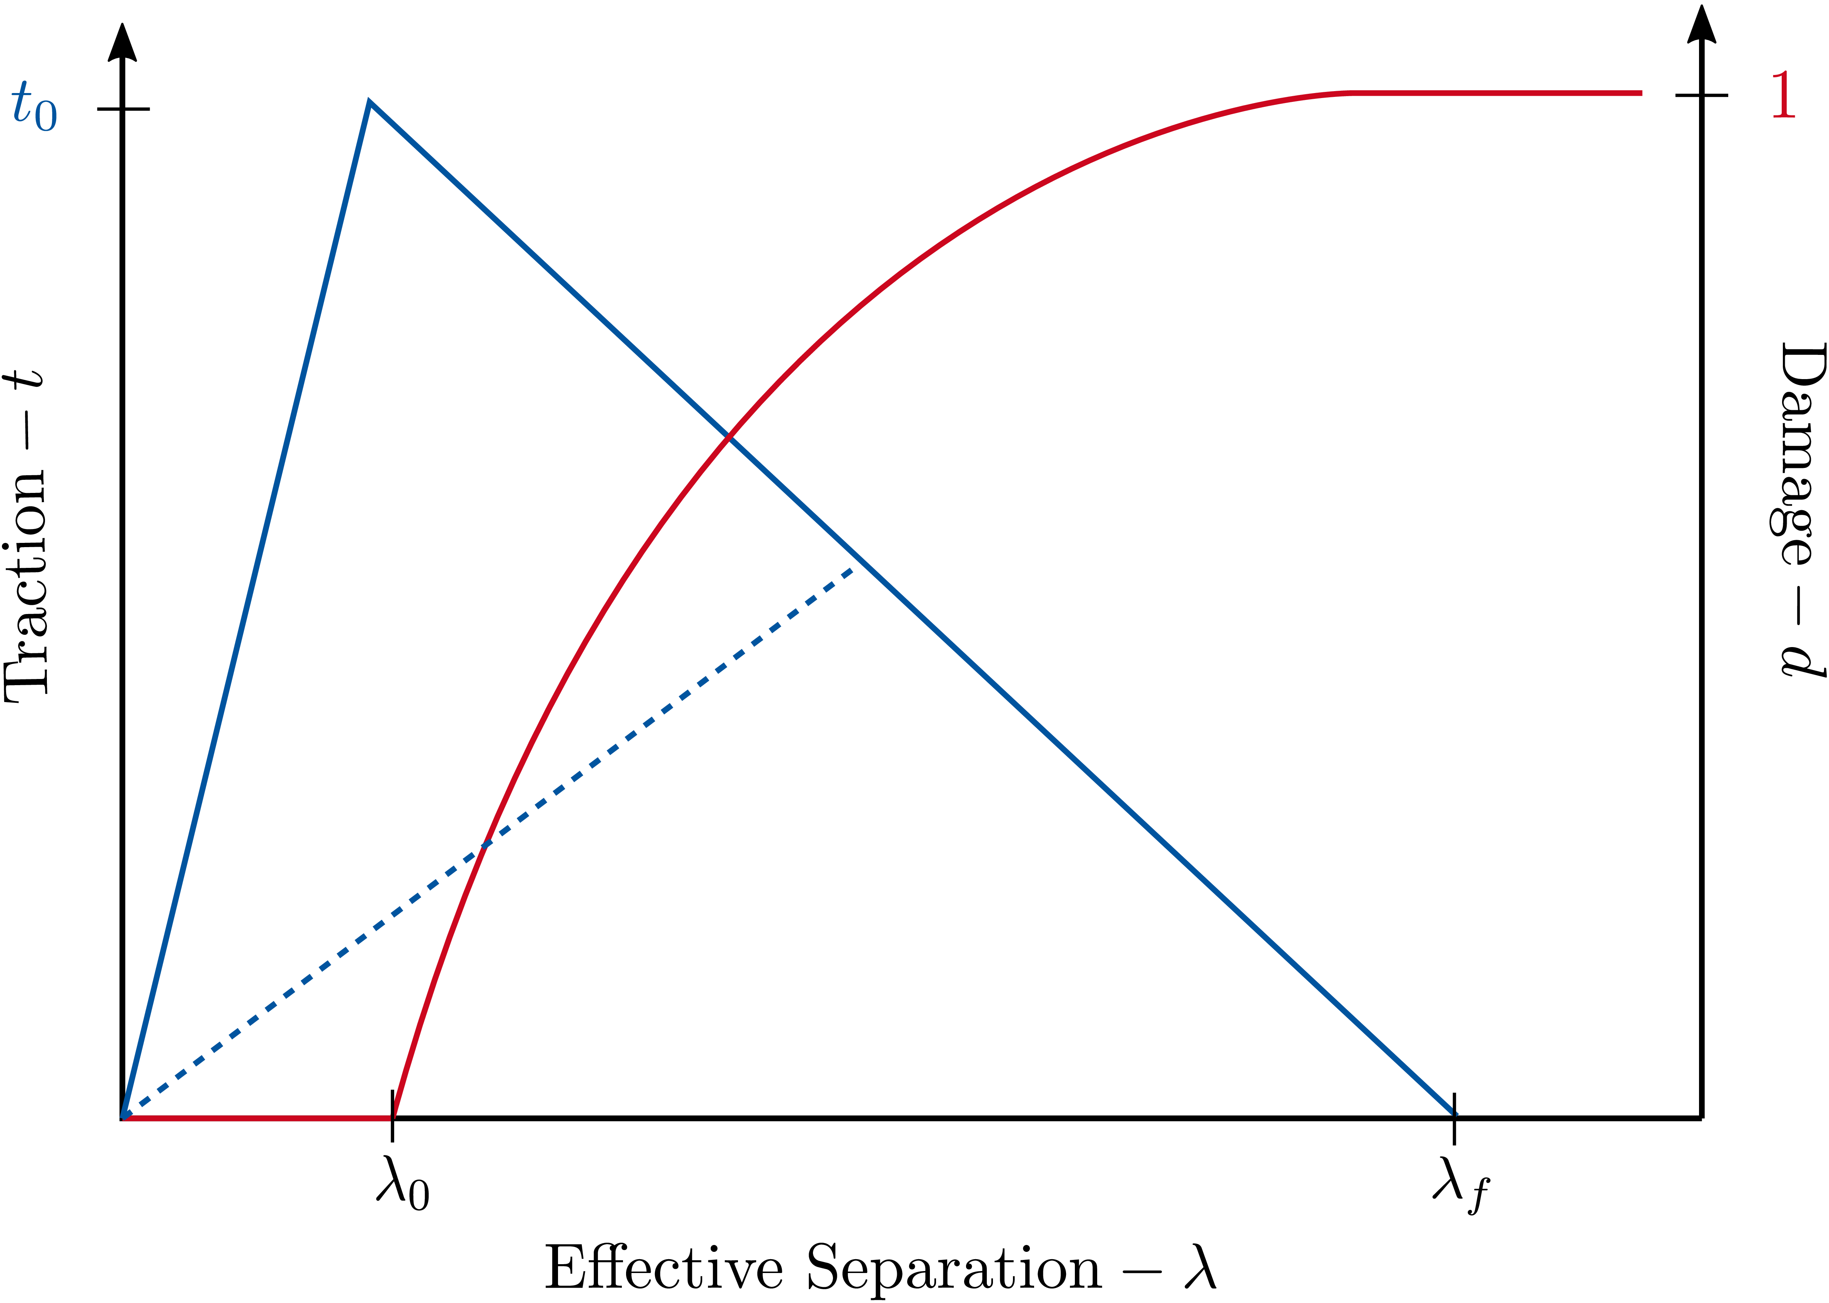
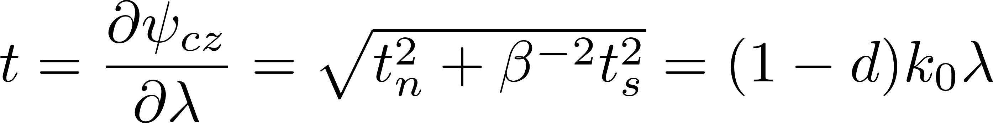
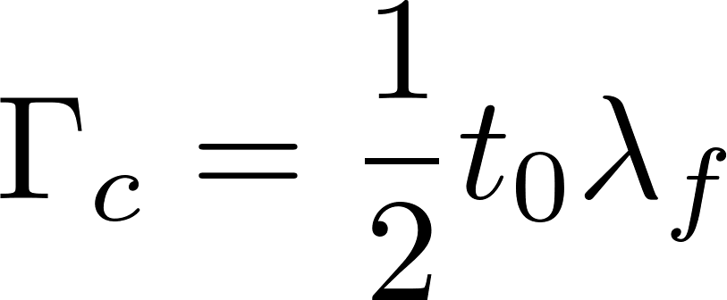
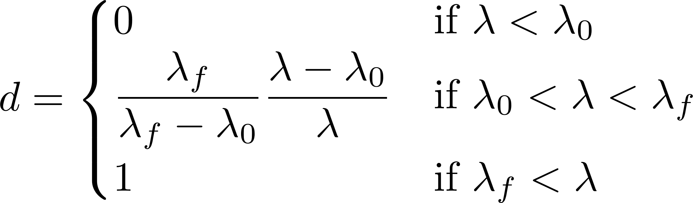



Traction-Separation Law
Traction:
Traction
Damage
Free Energy:
Damage Parameter:
Effective Separation
: maximum strength
: separation at maximum strength
: failure separation
Notes:
-define the traction as derivative of the free energy
-show the Bi-linear TSL
-fracture energy of CZ and equivalence to the fracture energies of the failure mechanism comparison
-damage parameter

Slide 8
Overview
Motivation
Cohesive Zones
Numerical Examples
Summary and Outlook

Slide 9







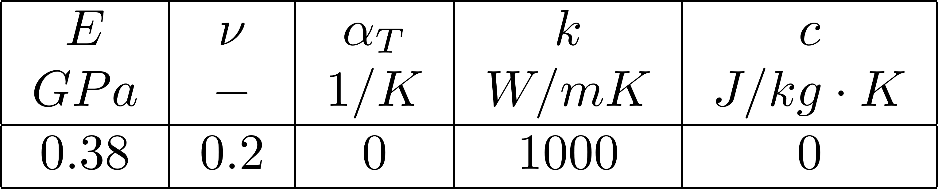
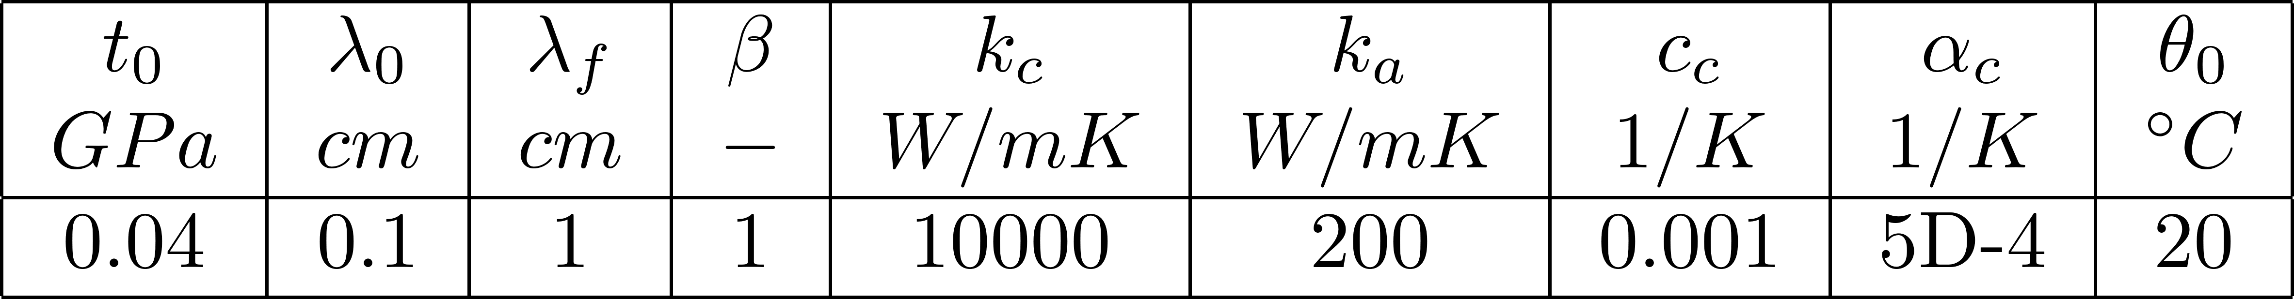
Boundary Conditions
y
x
Bulk Material Parameters
Cohesive Zone Parameters
Notes:
Include measurements, geometry, loads, and parameter set being used

Slide 10



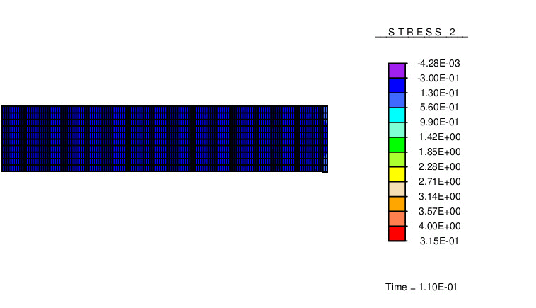

Interface Resistance at Varying Temperatures
y
x
Notes:
-the tests were also done with a temperature gradient, but the results were, as expected, the same as with a constant temperature over the width

Slide 11
Overview
Motivation
Cohesive Zones
Numerical Examples
Summary and Outlook

Slide 12
Summary and Outlook
Summary
A cohesive zone formulation used to model separation
Further research and development
Interfacial material parameters
Parameter temperature dependency
Thermal-coupling
Inclusion of thermal storage
Conduction in shear direction
Convection and radiation

Slide 13
Thank you for your attention

Slide 14
Paper References
[8] S. Rezaei, S. Wulfinghoff, and S. Reese. Prediction of fracture and damage in micro/nano coating systems using cohesive zone elements. International Journal of Solids and Structures, 121:62-74, 2017.

