Slide 1

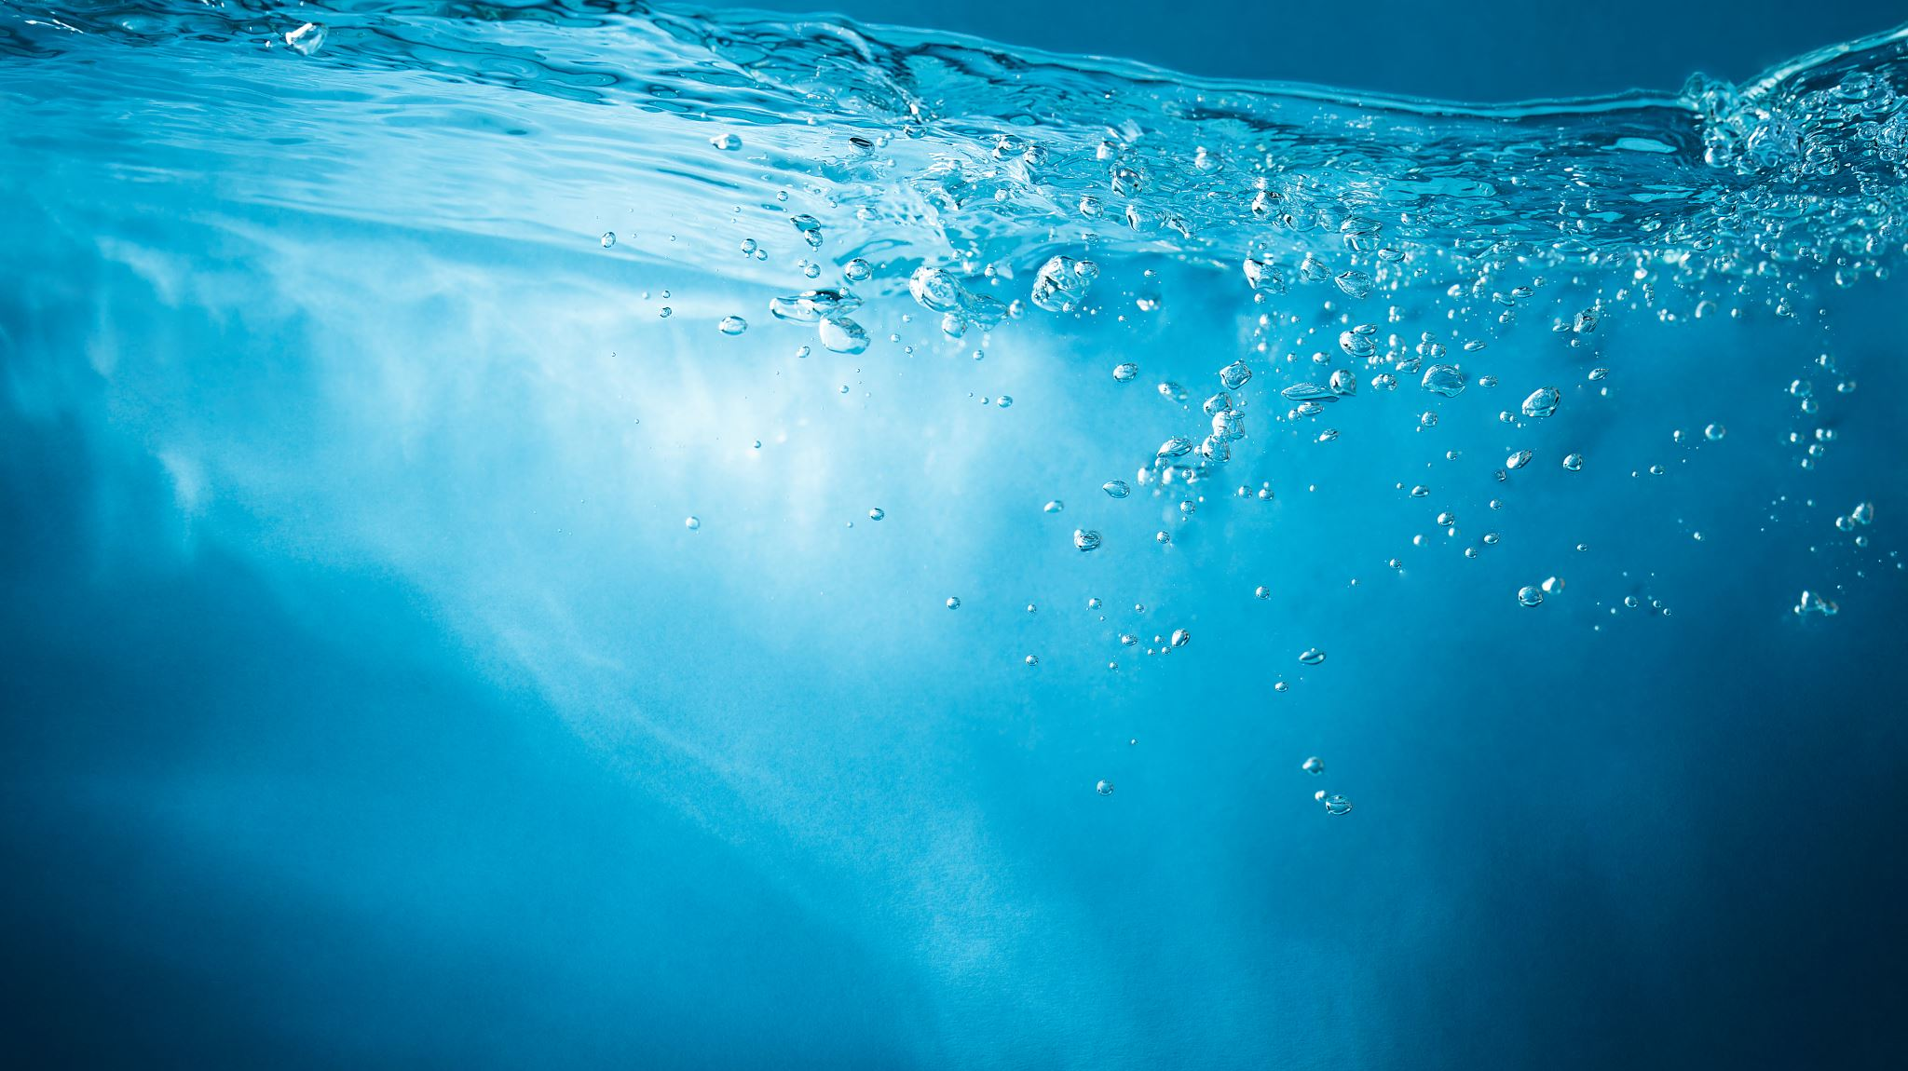
Rainwater harvesting
Dominika Szlawska

Slide 2
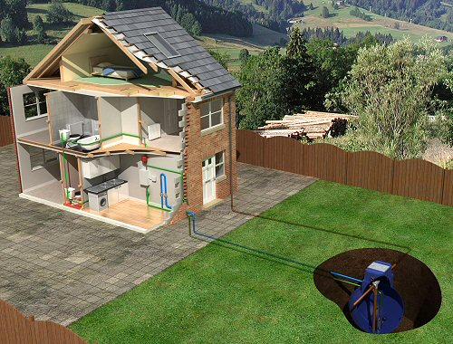
What is it rainwater harvesting?
Rain water harvesting is a technique of collection and storage of rainwater into natural reservoirs or tanks, or the infiltration of surface water into subsurface aquifers (before it is lost as surface runoff).

Slide 3
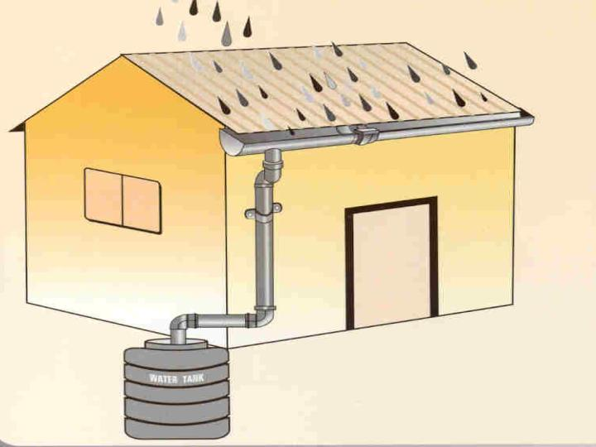
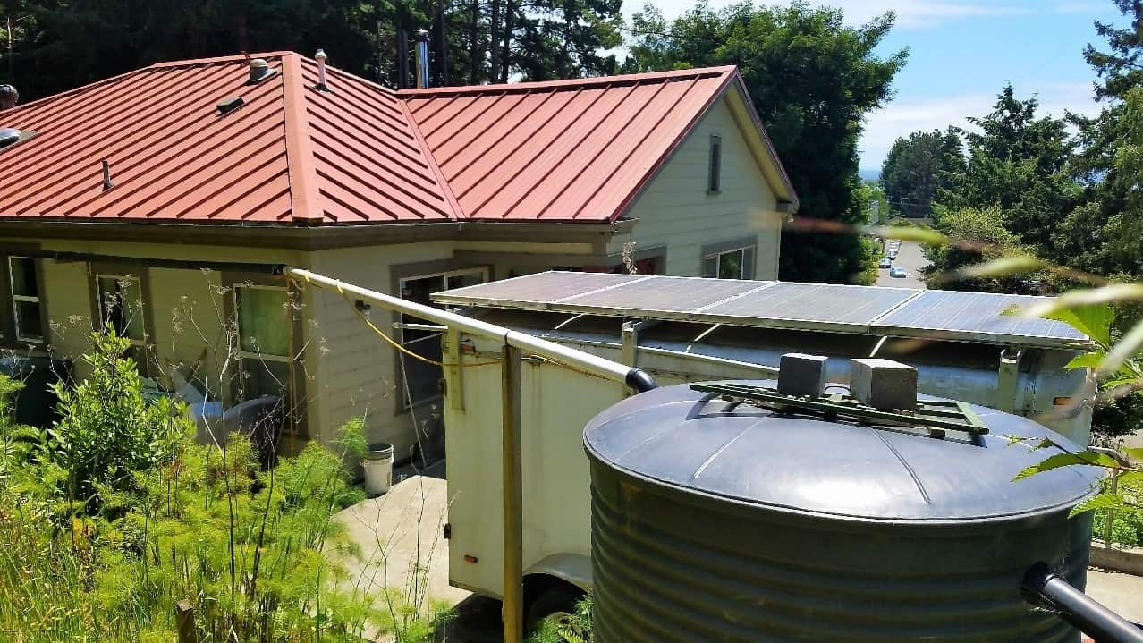
Rooftop harvesting

Slide 4
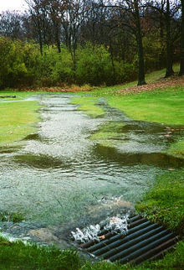
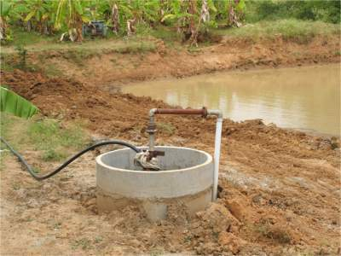
Runoff harvesting

Slide 5
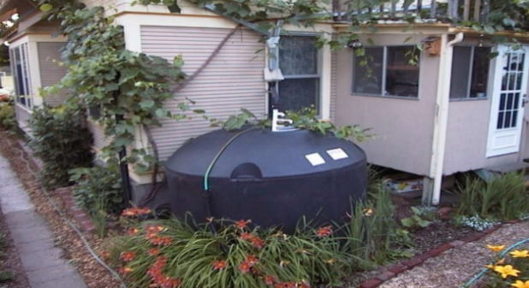

Rainwater harvesting techniques
Storage of rainwater on surface for future use
Recharge to ground water

Slide 6
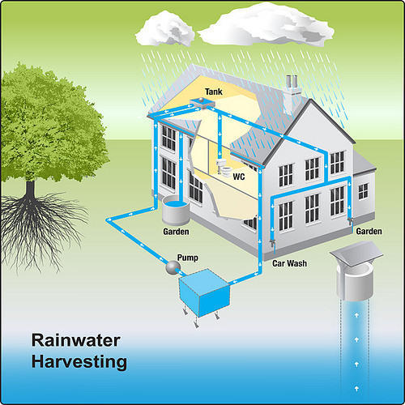

Slide 7
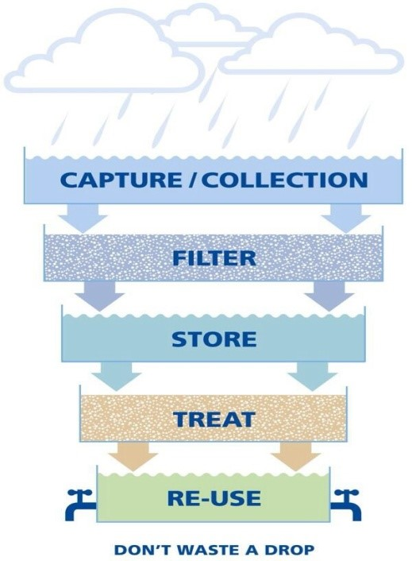

Slide 8
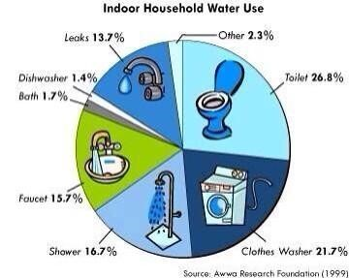
Uses for rainwater harvesting
It is unnecessary to use pure drinking water if all we need to use it for some other purpose rather than drinking.

Slide 9
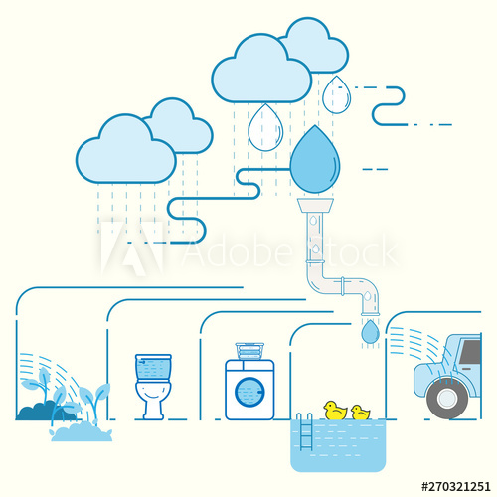
Uses for rainwater harvesting in general
Bathing and laundry
Flushing toilets
Watering lawns, gardens and houseplants
Composting
Water for wildlife, pets or livestock
Rinsing vegetables
Washing vehicles and equipment
Fire protection

Slide 10
Advantages
reduce water bills
provide an alternative supply during water restrictions
help maintain a green, healthy garden
to reduce soil erosion
Depending on tank size and climate, mains water use can be reduced by up to 100%.
This in turn can help:
reduce the need for new dams or desalination plants
protect remaining environmental flows in rivers
reduce infrastructure operating costs.

Slide 11
Disadvantes
Supplies can be contaminated by bird/animal droppings on catchment surfaces
Regular maintenance should be needed
Unpredictable rain fall

Slide 12
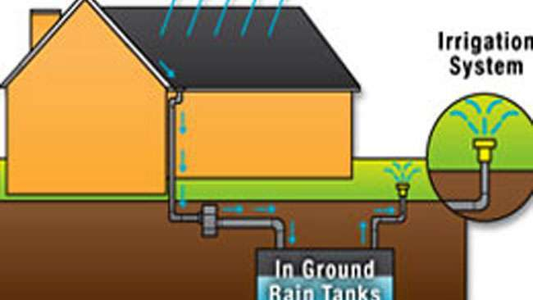
Conclusions
reduce water bills
reduce soil erosion and floods
is very useful for several non-drinking purposes
Collecting rainwater is cost effective and a best alternative to the scarcity for water world wide.

Slide 13
THANK YOU FOR YOUR ATTENTION

