Slide 1
Optimization
of an Airfoil Design
Zeinab Al-Hadi
Mahmoud El Daou
Nadim Khoury
Nadim Saridar
Mechanical Engineering
American University of Beirut

Slide 2

Motivation

Slide 3
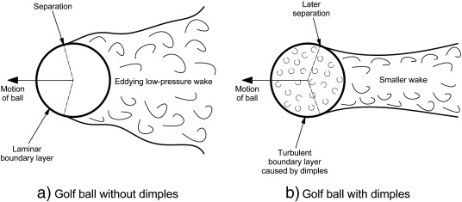
Motivation
Low Pressure Zone
Low Pressure Zone

Slide 4
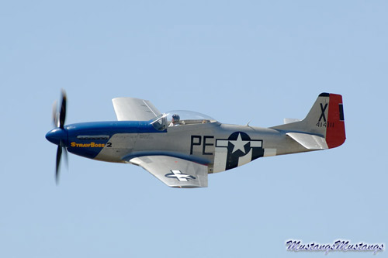
Project Description
Requirements:
- Maximize lift
- Minimize drag
The following criteria will not be considered:
Stability of the aircraft
Stress/Strain on the wing
Airplane model:
WW2 jet fighter Mustang P51d

Slide 5
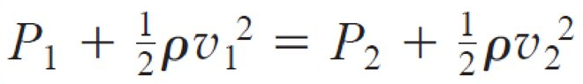
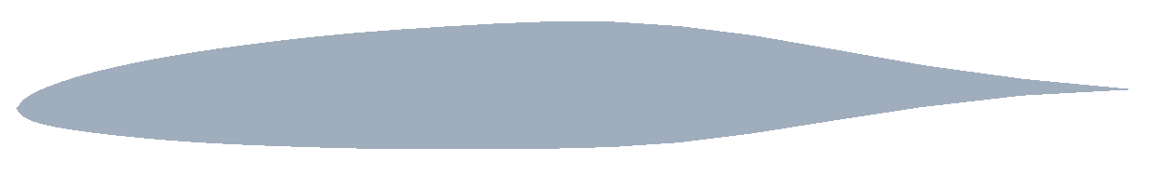
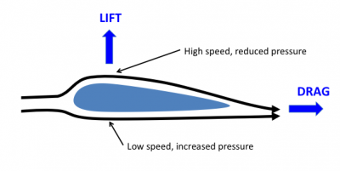
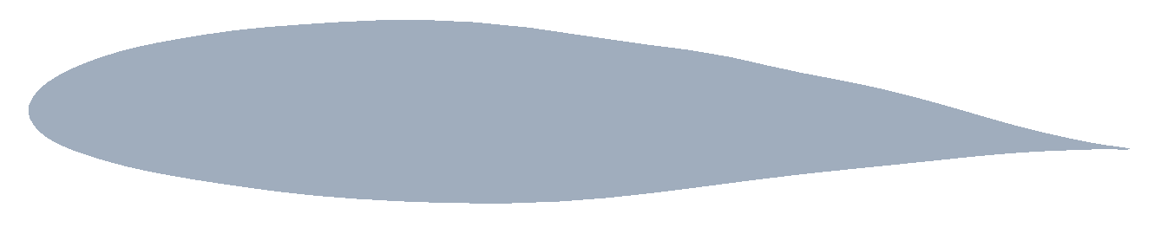
Solution
Bernoulli’s Equation at the same height
2D Tip Design
Chosen dimple diameters:
9cm on the tip
15cm on the root
2D Root Design

Slide 6
Results
Dimples on the upper camber of the 2D tip profile:
2D tip with dimples 2D tip without dimples
 | Cd | Cl | Cl/Cd
DP 7 | 0.015584 | 0.18188 | 11.67087
 | Cd | Cl | Cl/Cd
No Dimples | 0.011668 | 0.183497 | 15.72697
15.72 > 11.67
Bad Option!!

Slide 7
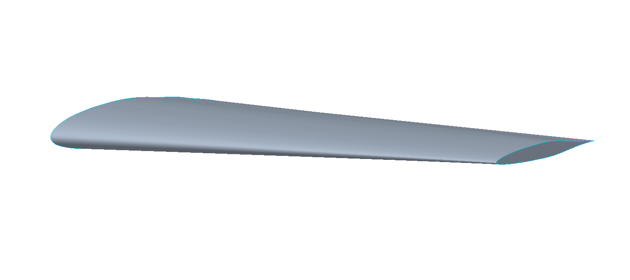
Results
3D analysis on the bottom camber using 6 different scenarios as follows:
8 Rows of dimples with 1 row on the leading edge
With the removal of the dimples on the leading edge
With the removal of 4 rows and keeping the rest
3 rows closest to tip
Only 2 rows nearest to the toot
Only 1 row closest to the root
3D Airfoil Design

Slide 8
Summary of Results
Design | Cd | Cl | Cl/Cd
Original 3D No Dimples | 0.18119 | 2.4864 | 13.723
8 Rows of dimples with 1 row on the leading edge | 0.196129 | 2.523025 | 12.8641
No rows of dimples on leading edge | 0.21474 | 2.54883 | 11.86955
4 rows | 0.17947 | 2.517058 | 14.02492
3 rows closest to tip | 0.179774 | 2.469791 | 13.7383
2 rows closest to root | 0.178089 | 2.571812 | 14.44116
1 row closest to root | 0.175177 | 2.480568 | 14.16038

Slide 9
Summary of Results
Design | Drag | Lift | Ratio
Original, 0 angle | 0.18119 | 2.4864 | 13.723
With Dimples, 0 angle | 0.178089 | 2.571812 | 14.44116
Original, 3º angle | 0.29636 | 5.3084 | 17.912
With Dimples, 3º angle | 0.43939 | 7.1488 | 16.27

Slide 10
Thank you

