Slide 1
Degrowth
Communication Skills 1
Assignment 2
Bruno Stemberger
Lukas M. Vögeli
Eirik D. Haandlykken

Slide 2
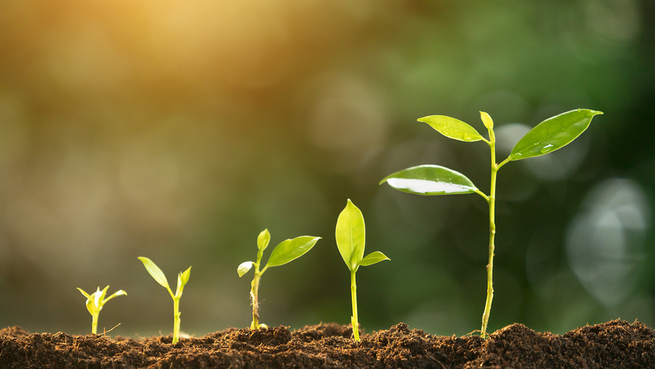
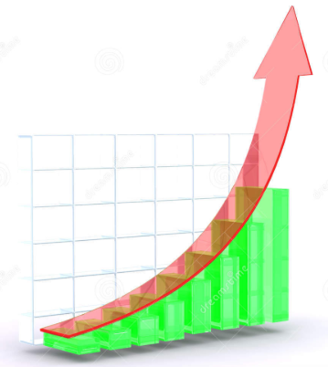
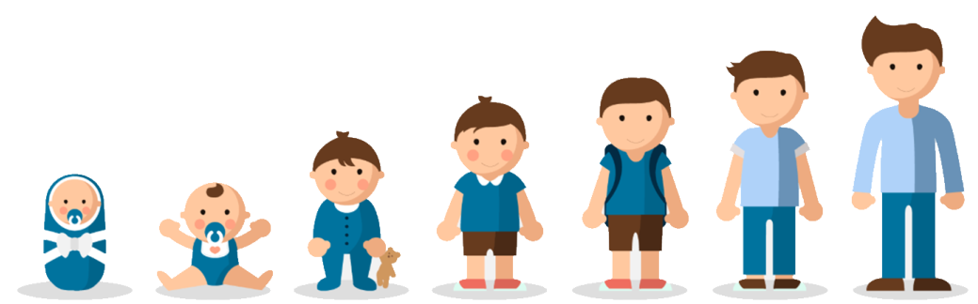
Progress = Growth ?

Slide 3
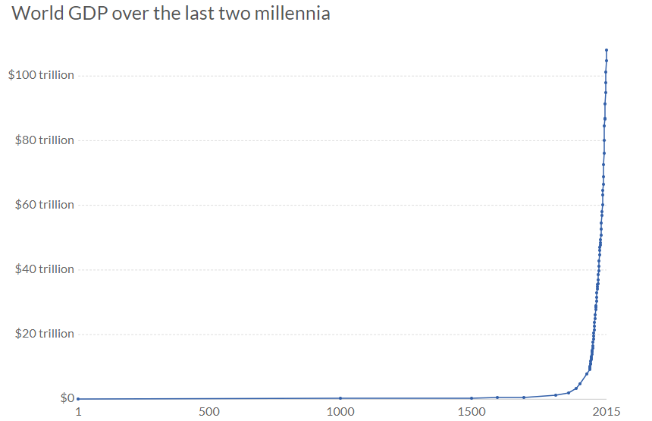

World GDP

Slide 4
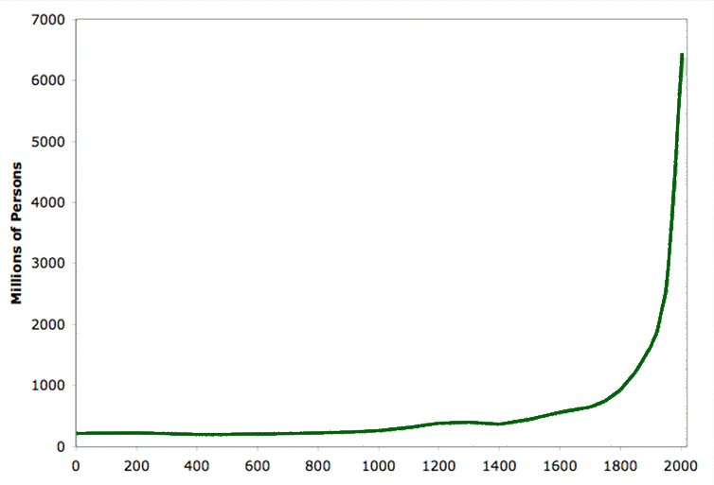

World Population

Slide 5
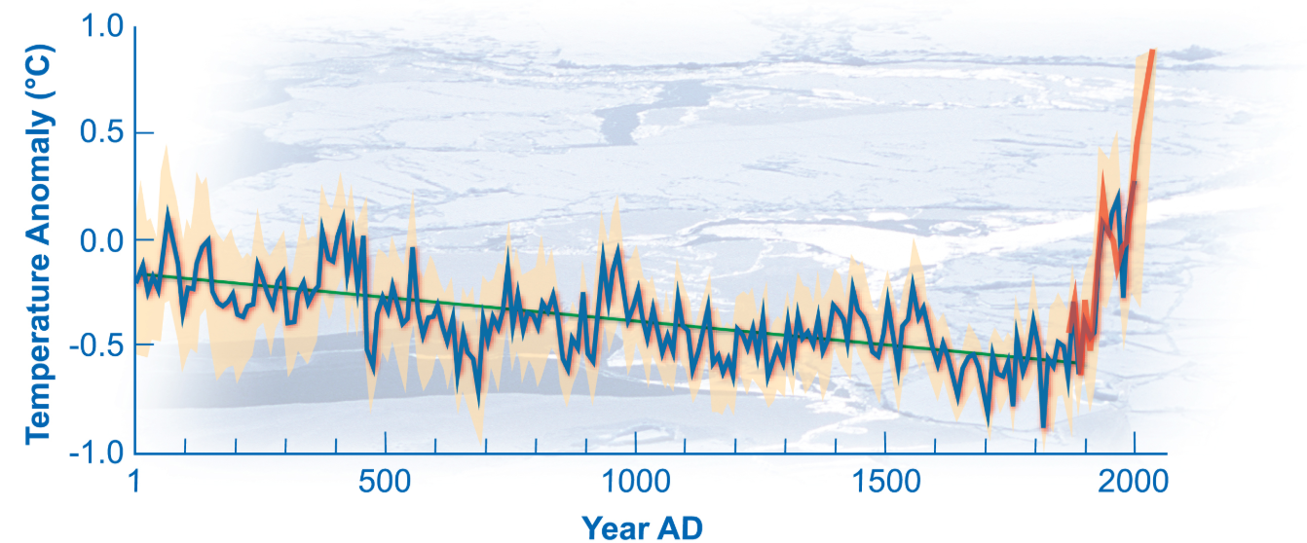


Increase in Temperature

Slide 6
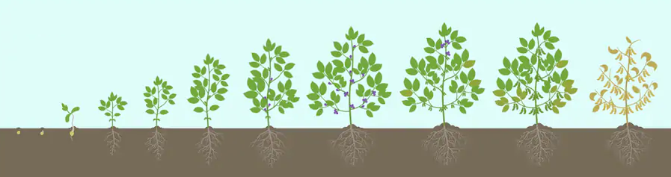
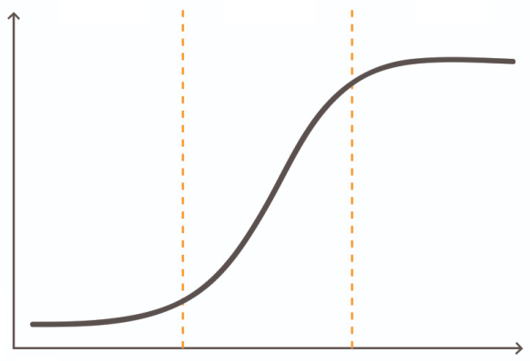
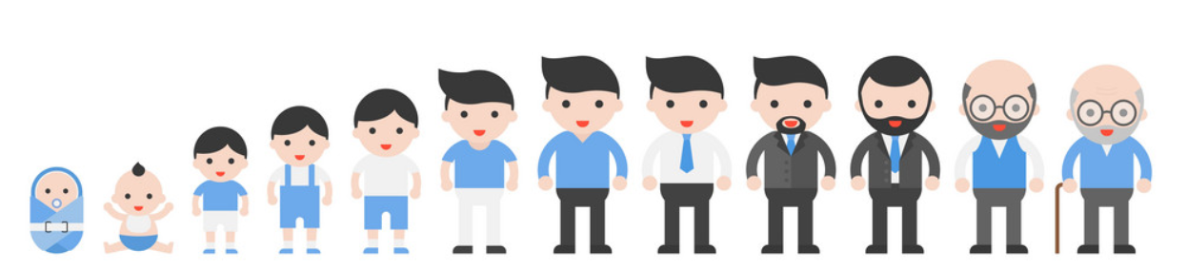
Progress = Degrowth

Slide 7
Measure of Growth
Built
Environment
Natural
Environment
Social
Environment
Natural Capital
-3%
Social Capital
Resources
Intangibles
-7%
4%
Notes:
As Bruno illustrated, growth in GDP has been the first measure of economic progress for half a century, but the 21st century requires a far more ambitious and global economic goal.
Capitalism measures growth by GDP. Gross Domestic Product is simply the sum of the final goods and services produced in a country within a year. But is this really the right way to measure economic progress?
Let me show you a simple graph to propose to you a different approach in measuring growth:
Look at this diagram, the diagram shows the overlapping of Social and natural capital. The social capital ­– based on our cultural world – is basically the GDP, like intangibles. The natural capital – based on the material world – is the resources we need in order to produce, like oil or minerals.
When calculating GDP we don’t take the natural capital into consideration. Let me show you a very simplified example. Let’s say a country’s social capital has an increase of 4% over a year. This is great, right? The GDP have just had an increase of 4%, hence the growth, according to capitalism, has been 4%. But wait… To achieve this increase in GDP, the country has needed to spend 7% of its resources. In other words, the reduction of the natural capital is 7%.
This is where degrowth as an economic mindset comes into play.
If we look at the combination of natural and social capital, we turn out with a growth at -3%. This is just an example of course and a very simplified way of thinking of degrowth.
Degrowth is a bit more complex than this example, but how do we illustrate it? AsI mentioned earlier, we need to define an ambitious and global economic goal. Kathy Raworth defined it like this: Meet the needs of all within the means of the planet. If this goal is drawn on one page, it comes out – as weird as it sounds – like a doughnut .

Slide 8
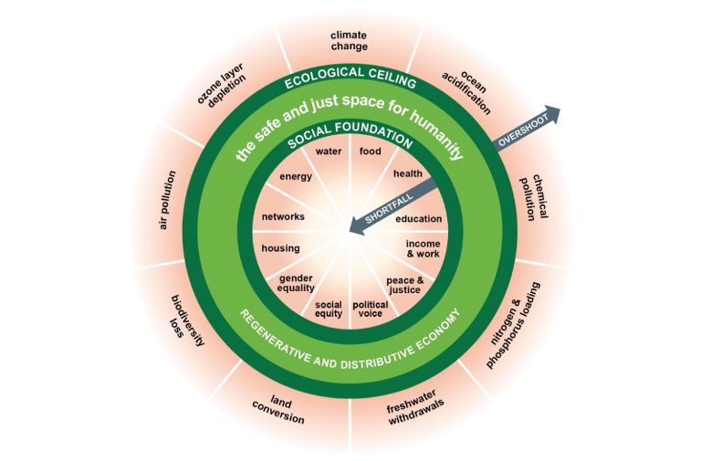

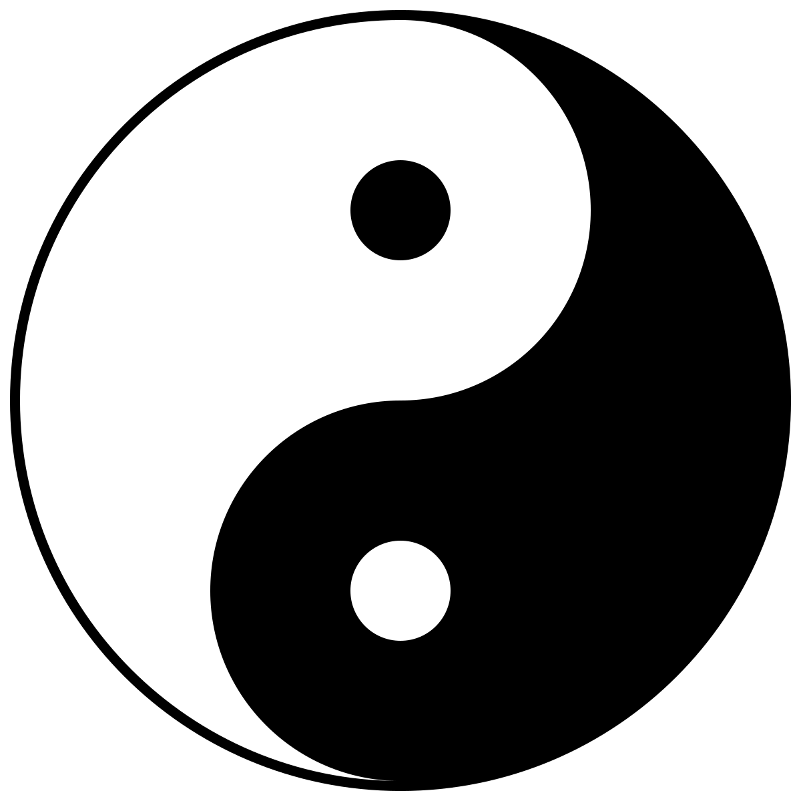


Doughnut of Degrowth
Notes:
Now the challenge will be to create an economy where no one falls short on life essentials while safeguarding the Earth’s life-giving systems. …
I think that this switch of purpose transforms the meaning and shape of economic progress: from endless growth to thriving in balance.

Slide 9
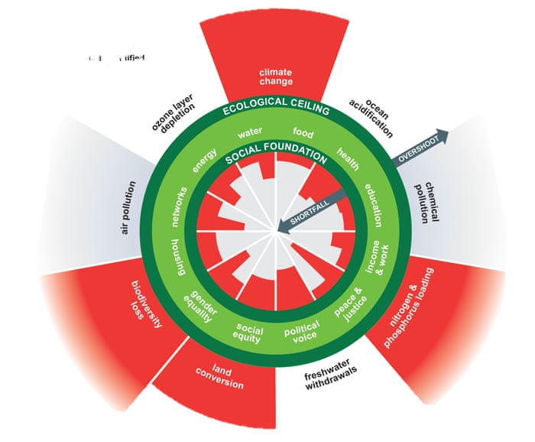
Doughnut of Degrowth

Slide 10
References
Raworth, K. (2018) A healthy economy should be designed to thrive, not grow. https://www.ted.com/talks/kate_raworth_a_healthy_economy_should_be_designed_to_thrive_not_grow#t-517703 Accessed 8 December 2019.
Raworth, K. (2018) Seven Ways to Think Like a Twenty-First-Century Economist. https://www.resilience.org/stories/2017-04-06/doughnut-economics/ Accessed 13 December 2019.
What is degrowth (n.d.) https://www.degrowth.info/en/ Accessed 8 December 2019.
Degrowth (2019) https://en.wikipedia.org/wiki/Degrowth Accessed 9 December 2019.

