Slide 1
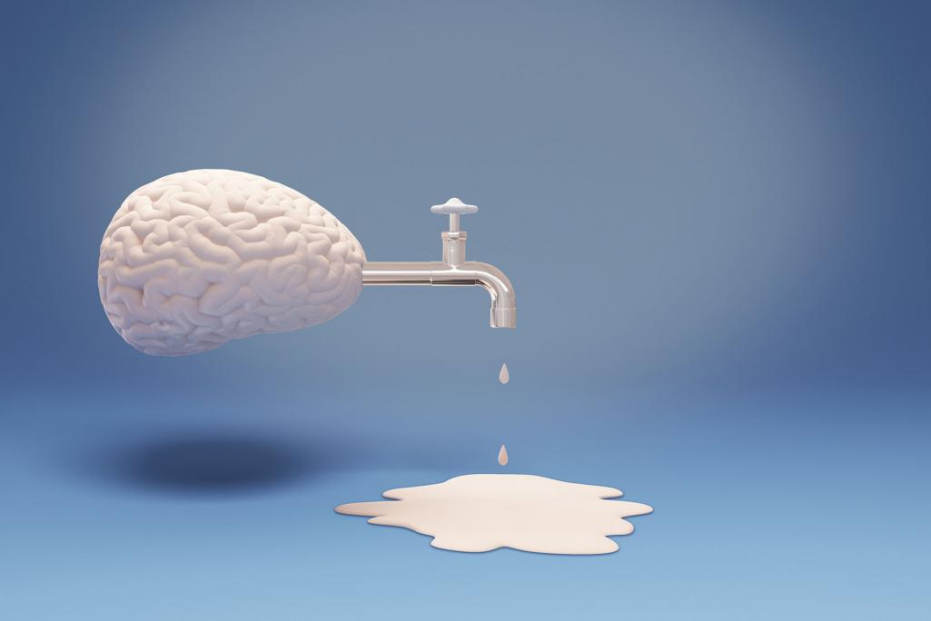
BRAIN DRAIN
Prakhar Rastogi
Perfect K. Marenga
Jordan Pinheiro

Slide 2
INTRODUCTION
Brain drain is the emigration of highly trained or qualified people from a particular country
Brain drain can result from several factors including political turmoil or the existence of more favorable professional opportunities elsewhere.
Brain drain causes countries, industries, and organizations to lose a core portion of valuable individuals.

Slide 3
INTRODUCTION
Brain drain is the emigration of highly trained or qualified people from a particular country
Brain drain can result from several factors including political turmoil or the existence of more favorable professional opportunities elsewhere.
Brain drain causes countries, industries, and organizations to lose a core portion of valuable individuals.

Slide 4
INTRODUCTION
Brain drain is the emigration of highly trained or qualified people from a particular country
Brain drain can result from several factors including political turmoil or the existence of more favorable professional opportunities elsewhere.
Brain drain causes countries, industries, and organizations to lose a core portion of valuable individuals.

Slide 5
HISTORY
The term "brain drain" was first coined in 1963 by the Royal Society to emphasize on the issue of UK citizens especially scientists and technologists immigrating to US
In the 19th century and 20th century there were notable emigrations to North America from Europe
In modern times, from developing nations to developed nations

Slide 6
HISTORY
The term "brain drain" was first coined in 1963 by the Royal Society to emphasize on the issue of UK citizens especially scientists and technologists immigrating to US
In the 19th century and 20th century there were notable emigrations to North America from Europe
In modern times, from developing nations to developed nations

Slide 7
HISTORY
The term "brain drain" was first coined in 1963 by the Royal Society to emphasize on the issue of UK citizens especially scientists and technologists immigrating to US
In the 19th century and 20th century there were notable emigrations to North America from Europe
In modern times, from developing nations to developed nations

Slide 8
FACTORS CAUSING BRAIN DRAIN
PUSH FACTORS
Insufficient opportunity for research and higher education
Difficult in maintaining standard of living
Political instabilities
Discrimination and sheer insecurity
Poor Health facilities
High unemployment rate

Slide 9
FACTORS CAUSING BRAIN DRAIN
PUSH FACTORS
Insufficient opportunity for research and higher education
Difficult in maintaining standard of living
Political instabilities
Discrimination and sheer insecurity
Poor Health facilities
High unemployment rate

Slide 10
FACTORS CAUSING BRAIN DRAIN
PUSH FACTORS
Insufficient opportunity for research and higher education
Difficult in maintaining standard of living
Political instabilities
Discrimination and sheer insecurity
Poor Health facilities
High unemployment rate

Slide 11
FACTORS CAUSING BRAIN DRAIN
PUSH FACTORS
Insufficient opportunity for research and higher education
Difficult in maintaining standard of living
Political instabilities
Discrimination and sheer insecurity
Poor Health facilities
High unemployment rate

Slide 12
FACTORS CAUSING BRAIN DRAIN
PUSH FACTORS
Insufficient opportunity for research and higher education
Difficult in maintaining standard of living
Political instabilities
Discrimination and sheer insecurity
Poor Health facilities
High unemployment rate

Slide 13
FACTORS CAUSING BRAIN DRAIN
PUSH FACTORS
Insufficient opportunity for research and higher education
Difficult in maintaining standard of living
Political instabilities
Discrimination and sheer insecurity
Poor Health facilities
High unemployment rate

Slide 14
FACTORS CAUSING BRAIN DRAIN
PULL FACTORS
Opportunity for career development
Intellectual liberty
Lucrative economic prospects
Modern educational system and better opportunity for higher education
Better working conditions and better employment opportunities
Better health facilities and way of life

Slide 15
FACTORS CAUSING BRAIN DRAIN
PULL FACTORS
Opportunity for career development
Intellectual liberty
Lucrative economic prospects
Modern educational system and better opportunity for higher education
Better working conditions and better employment opportunities
Better health facilities and way of life

Slide 16
FACTORS CAUSING BRAIN DRAIN
PULL FACTORS
Opportunity for career development
Intellectual liberty
Lucrative economic prospects
Modern educational system and better opportunity for higher education
Better working conditions and better employment opportunities
Better health facilities and way of life

Slide 17
FACTORS CAUSING BRAIN DRAIN
PULL FACTORS
Opportunity for career development
Intellectual liberty
Lucrative economic prospects
Modern educational system and better opportunity for higher education
Better working conditions and better employment opportunities
Better health facilities and way of life

Slide 18
FACTORS CAUSING BRAIN DRAIN
PULL FACTORS
Opportunity for career development
Intellectual liberty
Lucrative economic prospects
Modern educational system and better opportunity for higher education
Better working conditions and better employment opportunities
Better health facilities and way of life

Slide 19
FACTORS CAUSING BRAIN DRAIN
PULL FACTORS
Opportunity for career development
Intellectual liberty
Lucrative economic prospects
Modern educational system and better opportunity for higher education
Better working conditions and better employment opportunities
Better health facilities and way of life

Slide 20
EFFECTS OF BRAIN DRAIN
Developing Countries
Shortage of skilled and competent workers.
Poor health care system resulting from professional health workers emigrating to other countries (Sub-Saharan Africa most affected).
Decrease in technological and industrial advancement due to migration of engineers and scientist.
Misuse of state funds due to incompetent workers.

Slide 21
EFFECTS OF BRAIN DRAIN
Developing Countries
Shortage of skilled and competent workers.
Poor health care system resulting from professional health workers emigrating to other countries (Sub-Saharan Africa most affected).
Decrease in technological and industrial advancement due to migration of engineers and scientist.
Misuse of state funds due to incompetent workers.

Slide 22
EFFECTS OF BRAIN DRAIN
Developing Countries
Shortage of skilled and competent workers.
Poor health care system resulting from professional health workers emigrating to other countries (Sub-Saharan Africa most affected).
Decrease in technological and industrial advancement due to migration of engineers and scientist.
Misuse of state funds due to incompetent workers.

Slide 23
EFFECTS OF BRAIN DRAIN
Developing Countries
Shortage of skilled and competent workers.
Poor health care system resulting from professional health workers emigrating to other countries (Sub-Saharan Africa most affected).
Decrease in technological and industrial advancement due to migration of engineers and scientist.
Misuse of state funds due to incompetent workers.

Slide 24
Developed Countries
Readily available work force
International students contributed to the economy by paying college fees
Ultimately, results in the development of country
Number of qualified professionals outnumbering the jobs opportunities

Slide 25
Developed Countries
Readily available work force
International students contributed to the economy by paying college fees
Ultimately, results in the development of country
Number of qualified professionals outnumbering the jobs opportunities

Slide 26
Developed Countries
Readily available work force
International students contributed to the economy by paying college fees
Ultimately, results in the development of country
Number of qualified professionals outnumbering the jobs opportunities

Slide 27
Developed Countries
Readily available work force
International students contributed to the economy by paying college fees
Ultimately, results in the development of country
Number of qualified professionals outnumbering the jobs opportunities

Slide 28
Brain Drain to Gain
Making it mandatory for Scholarship students of public universities to work in their home country for several
Imitating Taiwanese Model of reverse brain drain
Taiwanese government adopted several measures to attract Taiwanese ex-pats
Equipping the existing institutes with latest technologies
Developing Educational institutes with world-class infrastructure

Slide 29
Brain Drain to Gain
Making it mandatory for Scholarship students of public universities to work in their home country for several
Imitating Taiwanese Model of reverse brain drain
Taiwanese government adopted several measures to attract Taiwanese ex-pats
Equipping the existing institutes with latest technologies
Developing Educational institutes with world-class infrastructure

Slide 30
Brain Drain to Gain
Making it mandatory for Scholarship students of public universities to work in their home country for several
Imitating Taiwanese Model of reverse brain drain
Taiwanese government adopted several measures to attract Taiwanese ex-pats
Equipping the existing institutes with latest technologies
Developing Educational institutes with world-class infrastructure

Slide 31
Brain Drain to Gain
Making it mandatory for Scholarship students of public universities to work in their home country for several
Imitating Taiwanese Model of reverse brain drain
Taiwanese government adopted several measures to attract Taiwanese ex-pats
Equipping the existing institutes with latest technologies
Developing Educational institutes with world-class infrastructure

Slide 32
Brain Drain to Gain
Making it mandatory for Scholarship students of public universities to work in their home country for several
Imitating Taiwanese Model of reverse brain drain
Taiwanese government adopted several measures to attract Taiwanese ex-pats
Equipping the existing institutes with latest technologies
Developing Educational institutes with world-class infrastructure

Slide 33

Thank You

