Slide 1
SEEK DISCOMFORT

Slide 3

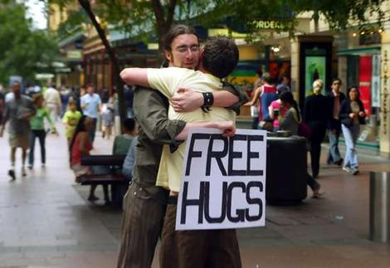

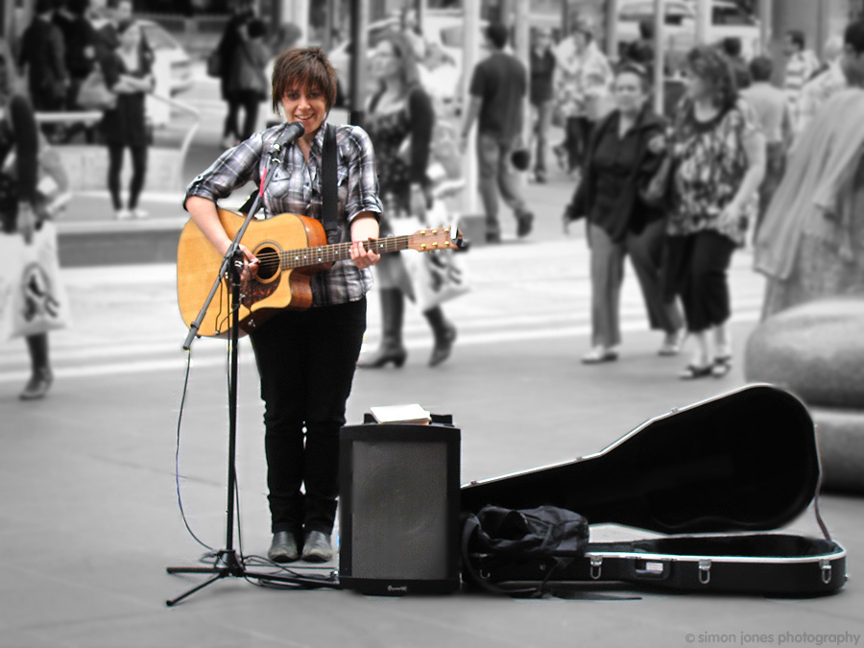
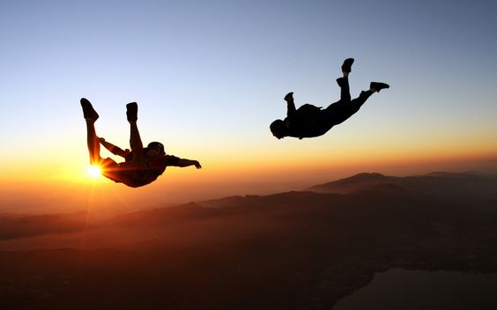

Slide 4
”The best things in life are on the other side of fear” – Will Smith
”Growth and comfort do not coexist” – Ginny Rometty, CEO of IBM
”If you want something you’ve never had, you have to do something you’ve never done” - Thomas Jefferson, third president of USA

