Slide 1
Fuel of the Future?
Presented by,
Krupesh Beekanahalli Shivaprakash

Slide 2
Current Fuels
  Around 2.5 billion vehicles in 2015 and will be 4 billion in 2020.
  Vehicles are mainly powered by fossil fuels.
  Fossil fuels are non renewable and demand is incrasing..
  Ever increasing Pollution, Green House effect , acidification and rising fuel prices.
  So, it is time to seriously search for an alternative fuels.

Slide 3
Alternative Fuels
The most reliable options for alternative fuels for vehicles are,
Bio fuels
Electricity (Electric vehicles)
Hydrogen
Which is the most reliable option?
Bio fuels have lot of technical challenges, and also it leads to deforestation.
World’s major electricity production is based on fossil fuel.
Hydrogen Fuel is renewable, readily available and environmental friendly.

Slide 4
Can hydrogen be the fuel of future?
Good combustive properties.
Zero Emission fuel
Hydrogen can be effective in Fuel Cell Vehicles and Internal Combustion Engines.
High Efficiency

Slide 5
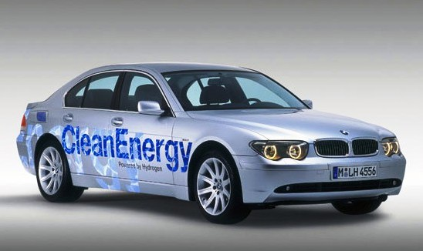
Hydrogen Internal Combustion Engine Car
BMW-hydrogen7

Slide 6
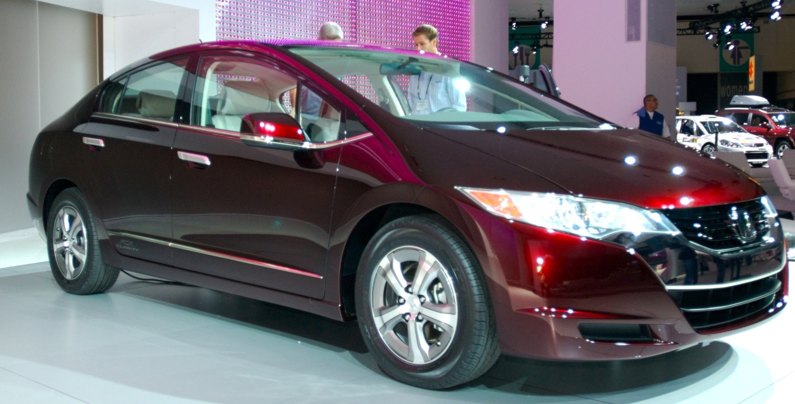
Hydrogen Fuel Cell Vehicle
Honda FCX

Slide 7
References
“Hydrogen as a spark ignition engine fuel”. Ghazi A. Karim (2003)
“The hydrogen-fueled internal combustion engine: a technical review”. C.M. White, R.R. Steeper and A.E. Lutz (2006).
“Hydrogen-fueled internal combustion engines”. Sebastian Verhelst and Thomas Wallner (2009).
“A review on fuel cell technologies and power electronic interface”. A. Kirubakaran, Shailendra Jain and R.K. Nema (2009).
“Review and analysis of PEM fuel cell and manufacturing”. Viral Mehata, Joyce Smith Cooper.
“Hydrogen and Fuel Cell Technologies for Sustainable Future”. Ibrahim Dincer (2008).
www.conserve-energy-future.com
www.wikipedia.com

Slide 8
THANK YOU

