Slide 1
THE PHYSICS BEHIND BOATS AND PLANES
Gomà, Pol
Pacheco, Rafael
Pérez, Magdalena
Communication Skills 1

Slide 2
Introduction
SHIPS
Fluid statics
(hydrostatics)
PLANES
Fluid dynamics
(aerodynamics)

Slide 3
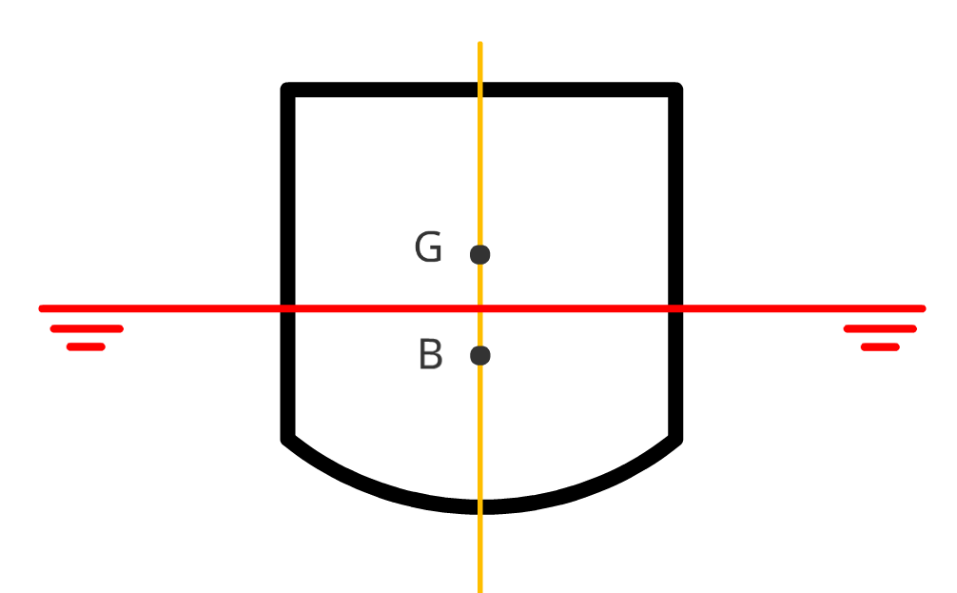
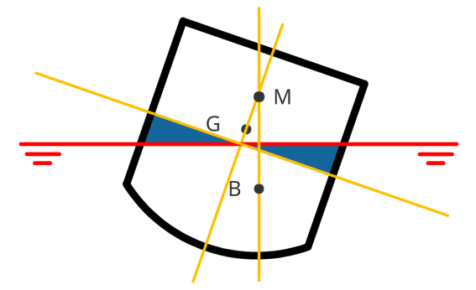
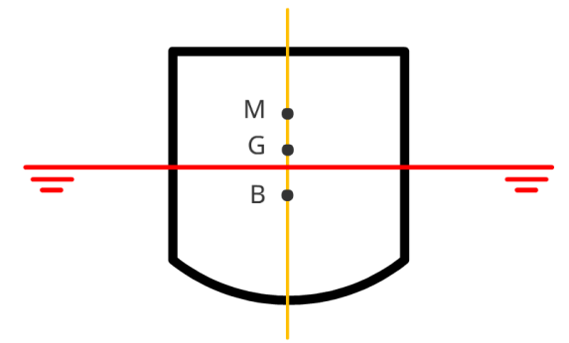

Hydrostatics - Review
Floats if:
Equilibrium between weight and buoyancy.
Stable if:
$GM ≫0 \&$
$V_{lost}=V_{gained} \& \frac{d\left(G\right)}{dθ}=0$

Slide 4
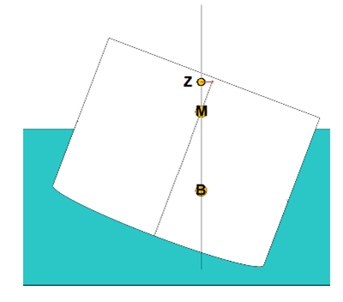
Stability – Righting arm
The ship will keep rolling and may sink.
G

Slide 5
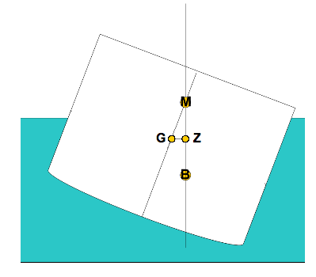


Stability – Righting arm
*This is valid only for small angles

Slide 6

Stability
Old fashion way:
Valid if $V_{lost}=V_{gained}$
Modern techniques:
numerical method
+
computational aid
- G and B for any angle
- CoG may not be constant

Slide 7
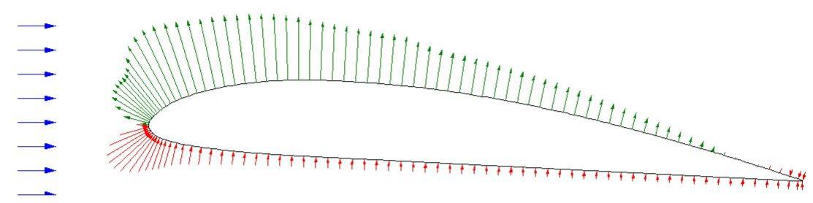
How is lift generated? – Review
Lift is generated by changing the velocity of a flow.
Change in velocity
Change in pressure
Resultant force
http://dhaerotech.com/Images/Clark%20Y%20Aileron%20Forces.jpg

Slide 8
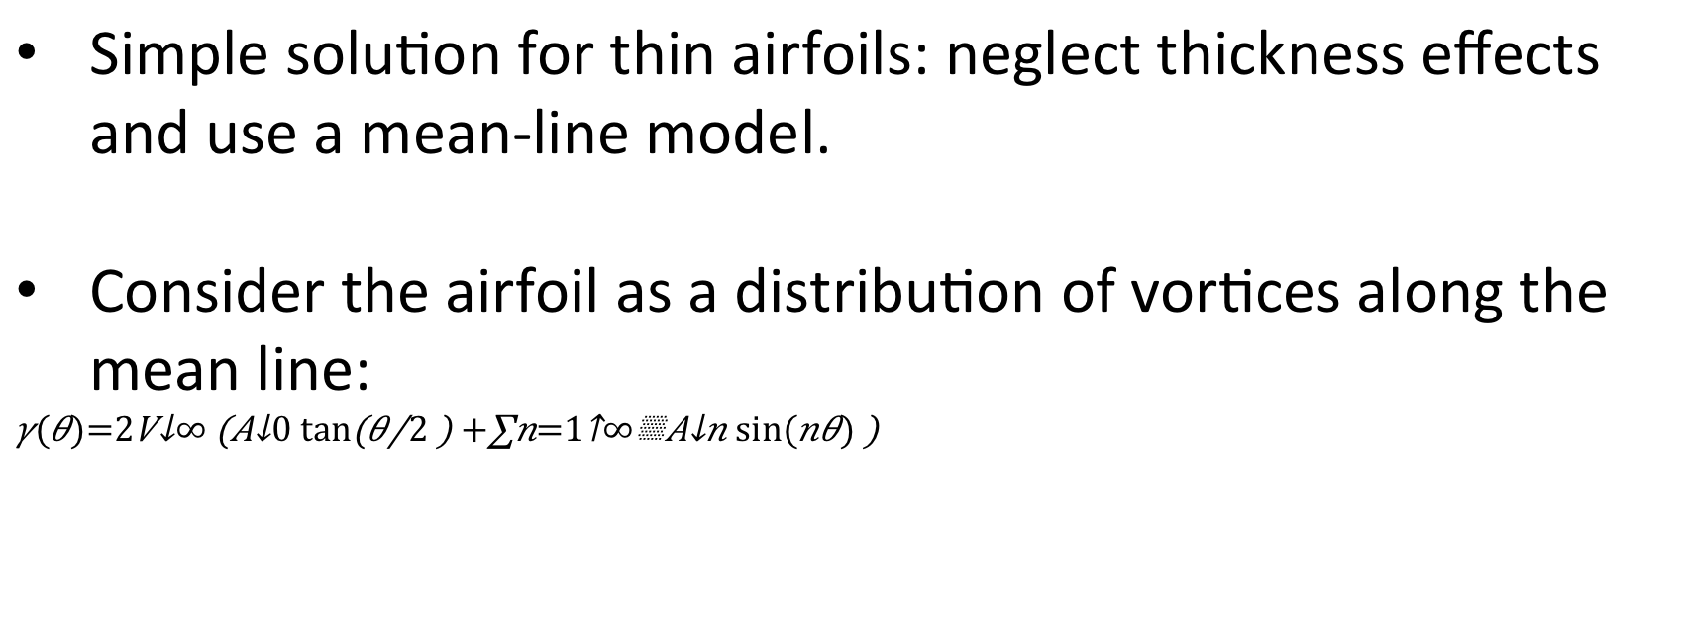
2D thin airfoil theory – Potential flow
Simple solution for thin airfoils: neglect thickness effects and use a mean-line model.
Consider the airfoil as a distribution of vortices along the mean line:
$$γ(θ)=2V_{∞}\left(A_{0}\tan\left(θ/2\right)+\sum_{n=1}^{∞}{A_{n}sin⁡(nθ)}\right)$$
http://dhaerotech.com/Images/Clark%20Y%20Aileron%20Forces.jpg

Slide 9
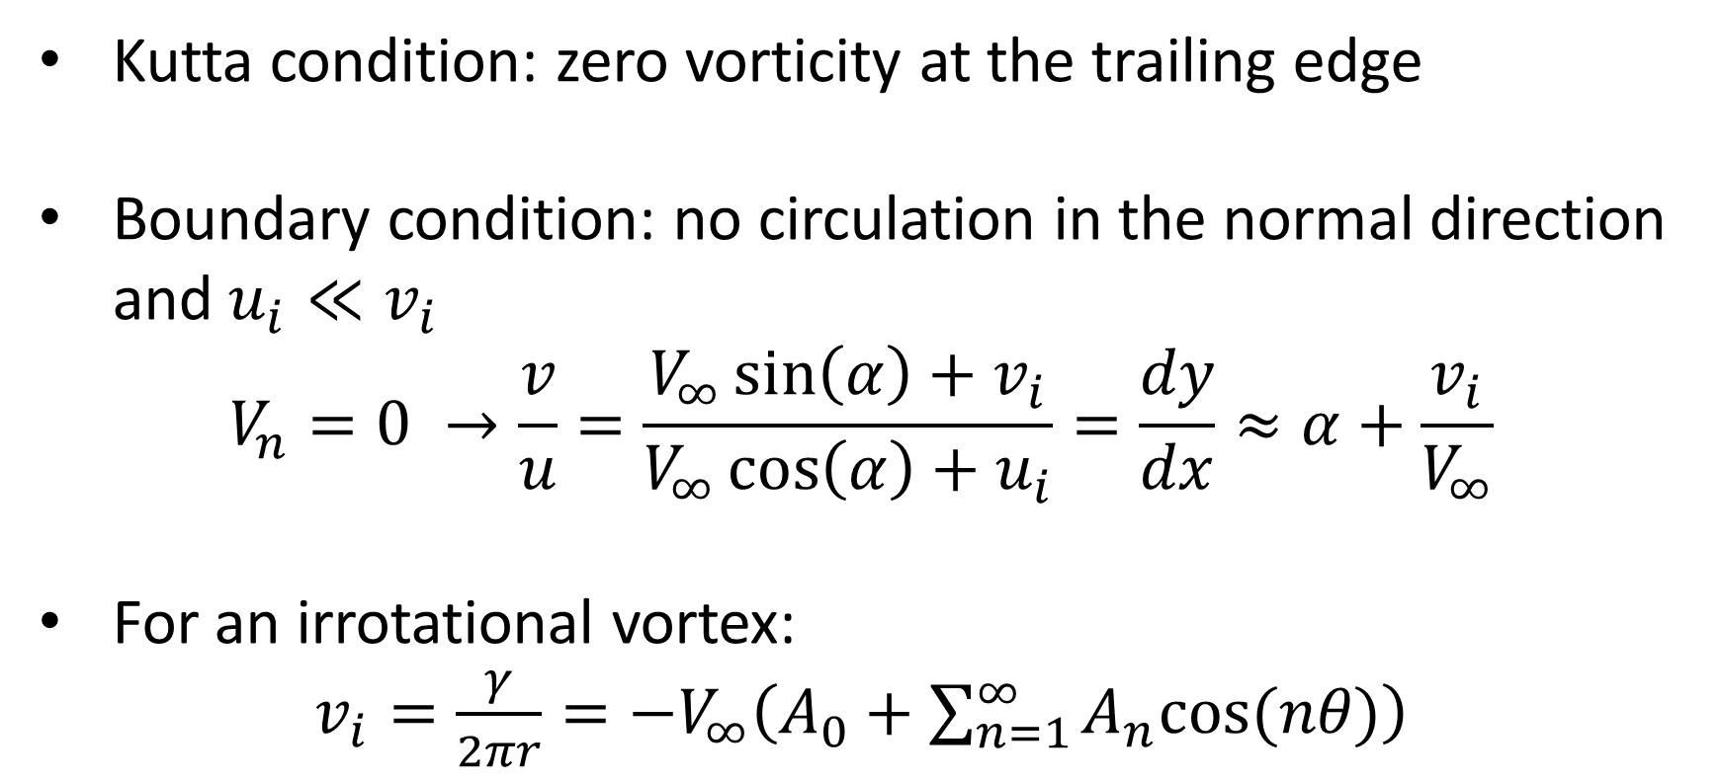
2D thin airfoil theory – Potential flow
Kutta condition: zero vorticity at the trailing edge
Boundary condition: no circulation in the normal direction and $u_{i}≪v_{i}$
$$V_{n}=0 →\frac{v}{u}=\frac{V_{∞}\sin\left(α\right)+v_{i}}{V_{∞}\cos\left(α\right)+u_{i}}=\frac{dy}{dx}≈α+\frac{v_{i}}{V_{∞}}$$
For an irrotational vortex:
$v_{i}=\frac{γ}{2πr}=−V_{∞}\left(A_{0}+\sum_{n=1}^{∞}{A_{n}cos⁡(nθ)}\right)$
http://dhaerotech.com/Images/Clark%20Y%20Aileron%20Forces.jpg

Slide 10
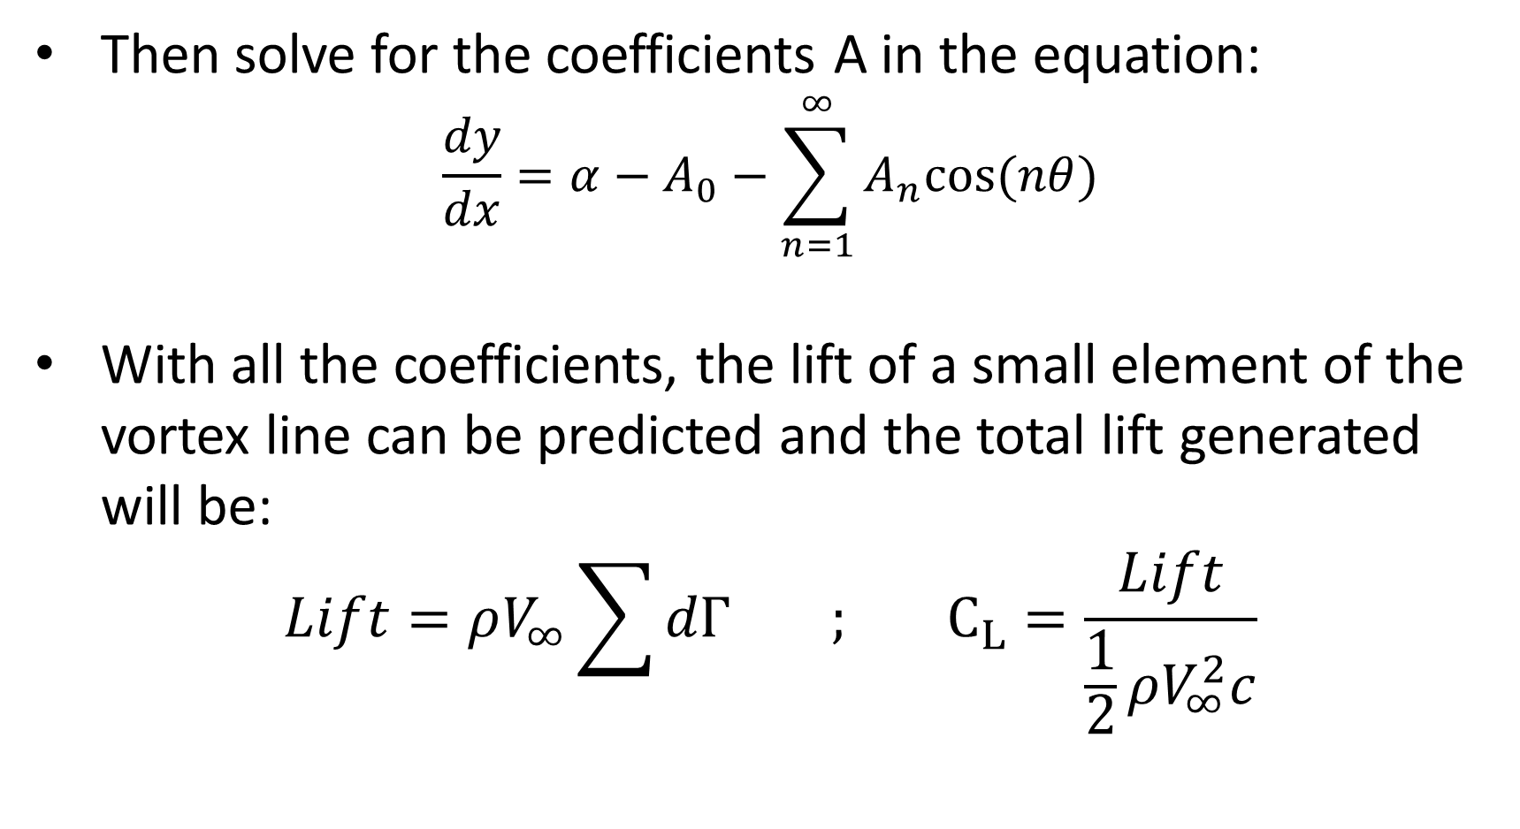
2D thin airfoil theory – Potential flow
Then solve for the coefficients A in the equation:
$$\frac{dy}{dx}=α−A_{0}−\sum_{n=1}^{∞}{A_{n}cos⁡(nθ)}$$
With all the coefficients, the lift of a small element of the vortex line can be predicted and the total lift generated will be:
$$Lift=ρV_{∞}\sum{dΓ} ; C_{L}=\frac{Lift}{\frac{1}{2}ρV_{∞}^{2}c}$$
http://dhaerotech.com/Images/Clark%20Y%20Aileron%20Forces.jpg

Slide 11
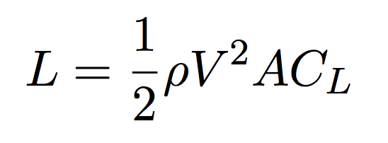
Factors that affect lift
Those associated with the object: shape and size.
Those associated with the motion of the object through the air: velocity and inclination.
Those associated with the air itself: mass, viscosity, compressibility.
All of them are gathered in the lift equation:

Slide 12
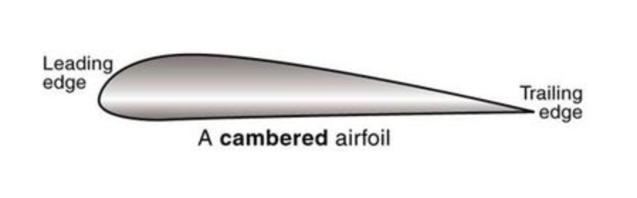
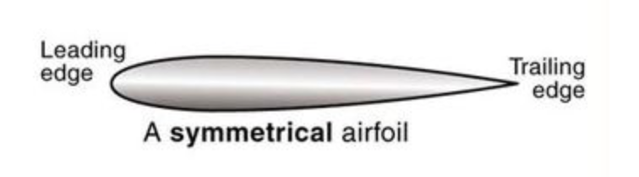
Shape and size effects
Lift is generally a complex function of the shape.
Shape effect modelled by the lift coefficient.
Lift depends specially on the amount of camber. Camber ⬆ ➔ Lift ⬆
Lift is proportional to the area. Doubling the area ➔ doubling the lift
http://www.pilotwings.org/airfoil-efficiency.html

Slide 13
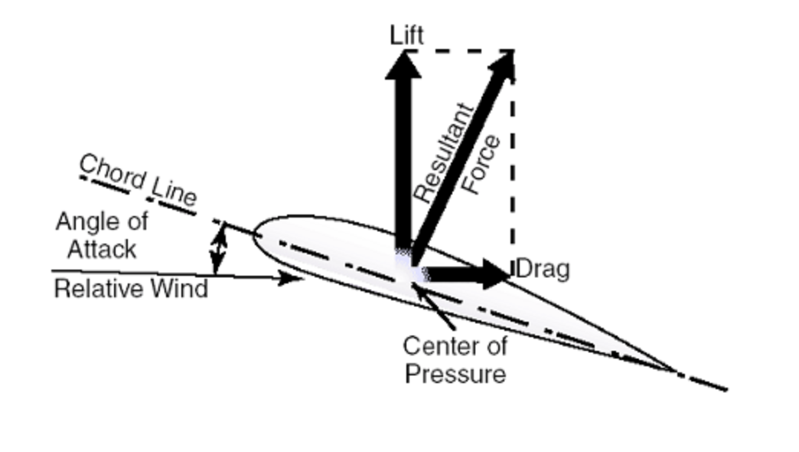
Velocity, density and inclination effects
Velocity: relative velocity between the object and the flow. Doubling the velocity ➔ quadrupling the lift
Density: Linear dependence. Halving the density ➔ Halving the lift
Angle of attack: angle between the chord line and the flight direction. Large effect on the lift.
http://www.advanced-flight-systems.com/Products/AOA/aoa.html

