Slide 1
NEW PARADIGMS IN RECYCLING
Comunication Skills
16/12/2016
Benjamin Herzog
Alba Ruiz de Alegría
Julius Weiss

Slide 2
Index
Introducction
State of the art
Plastic
Bioplastic
Eco-design
Spotlight problem

Slide 3
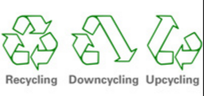
Introduction
PRIMARY RESOURCES
Non-renewable
Renewable
Metals
Petroleum
Coal
…
Oxygen
Water
Sun
…
LIMITED!! → Solution
Recycle

Slide 4
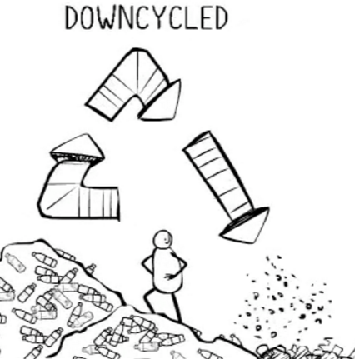
State of the art
Waste materials or useless products
materials or products of LOWER QUALITY and REDUCED FUNCTIONALITY
materials or products of LOWER QUALITY and REDUCED FUNCTIONALITY
…
Waste materials or useless products

Slide 5
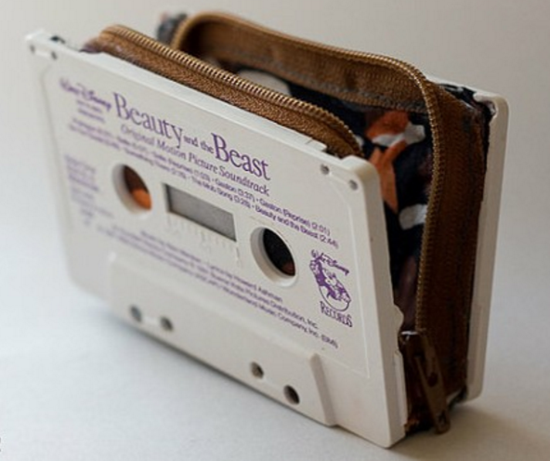
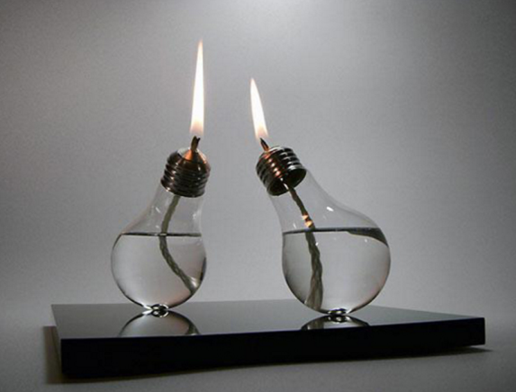
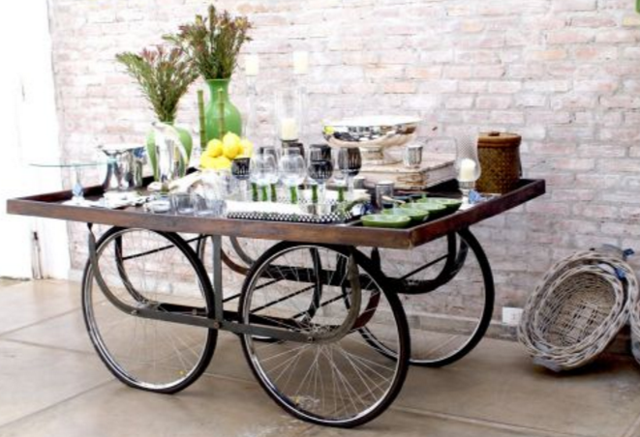
State of the art
UPCYCLING
Waste materials or useless products
materials or products of EQUAL or GREATER VALUE

Slide 6
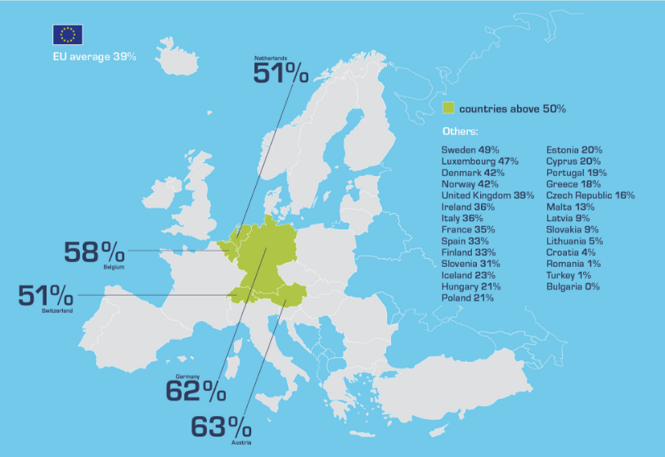
State of the art
Recicling rate in Europe

Slide 7
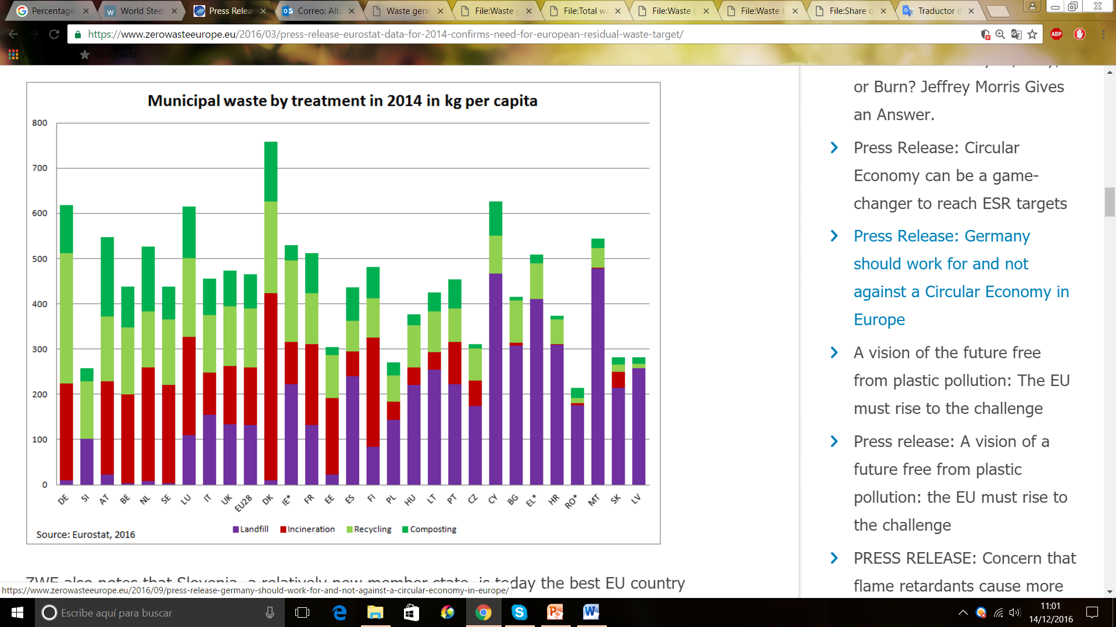
State of the art

Slide 8
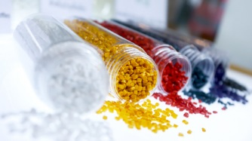
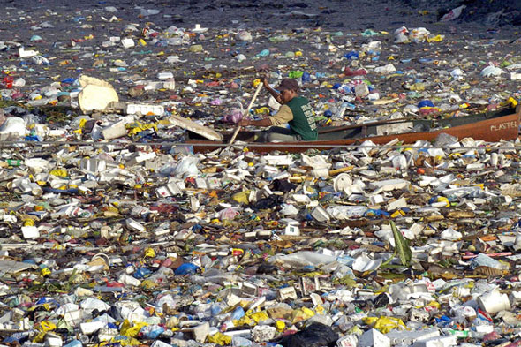
Plastic
©panalytical.com
Useful properties
Flexible
Low weight
Resistance against water and electricity
© Coastal wiki
BUT
Produced with mineral oil
Not degradable in nature
→ Issue with disposal

Slide 9
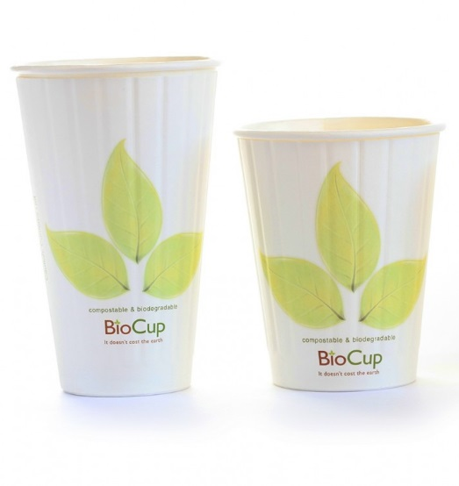
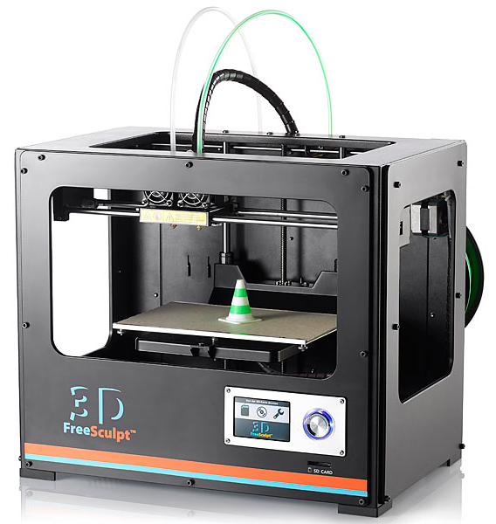
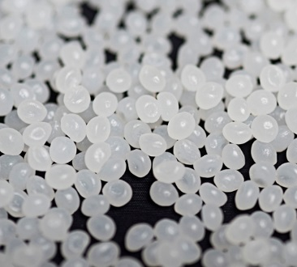
Bioplastic
Made out of non-fossil resources
Example: Polylactic Acid (PLA)
made out of starch from corn
Similar properties!
©treadingmyownpath.com
©transkript
©FreeSculpt

Slide 10
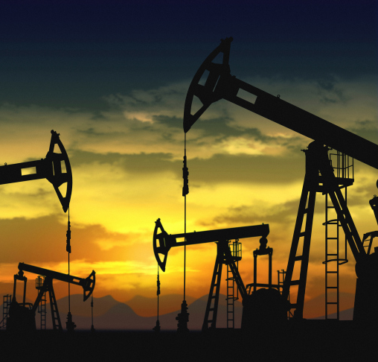
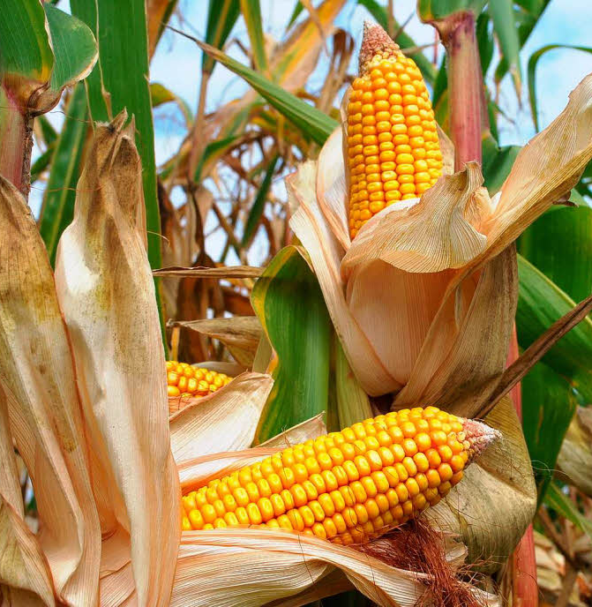
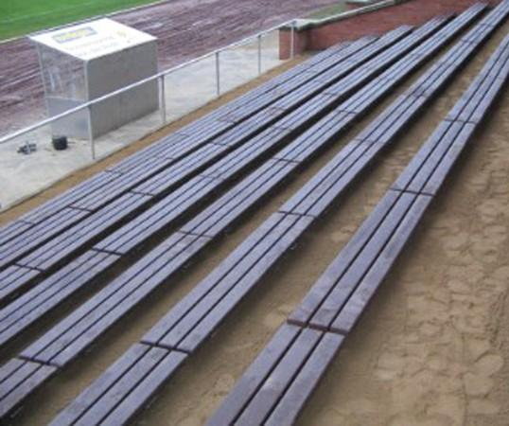
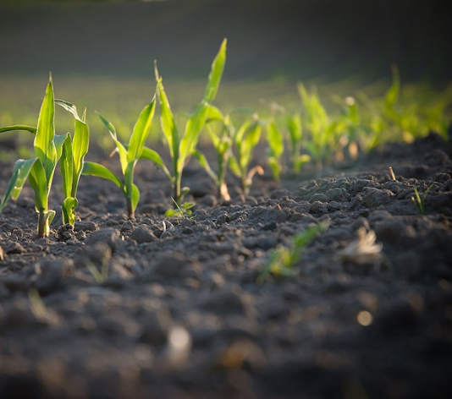
Comparison
 | Conservative plastic | Bioplastic
Production
Recycling
©ridley-thomas.lacounty.gov
©parmaquotidiano.info
©baushop24.com
©landkreis-wug.de

Slide 11
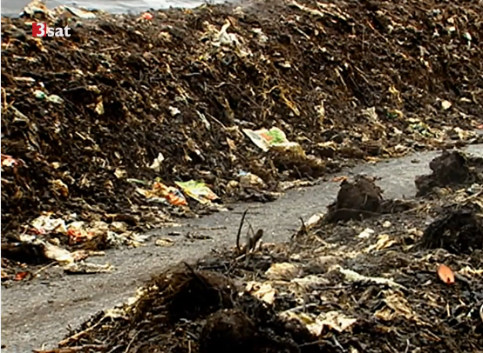
Critical view
Bioplastic only decays under certain conditions (composting plant: ~60°C, humidity, air)
BUT:
Often retention time is too short
Separation problem
→Treated like normal plastic

Slide 12
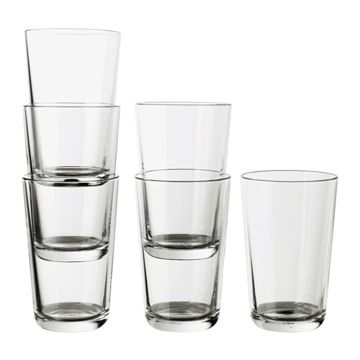
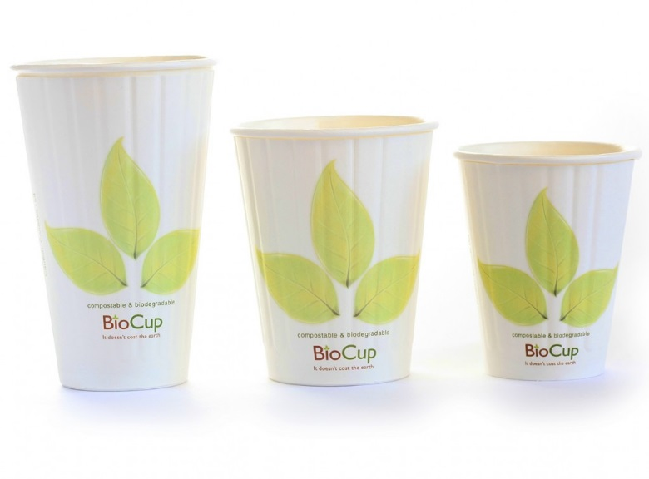
Critical view
Corn for PLA is often genetically manipulated; USA → Europe
©ikea.com

Slide 13
Eco-design
Avoid composite materials
Easy deconstruction
Secondary raw materials
Prefer renewable materials
Prefer materials known how to recycle

Slide 14
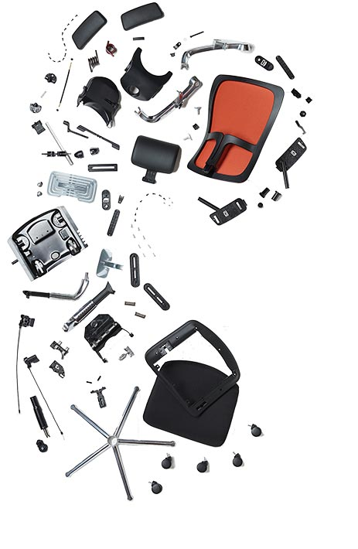
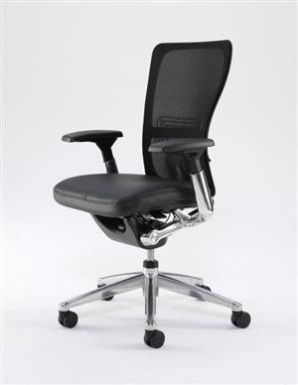
Eco-design
©trentini.lv

Slide 15
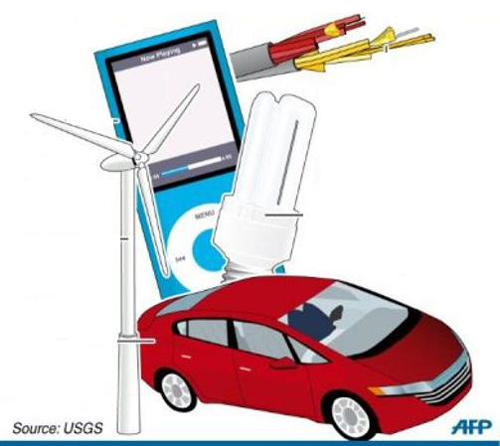
Spotlight problem: rare earth elements
Demand growth 20-50% until 2020
Europe has no own source
less than 1% of REEs currently enter the recycling loop
Lack of suitable recycling technologies/ infrastructures
©richminerals-af.com

Slide 16
Thank you for your Attention!

Slide 17
Sources
http://www.plastic-planet.at/die-geschichte-des-kunststoffs/ (13.12.2016)
http://www.urbanara.co.uk/journal/buying-guide/plastic/ (13.12.2016)
http://www.wiwi.uni-muenster.de/vwt/Veranstaltungen/Ausgewaehlte_Kapitel_der_Energiewirtschaft/WS1112/02a_globale-energiemrkte.pdf (13.12.2016)
http://www.duh.de/presse/pressemitteilung/?no_cache=1&tx_ttnews%5Btt_news%5D=2748&cHash=769b41ab2a3cc6476dadc09ae599826b (13.12.2016)
https://www.oeko.de/oekodoc/1112/2011-003-en.pdf (14.12.2016)
http://www.europarl.europa.eu/RegData/bibliotheque/briefing/2013/130514/LDM_BRI(2013)130514_REV1_EN.pdf (14.12.2016)
Universität Stuttgart, lectures ISWA, Resource management, 2015
Universität Stuttgart, lectures ISWA, Waste treatment, 2015
https://www.zerowasteeurope.eu/2016/03/press-release-eurostat-data-for-2014-confirms-need-for-european-residual-waste-target/ (12.12.2016)
http://www.dforceblog.com/2010/03/11/%C2%BFque-es-downcycling-o-infraciclado/ (13.12.2016)
http://www.ecologiaverde.com/el-upcycling-supra-reciclaje/ (13.12.2016)
http://www.eea.europa.eu/about-us/competitions/waste-smart-competition/recycling-rates-in-europe/image_view_fullscreen (13.12.2016)

