Slide 1
Physics vs data-based models
Andino Saint Antonin

Slide 2
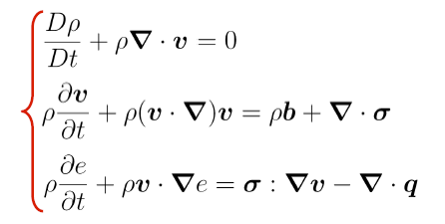
Physics-based modelling
Mechanical systems:
Establish causal relationship between variables using:
Conservation equations
Constitutive laws
Equations of state
Initial and border conditions
It can predict all future states (Laplace’s quote)
However:
Solving the equations might be impossible
Initial/border conditions unknown
Constitutive laws unknown or limited validity

Slide 3
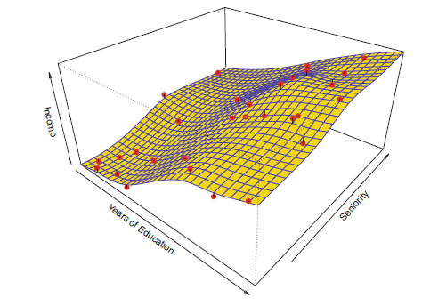
Data-based models
No apriori knowledge of how the system works
Large sets of observations
Data-based-model is a high-dimensional ‘interpolating surface’
Ideal for high-dimensional problems for which we have no mathematical models but a lot of data
However:
Can we extrapolate outside the training domain?
Is the interpolation valid? There might be singularities..

Slide 4
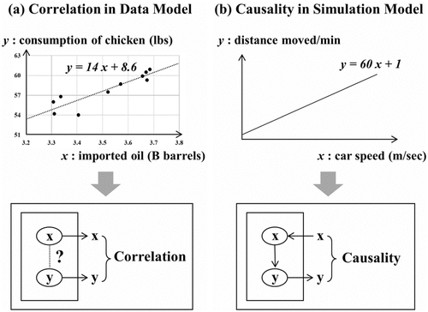
Correlation vs causality
Data-based models do not explain WHY (causality)
They only describe relationship between variables
Predictions limited to interpolation (& short extrapolation)
Physics-based models are predictive but can only be as good as our knowledge of physical laws (and initial conditions)

Slide 5
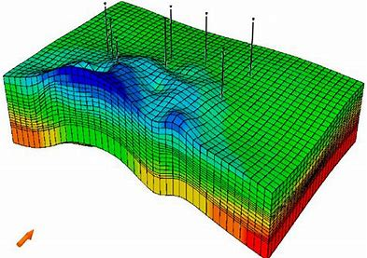
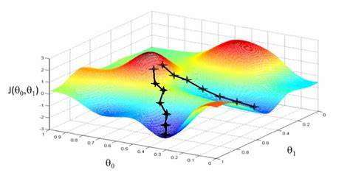
Oil industry examples: history matching
Forward modelling not possible: Geological models too uncertain
Inverse model:
  Find the model input (porosity, permeability) that will reproduce observed history
  Non-uniqueness
Minimization of errors is challenging with expensive function
Machine learning is giving us proxies for model behavior to assist the matching process

Slide 6
More applications
Machine learning can help with processes in our industry for which we have a lot of data but modelling the process using physics is extremely challenging.
E.g. using machine learning to predict multiphase flow in horizontal pipelines
Flow regime types for multiphase flow in horizontal pipes

Slide 7
Simulation | Machine Learning
Physics to forecast time dependent effects (long term) | Predictions based on history (predicts repetitive events, short term FC)
Requires knowledge of the laws, domain properties & initial cond. | Does not require knowledge of the laws (massive input / output data)
Change one variable at a time (avoid data bias in data) | Exposure if biased samples
Specific to each problem Proprietary simulator Slow | Very wide applicability Open source (or very cheap) Very quick
Uncertainty seldom acknowledged | Can be very accurate
Overfitting risk (seldom use test sets) | Independent test sets
Notes:
Present conventional approach.
Use of simulation and analytical methods to improve sidetrack performance
In the future, we plan to include machine learning and fully integrated it into our workflows.
ML is proven to work.
We can make it better with more and better data (painful as that may be)
ML learning good for SHORT term forecasts
(future not part of the training set!)
We still need SIMULATION for:
+ Long term forecasts
+ incremental economics (run with and without and see difference)
Analogs, common sense and engineering judgment should also be critical input.
Ideally, convergence of all sources will give us higher confidence in the results.
Next Q&A

Slide 8
Backup

