Slide 1
SEEK DISCOMFORT

Slide 2
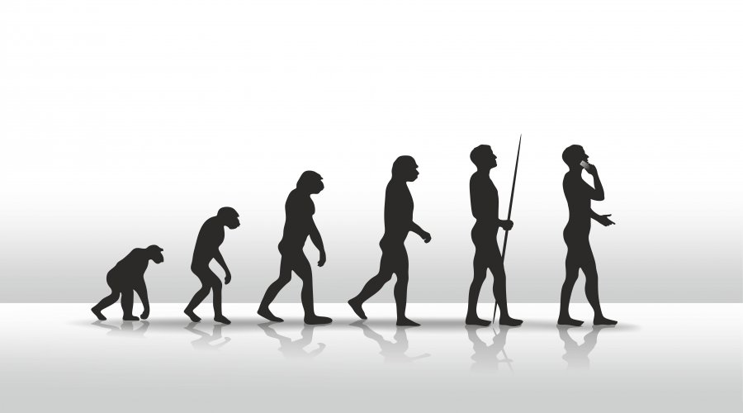

Slide 3
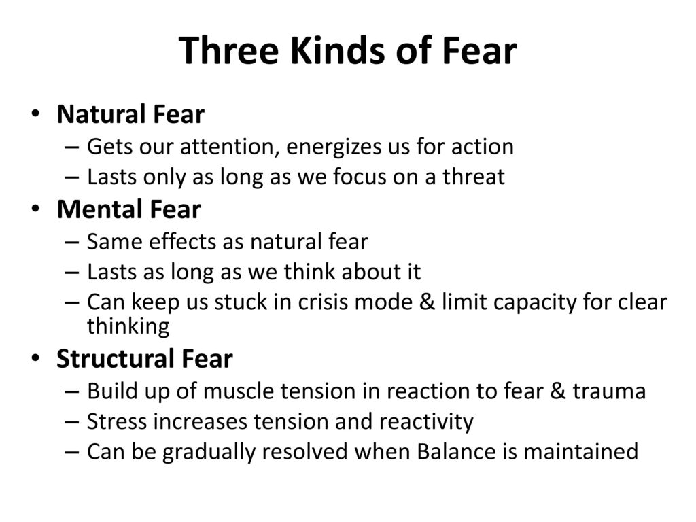

Slide 4

Why to seek discomfort?
Temporary discomfort increases your long-term comfort zone
Uncomfortable decisions bring opportunity

Slide 5

When to Embrace Discomfort
When it feels safe
When it´s repeatable
When there´s a clear benefit

Slide 6
What makes you uncomfortable?

Slide 7
”The best things in life are on the other side of fear”
– Will Smith
”Growth and comfort do not coexist”
– Ginny Rometty, CEO of IBM
”If you want something you’ve never had, you have to do something you’ve never done”
- Thomas Jefferson, third president of USA

Slide 8
SEEK DISCOMFORT

