Slide 1

BUSINESS FINANCE
Catherine Ramírez Villalba
Tamás Benedek
Ehsan Haji-Esmaili
Yiyng Lin

Slide 2


INTRODUCTION FUNDING START UP BUDGET OPERATING BUDGET BALANCE SHEET
BUSINESS FINANCE - CORPORATE FINANCE
WHAT KIND OF LONG-TERM INVESTMENTS SHOULD THE COMPANY DO?
WHERE THE COMPANY WILL GET LONG-TERM FINANCING FOR ITS INVESTMENT?
HOW THE COMPANY WILL MANAGES ITS FINANCE?
Notes:
Theory used by company management to mitigate risk and find the best financing for operations. Business finance includes risk management, financing options and capital management strategies.

Slide 3
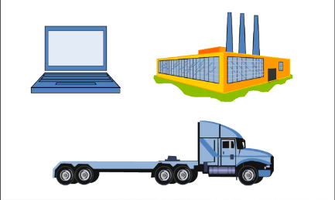

INTRODUCTION FUNDING START UP BUDGET OPERATING BUDGET BALANCE SHEET
WHAT KIND OF LONG-TERM INVESTMENTS SHOULD THE COMPANY DO?
CAPITAL BUDGET MANAGEMENT
(Plan and manage long-term investments)
Identify Investment opportunities that generate a value greater than the cost of acquisition.
i.e: Wal-Mart
Microsoft
Design Company
How much is perceived? - When? - Probability of receive it?
(VOLUME) (TIMMING) (RISK)
Notes:
Capital Buget management: is the Theory used by company management to mitigate risk and find the best financing for operations.
Business finance includes risk management, financing options and capital management strategies.
- The type of investment depends on the type of business
- Assesment of volume, timming and risk of the future cash flows is the heart of the capital budget

Slide 4

INTRODUCTION FUNDING START UP BUDGET OPERATING BUDGET BALANCE SHEET
WHERE THE COMPANY WILL GET LONG-TERM FINANCING FOR ITS INVESTMENT?
CAPITAL STRUCTURE
(Ways in which the company obtains and manages the long-term financing)
Which mix of debt and equity is the best?
How much the company should borrow?
What are the least expensive sources of funds for the company?
How and where to get the funds
Election of creditors
Which type of loan is suitable?
…and so on.
Notes:
The “How much” affects the RISK and the VALUE of the company

Slide 5

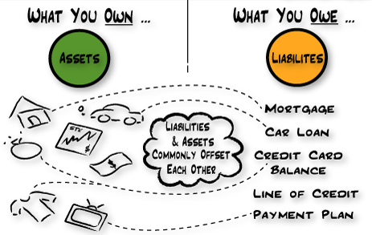
INTRODUCTION FUNDING START UP BUDGET OPERATING BUDGET BALANCE SHEET
HOW THE COMPANY WILL MANAGES ITS FINANCE?
OPERATING CAPITAL MANAGEMENT
(Refers to the management of the short-term assets and liabilities of a company)
Daily activity
How much cash and inventory should be available?
Should the company sell on credit?
How will any short-term financing be obtained if necessary?
…and so on.
Notes:
short-term assets as inventory, and short-term liabilities, such as money owed to suppliers
administration ensures that the company has adequate resources to continue on with their operations
The following are some questions about operating capital should answered

Slide 6

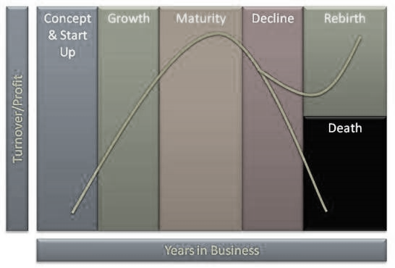

INTRODUCTION FUNDING START UP BUDGET OPERATING BUDGET BALANCE SHEET
FUNDING A BUSINESS
(Simple tips to guide entrepreneurs through the fundraising process across all phases of the business life cycle.)
5. BANK LOAN / VENTURE CAPITAL
4. ANGEL INVESTORS
3. CROWDFUNDING
2. FRIENDS AND FAMILY
1. BOOSTRAPPING
Notes:
1. use your own financial resources, such as money from a savings account or careful use of personal credit cards. Wise deployment of these precious dollars is critical.
2. Consider inviting family and friends to invest in the company with the understanding that their money may not be returned. In most cases, these friends and family are investing in you, not your business.
3. crowd financing is the collective effort of individuals who network and pool their money, usually via the Internet, to support efforts initiated by other people or organizations
4. Angel : This affluent individual – or a group of individuals who pool their research and resources – provides capital for a business start-up usually in exchange for convertible debt or ownership equity. Investments can range from $50,000 to $500,000
5. In the later stages of a growing business, the now-incorporated business might need a bank loan for various needs
To secure this loan, financial institutions will require several years of financial information on both the business and the entrepreneur.
They will want collateral to secure and guarantee a loan. To facilitate the process, engage with the financial institution at the earliest stages of the enterprise
For some very fast growing companies, the organization reaches a point in its life cycle when venture capital funds are required for hyper growth

Slide 7
INTRODUCTION FUNDING START UP BUDGET OPERATING BUDGET BALANCE SHEET
Personnel
Advertising/Promotions
Legal/Professional fees
Salaries/Wages
Occupancy
Accounting
Start-up Budget
Licenses/Permits
Income
Equipment
Utilities
Insurance
Payroll expenses
Supplies

Slide 8
INTRODUCTION FUNDING START UP BUDGET OPERATING BUDGET BALANCE SHEET
Personnel
The costs prior to open the business
Research
Licenses and permits
Consultants and experts
Utilities

Slide 9
INTRODUCTION FUNDING START UP BUDGET OPERATING BUDGET BALANCE SHEET
Legal/Professional fees
They are ordinary and necessary expenses directly related to operating your business and you may deduct fees paid to professionals.

Slide 10
INTRODUCTION FUNDING START UP BUDGET OPERATING BUDGET BALANCE SHEET
Occupancy
Occupancy costs refer to expenditure required to occupy and maintain the physical space a business inhabits, and usually represent one of the largest expenditures for a business.

Slide 11
INTRODUCTION FUNDING START UP BUDGET OPERATING BUDGET BALANCE SHEET
Licenses/Permits
When starting a business, you should pay attention to the important legal requirements associated with registrations, permits and licenses. Federal Requirements
most business types must apply for an Employer Identification Number (EIN) State Requirements
Business Licenses Tax Registration
Occupations and Professions Trade Name Registration
Licenses Based on Products Sold Employer Registrations

Slide 12
Equipment
Buy equipment
Benefits: determine the maintenance schedule yourself
easier than leasing
Downsides: The initial outlay for needed equipment may be too much
Eventually, you're stuck with outdated equipment.
Lease equipment
Benefits: keeps the equipment up-to-date
cost-effective
Downsides: You'll pay more in the long run

Slide 13
Insurance
Insurance is a critical part of the risk management system for a business. It is a way to protect yourself against unforeseen losses. An insurance policy is a legally binding contract with an insurer to provide compensation for a specified damage, loss, or injury suffered by you business in return for a sum of money (premium) paid. Three types:
unemployment insurance
Social Security
workers' compensation

Slide 14
INTRODUCTION FUNDING START UP BUDGET OPERATING BUDGET BALANCE SHEET
Supplies
When starting a business, the purchasing of start-up supplies is an important expense. The followings are some kinds of supplies:
General Supplies
Office Supplies
Business Care Supplies
Operational Supplies
Shipping Supplies

Slide 15
INTRODUCTION FUNDING START UP BUDGET OPERATING BUDGET BALANCE SHEET
Advertising/ Promotions
Advertising is paying to get your message to potential customers. Good advertising sells the benefits of a product or service, rather than simply discuss the product or service.
Promotions are events, activities, sponsorships, and contests that create and increase awareness of your product or service. Promotions differ from advertising because they are less educational in nature than traditional advertisements.

Slide 16
Salaries/wages
A salaried employee received a specified amount for a designated period, such as a week, month or year.
The salary you set must be high enough to attract top applicants but not so high that it eats into your profits or survival.

Slide 17
INTRODUCTION FUNDING START UP BUDGET OPERATING BUDGET BALANCE SHEET
Accounting
Accounting system should provide an accurate picture of your business and how it is doing. Setting up a good accounting system and understanding the numbers produced can make a major difference in how your business fares in the long run. This will help in
Pricing the Product Accurately
Knowing If it is Making Money or not
Knowing the Short Term and Long Term Cash Flow

Slide 18
INTRODUCTION FUNDING START UP BUDGET OPERATING BUDGET BALANCE SHEET
Income
An income statement shows all income and expense accounts over a period of time. It is also referred to as a profit and loss statement (or P & L), From an income statement you can determine how much money your business made after all expenses are accounted

Slide 19
INTRODUCTION FUNDING START UP BUDGET OPERATING BUDGET BALANCE SHEET
Utilities
Utilities Needed for a Business will depend on the nature and size of your operation.
The utility services: electric power, natural gas, steam supply, water supply, and sewage removal.

Slide 20
INTRODUCTION FUNDING START UP BUDGET OPERATING BUDGET BALANCE SHEET
Payroll expenses
Payroll expenses are costs incurred by an enterprise in employing workers, including compensation paid out to employees, plus all taxes and other costs of employment for which an employer is liable.
Payroll includes:
the wages themselves,
the taxes you withhold,
the taxes that you have to pay that you don't withhold.

Slide 21
INTRODUCTION FUNDING START UP BUDGET OPERATING BUDGET BALANCE SHEET
An operating budget is the annual budget of an activity containing estimates of the total value of resources required for the performance of the operation.
Operating budget
Operating costs
Income

Slide 22
INTRODUCTION FUNDING START UP BUDGET OPERATING BUDGET BALANCE SHEET
Start-up costs
Money needed to open your business
Your start-up budget will usually include such onetime only costs as major equipment, utility deposits, down payments, etc.
Operating costs
Money needed to keep it open
An operating budget is prepared when you are actually ready to open for business.

Slide 23
INTRODUCTION FUNDING START UP BUDGET OPERATING BUDGET BALANCE SHEET
In an operating budget the following costs should be taken into account.
Personnel
Insurance
Rent
Depreciation
Loan payments
Advertising / promotions
Legal / accounting
Miscellaneous expenses
Supplies
Payroll expenses
Salaries/wages
Utilities
Dues / subscriptions / fees
Taxes
Repairs / maintenance

Slide 24
INTRODUCTION FUNDING START UP BUDGET OPERATING BUDGET BALANCE SHEET
How to Write a Business Operating Budget
Step 1
Gather as much information as you can about what it should cost to operate your business venture.
Step 2
Figure the Gross Profit Margin
Step 3
Brainstorm a comprehensive list of fixed and semi variable costs.
As a rule of thumb, GPM should be at least 20 percent of total revenue.
Step 4
Seek advice from professionals
Step 5
Put pencil to paper and begin creating your budget.
Step 6
Revisit the budget on a monthly basis to ensure you are on track.

Slide 25
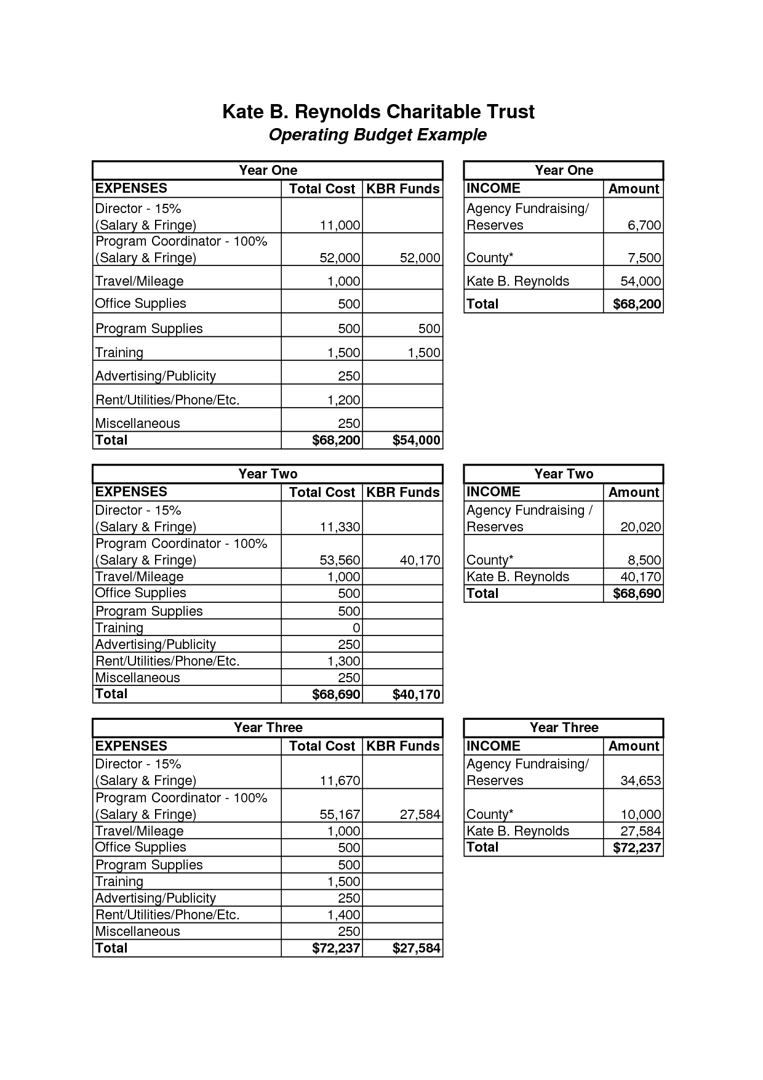
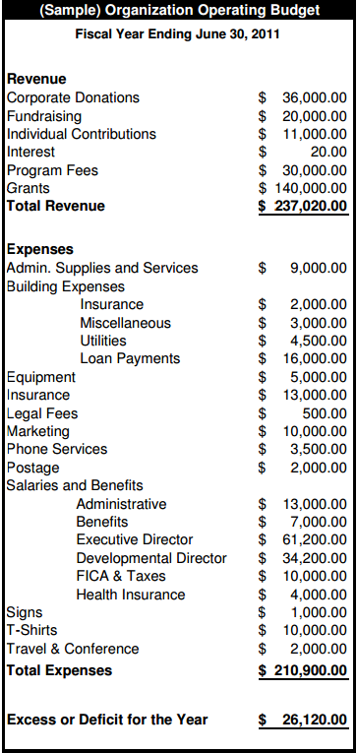
INTRODUCTION FUNDING START UP BUDGET OPERATING BUDGET BALANCE SHEET

Slide 26

INTRODUCTION FUNDING START UP BUDGET OPERATING BUDGET BALANCE SHEET
“
BALANCE SHEET
Definition:
The balance sheet is a snapshot of the company's financial standing at an instant in time.
”
It shows the company's financial position.
(smallbusinessnotes.com)
A balance sheet is called that because it must always balance:
what it owes:
liabilities
net worth
what it owns:
assets
BENEDEK Tamás

Slide 27
INTRODUCTION FUNDING START UP BUDGET OPERATING BUDGET BALANCE SHEET
ASSETS
Characterizes the company’s use of funds.
Is the sum of all the assets the company owns or are due to the company.
Accounting net values.
No approximations admitted.
Current Assets
Fixed Assets
Assets
Intangibles
Other Assets
BENEDEK Tamás

Slide 28

INTRODUCTION FUNDING START UP BUDGET OPERATING BUDGET BALANCE SHEET
Assets - Current Assets
Cash
in physical or virtual virtual form
Notes Receivable
incomes with uncertain terms:
- customer overdue payments
- owner & employee loans
Accounts Receivable
scheduled incomes from customers
as a result of commercial activity
Inventory
total net value of the goods owned by the company
Other current assets
prepaid expenses: rent for 1 year
Other Assets
miscellaneous: long term deposit
BENEDEK Tamás

Slide 29

INTRODUCTION FUNDING START UP BUDGET OPERATING BUDGET BALANCE SHEET
Assets - Fixed Assets
Fixed Assets
all the assets which are directly owned by the company:
- buildings
- cars
- machines, tools
- etc.
BENEDEK Tamás

Slide 30

INTRODUCTION FUNDING START UP BUDGET OPERATING BUDGET BALANCE SHEET
Assets - Intangibles
Intangibles
Mostly intellectual property:
- patents
- research papers
- license rights
- etc.
“Sony/ATV Music Publishing is now the largest music publishing company in the world with over 2 million songs under management” - Wikipedia
BENEDEK Tamás
BENEDEK Tamás

Slide 31
INTRODUCTION FUNDING START UP BUDGET OPERATING BUDGET BALANCE SHEET
Liabilities
The company's sources of money:
lender-investor & owner-investor
Characterizes the way the company respects it's financial obligations.
Current Liabilities
Non-Current
Liabilities
Accrued Expenses
BENEDEK Tamás

Slide 32
INTRODUCTION FUNDING START UP BUDGET OPERATING BUDGET BALANCE SHEET
Liabilities - Current Liabilities
The sum of all the financial obligations which mature in less than 12 months.
Accounts Payable
Accrued Expenses
all bills that have to payed towards the suppliers of all types:
- raw material
- utilities
- transportation
- communication
- etc.
all the expenses which will be or already are paid – periodic:
- salaries
- taxes
- interests on loans
- etc.
Note
Strict correlation with Accounts Receivable
Lack of proper resource management can lead to insolvent situations
BENEDEK Tamás

Slide 33
INTRODUCTION FUNDING START UP BUDGET OPERATING BUDGET BALANCE SHEET
Liabilities – Non-Current Liabilities
The sum of all the financial obligations which mature in more than 12 months.
Long term debts
Contingent Liabilities
The non-current (remainder) part of long term debts/loans.
May not be payed: warranties, lawsuits, etc.
Included only as a footnote
Notes payable
Generally towards shareholders
The amount of money they have invested in the company as capital not stock.
BENEDEK Tamás

Slide 34
INTRODUCTION FUNDING START UP BUDGET OPERATING BUDGET BALANCE SHEET
Equity / Net Worth
Equity or Net Worth is the last to mature source of funds.
It is the owners' share in the financing of all the assets.
(smallbusinessnotes.com)
Purchased
Equity
Earned Equity
Treasury Stock
BENEDEK Tamás

Slide 35
INTRODUCTION FUNDING START UP BUDGET OPERATING BUDGET BALANCE SHEET
Equity – Purchased Equity
Preferred
Stock
Capital
Stock
Guaranteed payment of dividends
No voting right
Payment of dividends after P/S
Voting right
BENEDEK Tamás

Slide 36
INTRODUCTION FUNDING START UP BUDGET OPERATING BUDGET BALANCE SHEET
Equity
Earned Equity
Treasury Stock
Profit that the owners could have withdrawn but they reinvested it in form of capital.
Stock bought back by the company from shareholders
Stock never issued
No dividends/Voting rights
Reserve to create liquidity when needed.
BENEDEK Tamás

Slide 37
INTRODUCTION FUNDING START UP BUDGET OPERATING BUDGET BALANCE SHEET
Current Assets
Fixed Assets
Intangibles
Other Assets
Current Liabilities
Non-Current
Liabilities
Accrued Expenses
Purchased
Equity
Earned Equity
Treasury Stock
BENEDEK Tamás

Slide 38
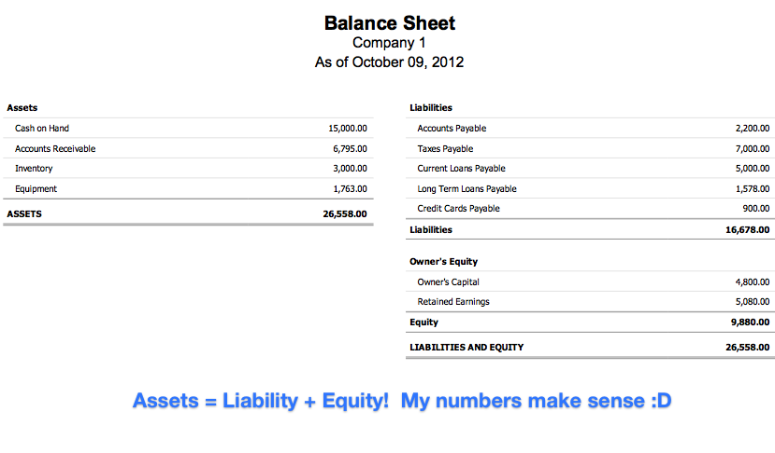
INTRODUCTION FUNDING START UP BUDGET OPERATING BUDGET BALANCE SHEET
(www.yourmomhatesthis.com)
BENEDEK Tamás

Slide 39

QUESTIONS?

